Slide 1
Europa

Slide 2
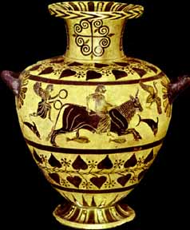
Hydria with Europa Riding the Bull, 6th B.C.

Slide 3
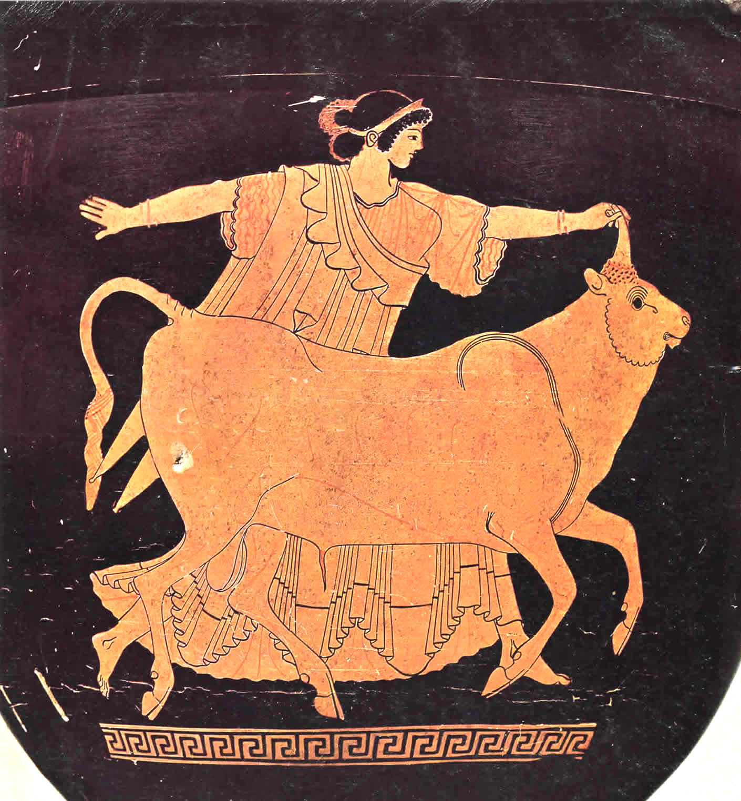
Europa and the Bull - Red-Figure Stamnos, Tarquinia Museum, circa 480 BCE

Slide 4
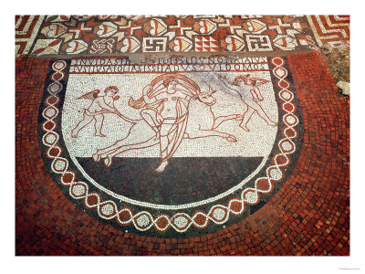
Lullingstone Villa mosaic, Roman Britain, 4th century A.D.
'If jealous Juno had seen the swimming of the bull she would with greater justice on her side have repaired to the halls of Aeolus'
http://www.asprom.org/resources/Lullingstone/LullingstoneDSN.html

Slide 5
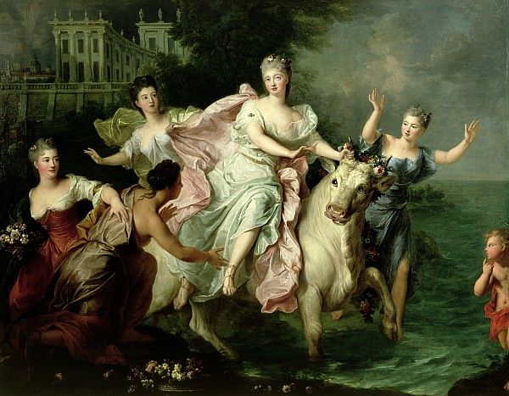
Pierre Gobert, c.1700

Slide 6
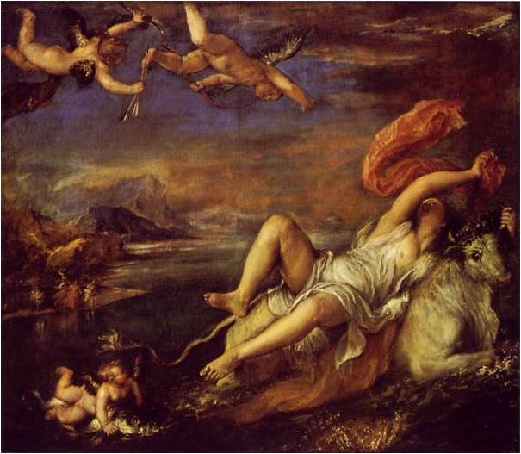
Titian. 1559-1562

Slide 7
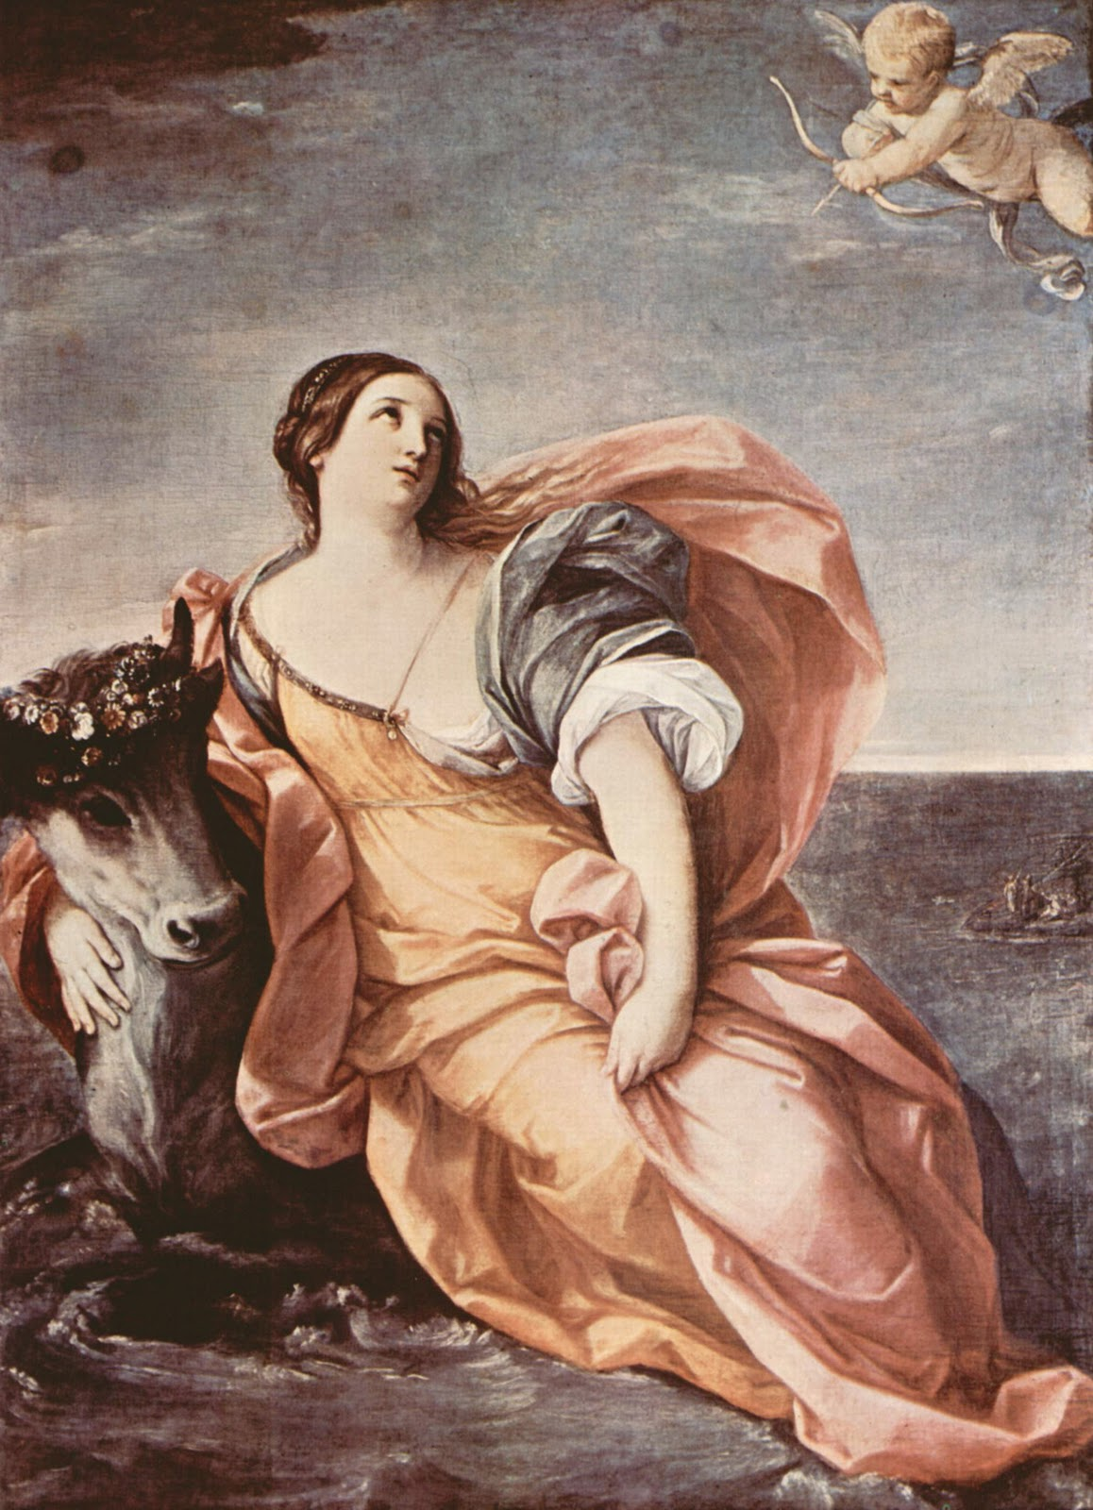
After RENI Guido, 1575-1642 (Italy)

Slide 8
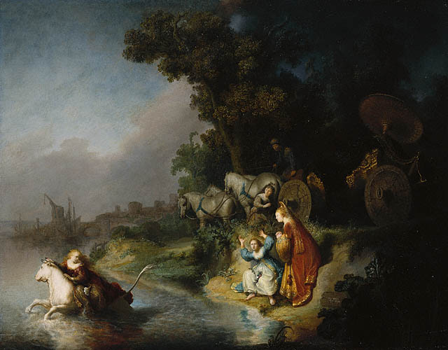
Rembrandt: THE ABDUCTION OF EUROPA (1632, Getty Museum, 61 x 78 cm)
http://traumwerk.stanford.edu/philolog/2005/12/rembrandt_and_ovid_the_abducti.html

Slide 9
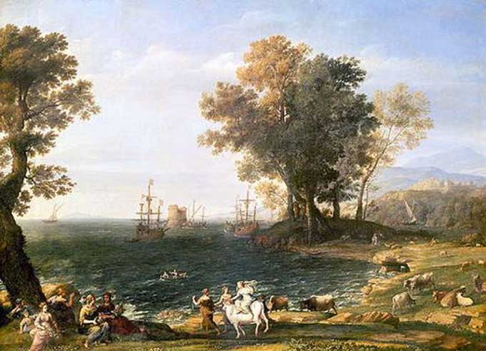
Claude Lorrain
Coast Scene with the Rape of Europa (1655)
Puskin Museum, Mosscow

Slide 10
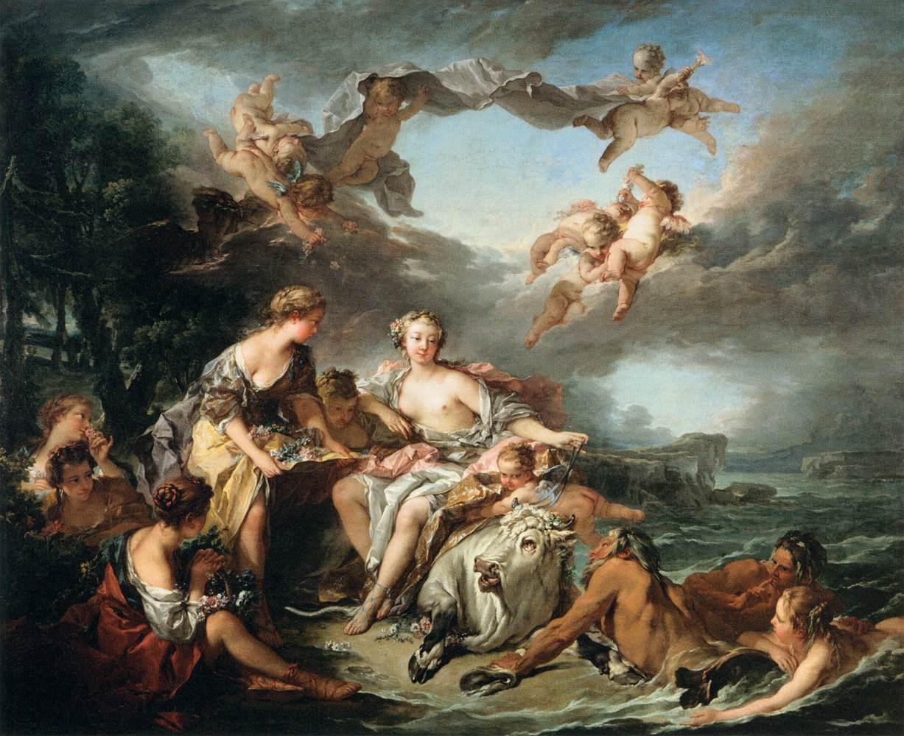
Francois Boucher (1747)

Slide 11
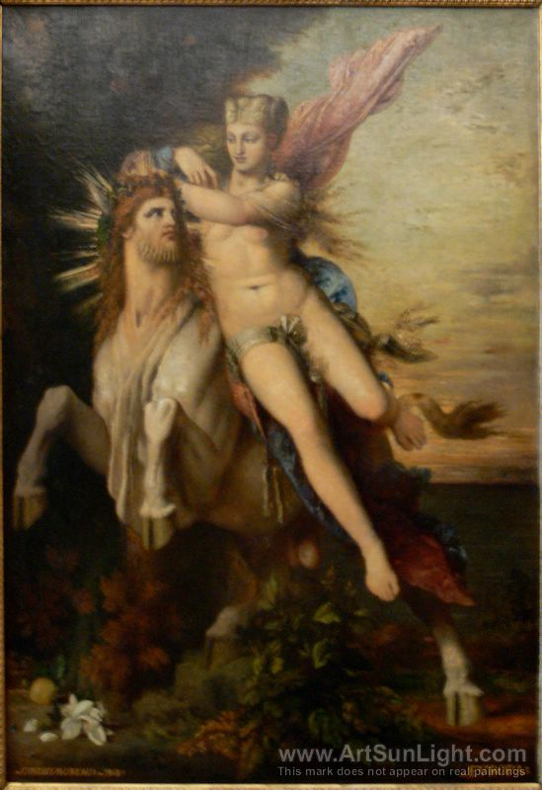
Gustave Moreau (1826-1898)

Slide 12
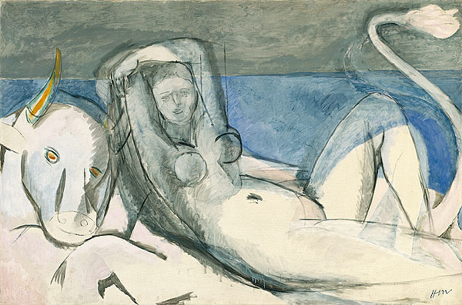
Henri Matisse (1869-1954)

Slide 13
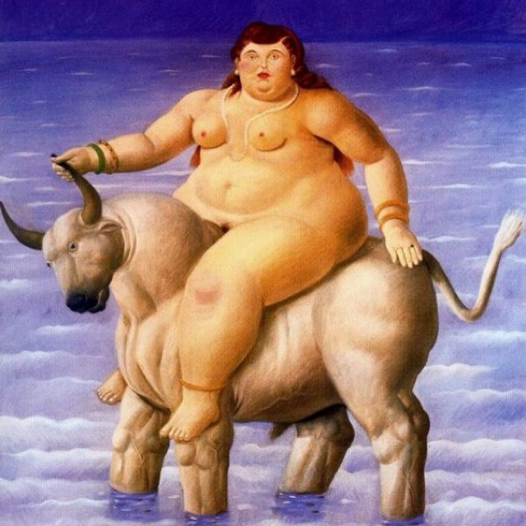
Fernando Botero 1998

Slide 14
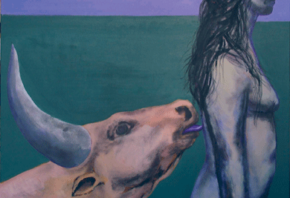
Alexandru Radvan (2004)

Slide 15
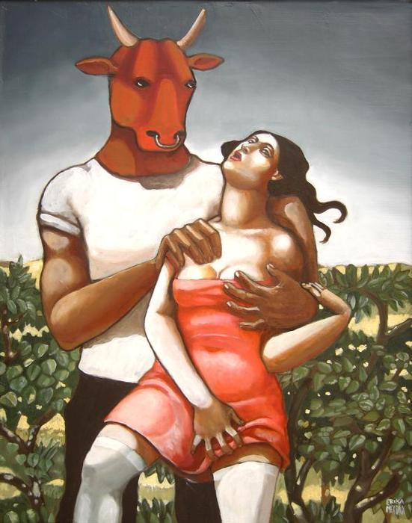
erika meriaux
2007

Slide 16
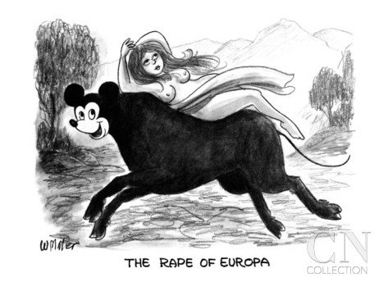

Slide 17
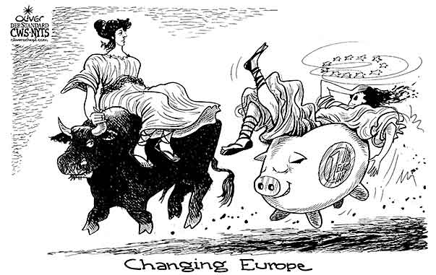
Europe as Europa
Oliver Schopf Austria
Austerity policy in many European member states.

Slide 18
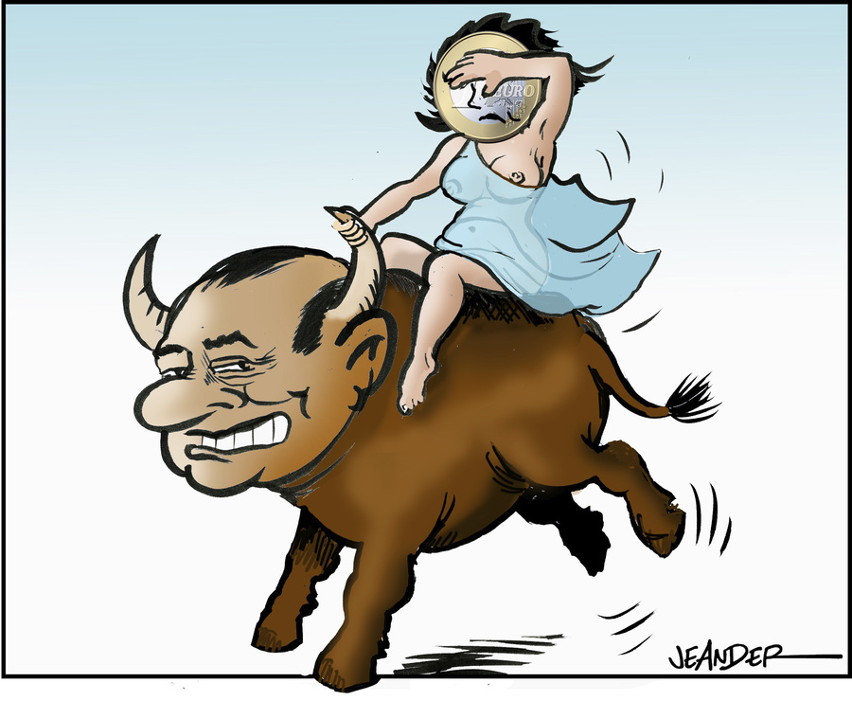
Berlusconi as the Bull

