Slide 1
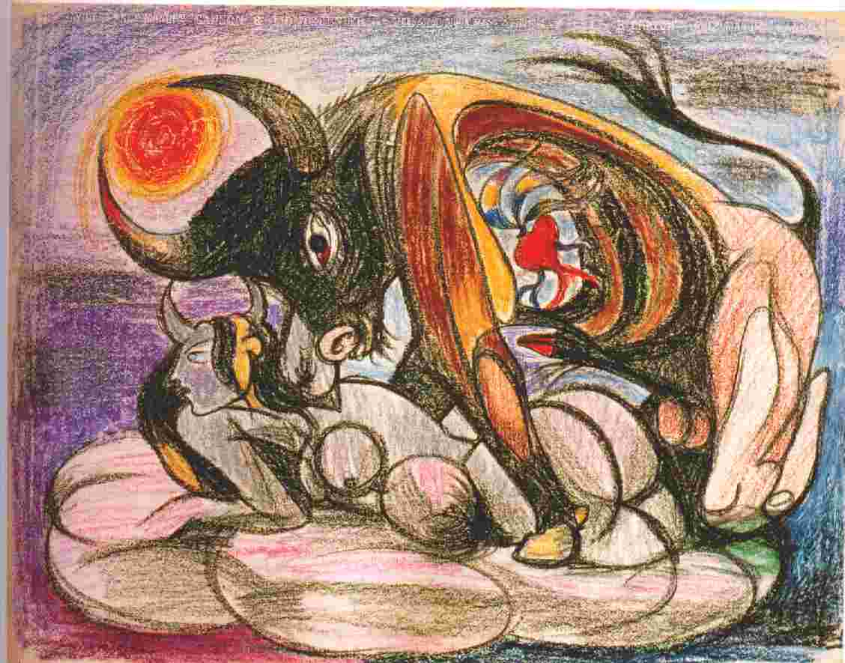
Picasso and the Myth of the Minotaur
Martin Ries. Art Journal, winter, 1972/1973, XXXII/2
Pablo Picasso. Pasiphae

Slide 2
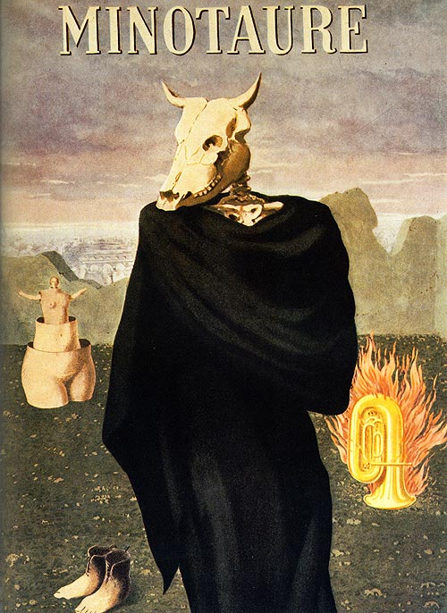
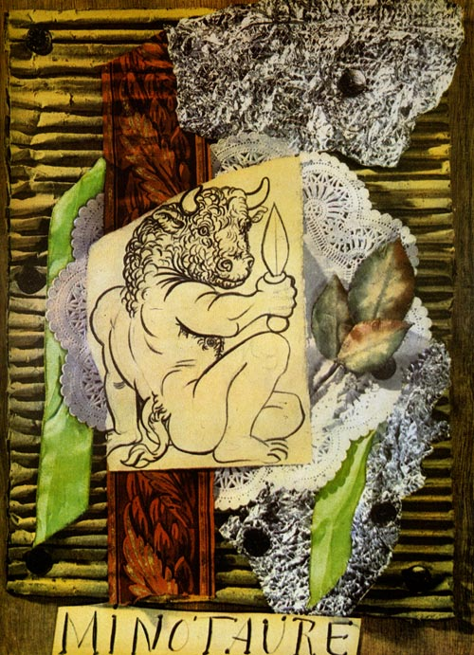
Minotaure (1933-1939)
Pablo Picasso, Minotaure no. 1, 1933
René Magritte, Minotaure no. 10, 1937
Albert Skira

Slide 3
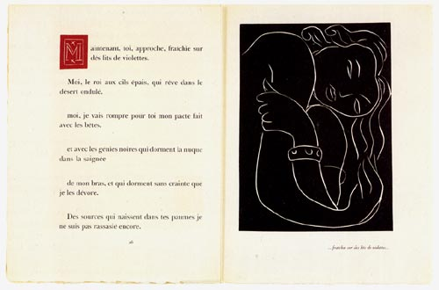
Henri Matisse’s “Embrace”, an illustration for Montherlant’s “Pasiphae: Chant de Minos”
http://www.henri-matisse.net/poetry_french_b.html

Slide 4
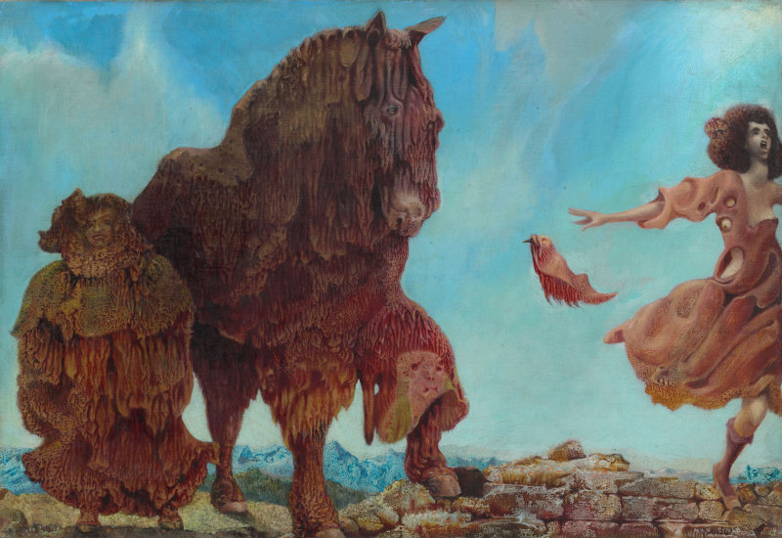
Max Ernst “Spanish Physician” (1940)

Slide 5
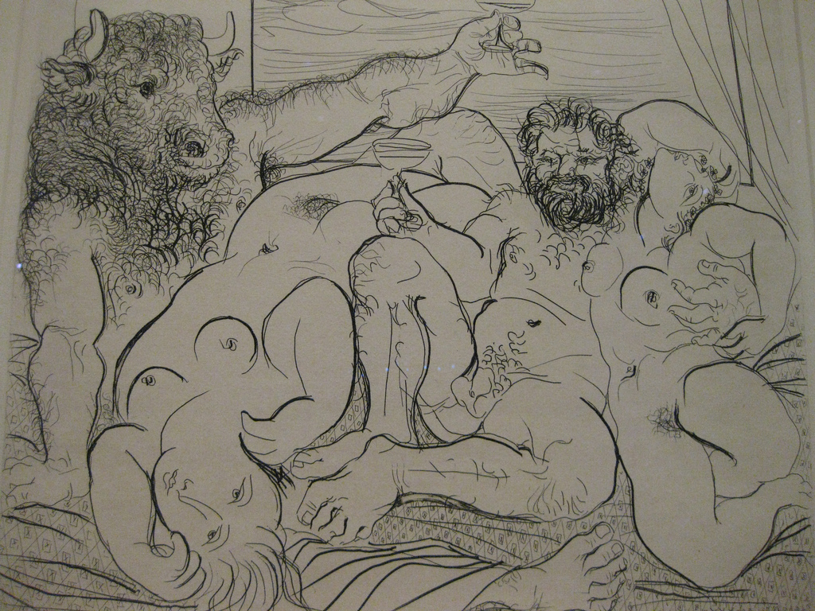
Pablo Picasso - Bacchanal and Minotaur – 1933
“not the terrible monster but a sympathetic and pampered pet” (Martin Ries)

Slide 6
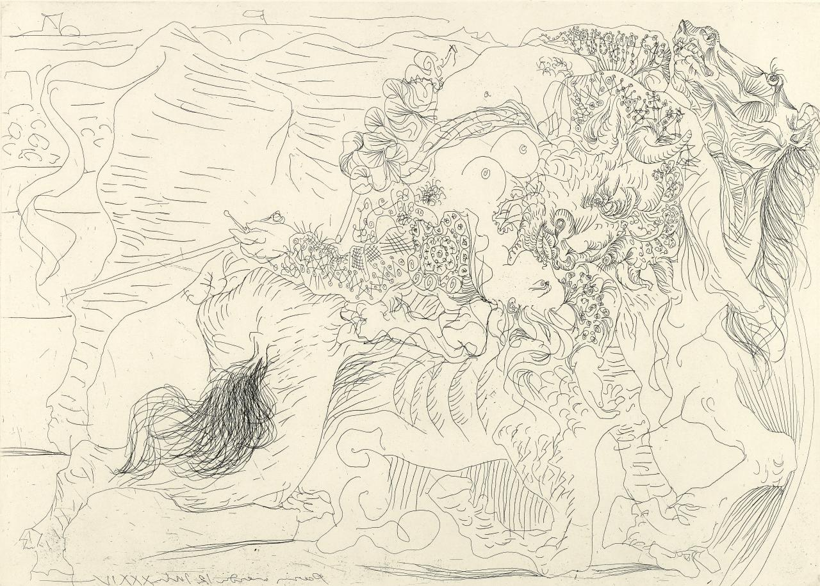
Picasso. Tauromachie. 1934

Slide 7
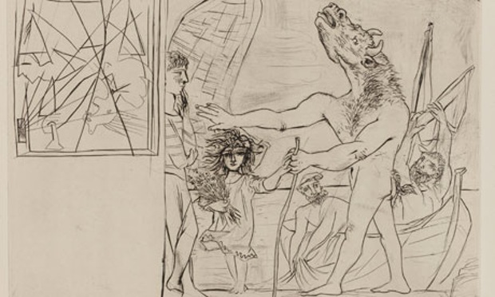
One of a “series of Oedipal Minotaurs bereft of creative powers and guided by a ‘Flower Child’”
Martin Ries

Slide 8
POWER AND TENDERNESS IN MEN AND IN PICASSO’S MINOTAUROMACHY
By Chaim Koppelman
Reprinted from the Journal of the Print World

Slide 9
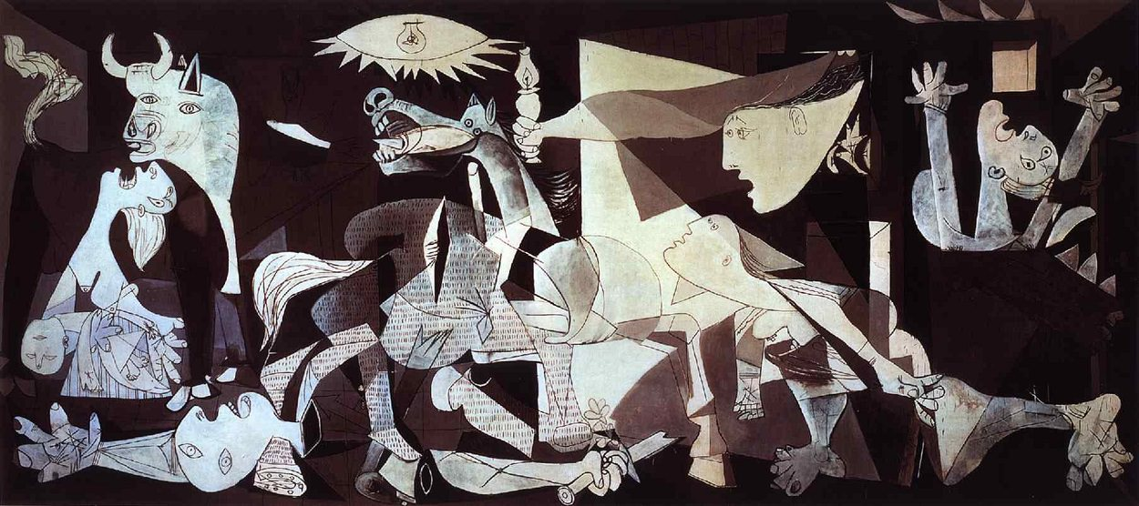
Picasso’s “Guernica” (1937)
http://www.pablopicasso.org/guernica.jsp

