Slide 1
Ariadne

Slide 2
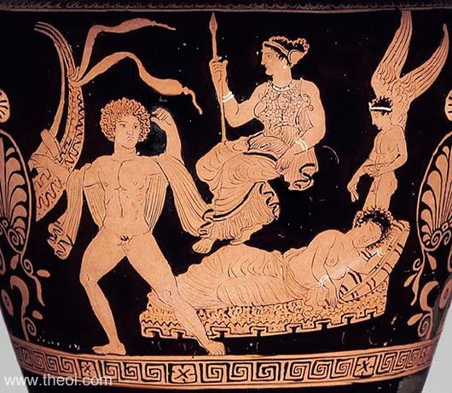
ARIADNE ABANDONED BY THESEUS
Museum Collection: Museum of Fine Arts, Boston, Massachusetts, USA
Catalogue Number: Boston 00.349a
Beazley Archive Number: N/A
Ware: Apulian Red Figure
Shape: Stamnos

Slide 3
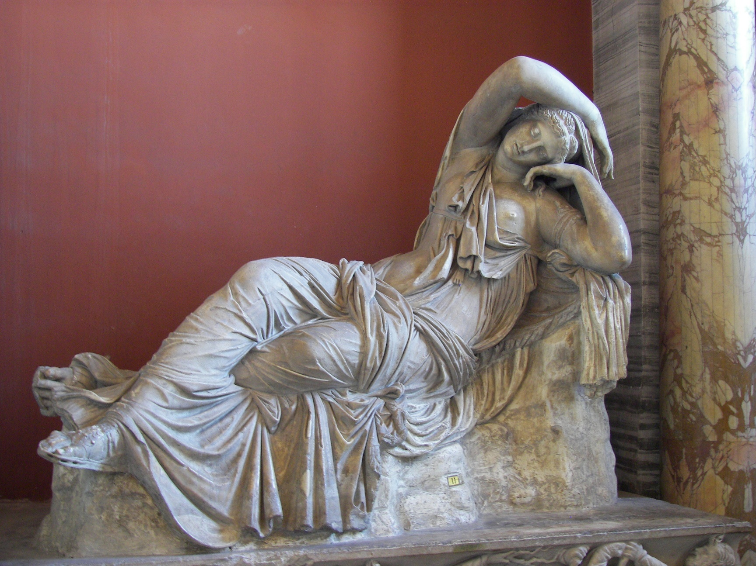
Vatican “Sleeping Ariadne”

Slide 4
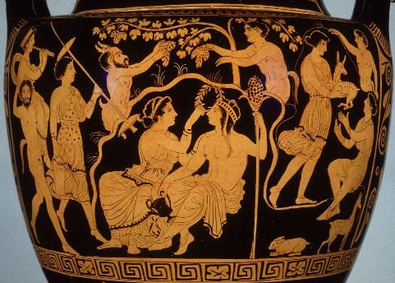
Ariadne and Dionysos, Toledo 1981.110

Slide 5
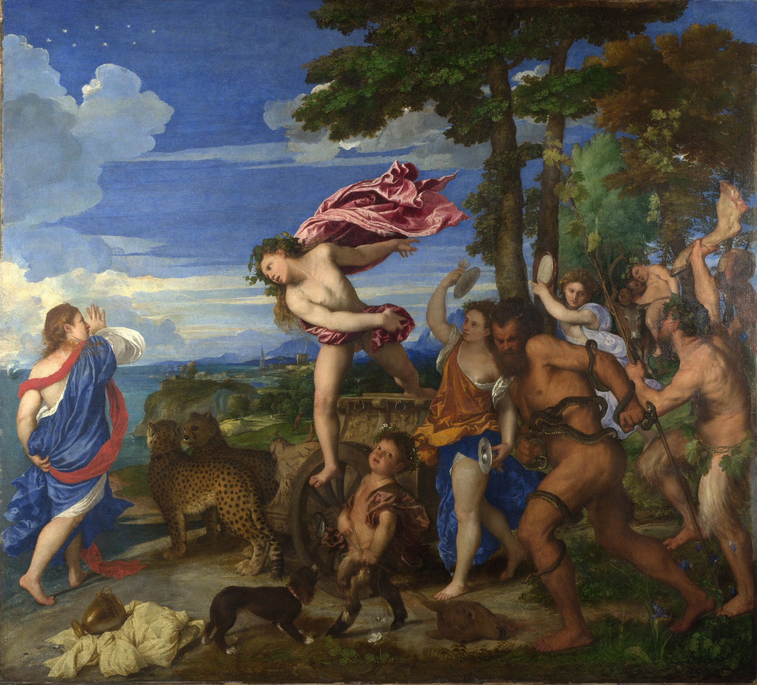
Titian. Bacchus and Ariadne
1520-3

Slide 6
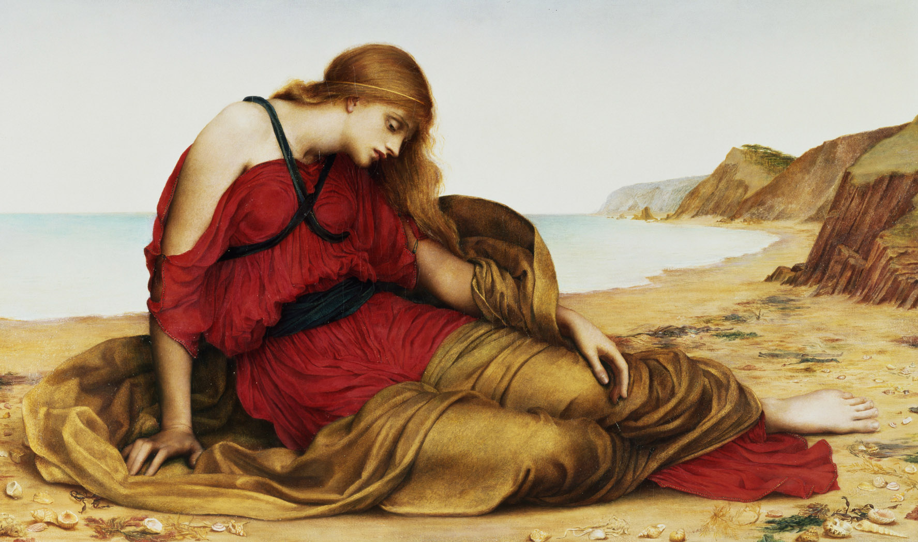
Ariadne on Naxos. Evelyn_De_Morgan. 1877

Slide 7
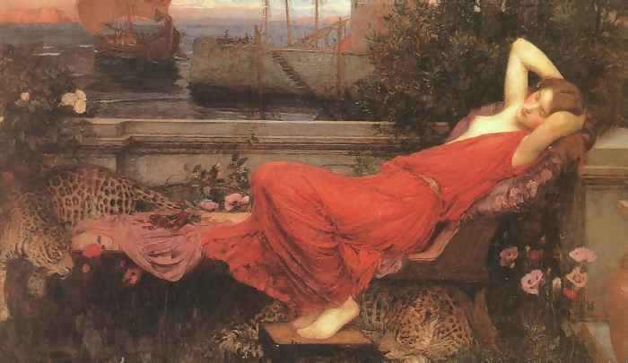
Ariadne. 1898
John William Waterhouse, Oil on Canvas,

Slide 8
Richard Strauss. 1916

Slide 9
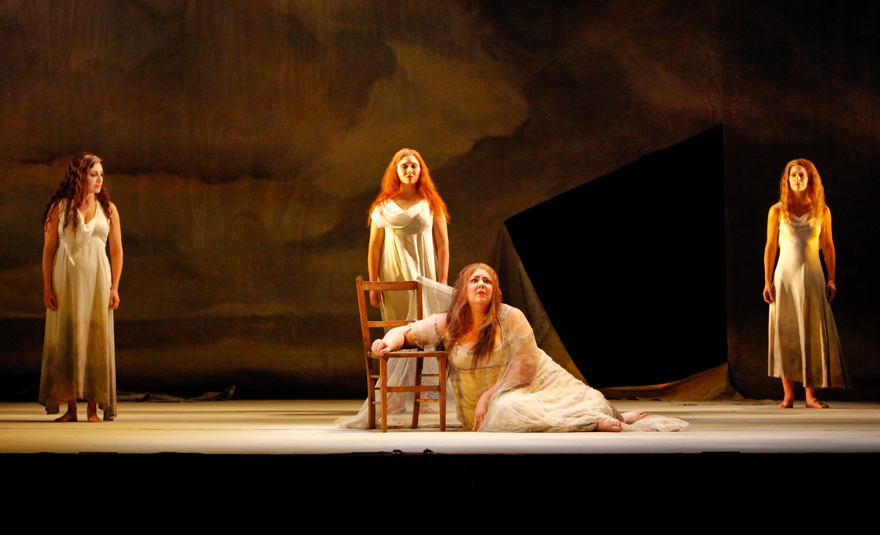
Sc
Scene from Boston Lyric Opera Production 2010
https://www.youtube.com/watch?v=UMARSW--VKY

Slide 10
Dead Can Dance “Ariadne” on Into the Labyrinth (1993)
https://www.youtube.com/watch?v=-uNBi5sYcYo

