Slide 1
Poseidon
bY: Austin VanLaningham, Henry mccluskey & trey swearingen

Slide 2
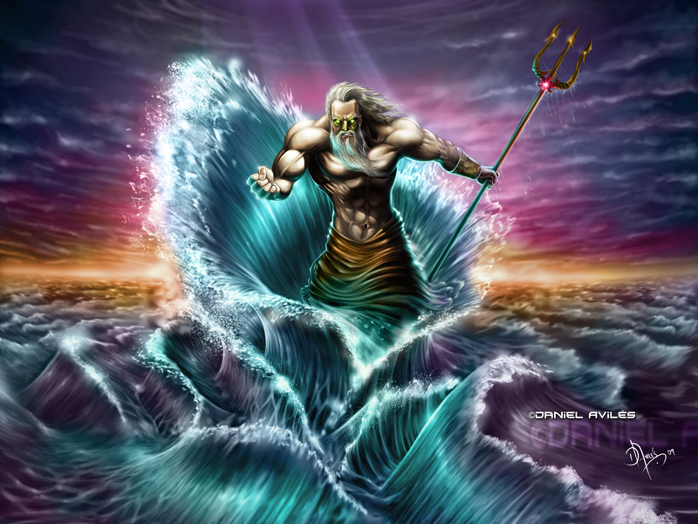
http://mythologyfacts.weebly.com/information-about-poseidon.html
General Information
God of the seas, horses and earthquakes
Protector of the waters
Poseidon’s weapon is the trident
Causes earthquakes with the trident
“The Earth-Shaking Bull

Slide 3
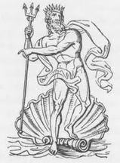
http://mythologyfacts.weebly.com/information-about-poseidon.html
General Information
Bad temper
Very creative
Second to Zeus in power
Ruler of the Sea
Can create storms and causing shipwrecks
Has an underwater palace that he built himself

Slide 4
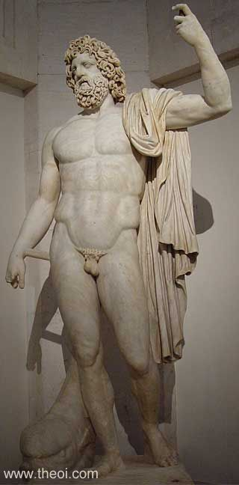
http://www.theoi.com/Gallery/S2.3.html
“Poseidon Statue”
Museum in Madrid
Roman copy of the Greek statue

Slide 5
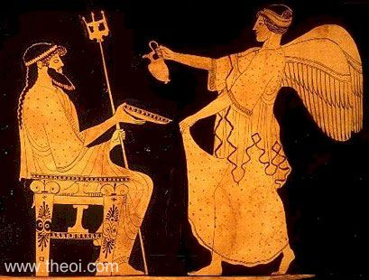
http://www.theoi.com/Gallery/K2.1B.html
“Poseidon and Iris”
475 B.C. - 450 B.C.
In the Yale University Art Gallery
Painted by Aegisthus

Slide 6
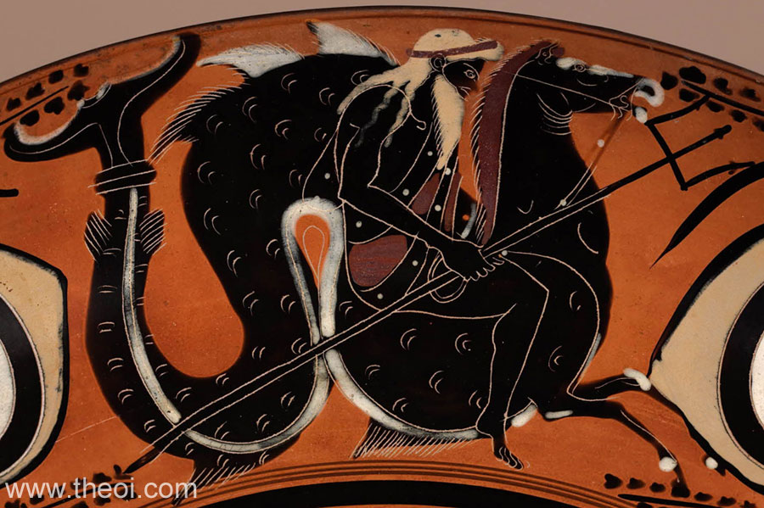
http://www.theoi.com/Gallery/K2.4.html
“Poseidon Riding Hippocamp”
God of the Mediterranean Sea
Name connected with Potos, Pontos, & Potamos
Determined by family that he should ruler over the sea
After his birth, he was raised among a flock of lambs
Mother “Rhea” pretended to give birth to a young horse

Slide 7
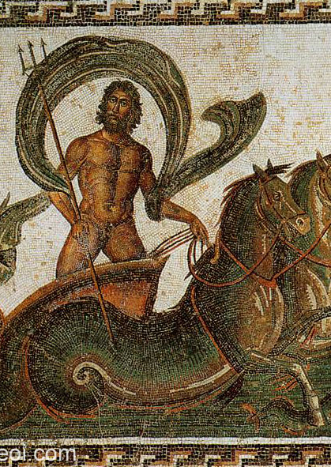
http://www.theoi.com/Gallery/Z2.1.html
“Poseidon and Hippocamps”
Hippocamp is a mythical seahorse
Married to Amphitrite
Had three children
Triton, Rhode, and Benthesicyme
Worship extend across Greece and Southern Italy, but was more looked up to in Peloponnesus

Slide 8
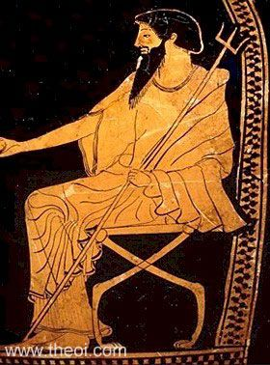
Poseidon Enthroned
Greek vase
Toledo Museum of Art
480 B.C.
http://www.theoi.com/Gallery/P14.5C.html

Slide 9
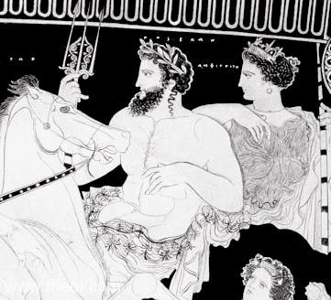
Poseidon & amphitrite
Greek Vase
Jatta National Archaeological Museum
400 B.C. – 390 B.C.
http://www.theoi.com/Gallery/P14.7.html

Slide 10
Comparing the images
All of the images contain Poseidon holding his trident
In two out of the six, the images show Poseidon’s seahorse, Hippocamp
All images show Poseidon portrayed with a long beard

Slide 11
Theories of Myth
Myth as Aetiology
Received his trident from the Cyclops after setting them free
Uses trident to create earthquakes, storms, tsunamis, etc.
Explaining earthquakes and storms in the sea
Explains where tsunamis and waves come from

Slide 12
Theories of myth
Myths as Instructive Models
Protecting sailors at sea
Guiding ships to safety
Filling nets with fish

Slide 13
Discussion Question
Why did Poseidon choose the sea as his empire, rather than the sky or land?

