Slide 1
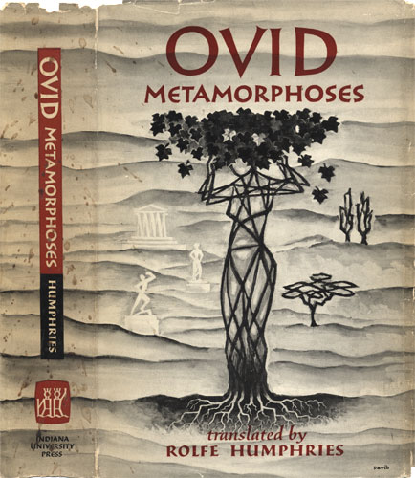
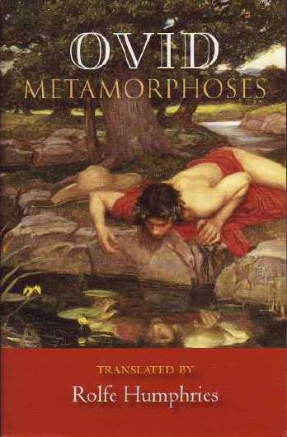
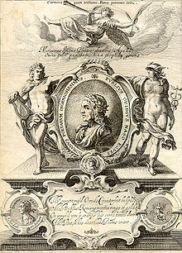
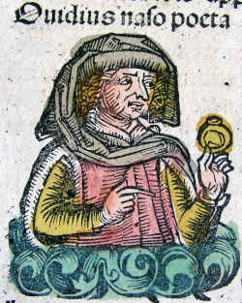
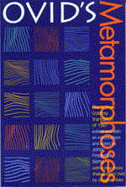
Ovid’s Metamorphoses

Slide 2
Cover of George Sandys's 1632 edition of Ovid's Metamorphosis Englished

Slide 3
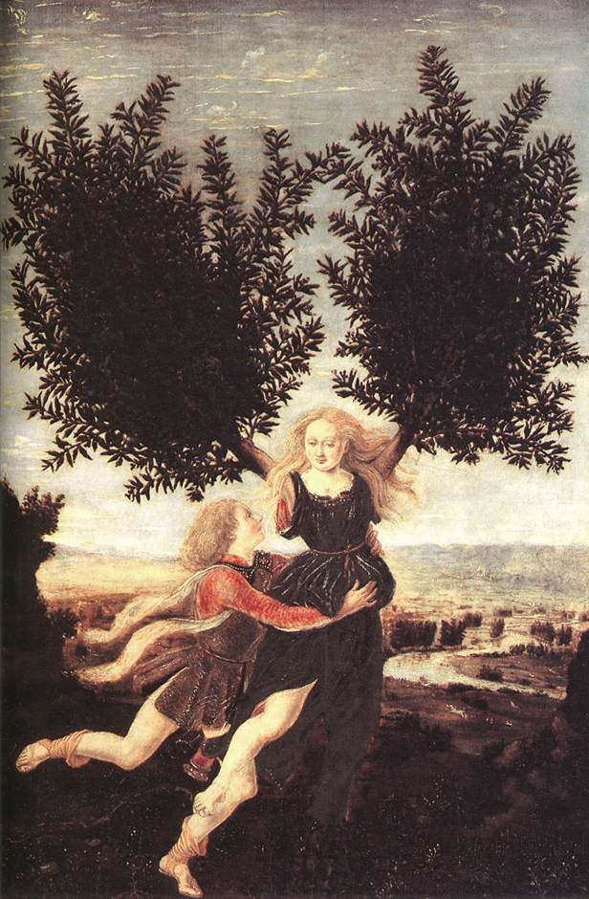
Metamorphoses
meta = change
morph = shape
Ovid’s poem (8 A.D.) is a chronological catalogue of myths about shape changing.
Chronological:
beginning with creation
ending with the apotheosis of Julius Caesar

Slide 4
Some Useful Ovid Websites
http://www.uvm.edu/~hag/ovid/baur1703/baur1703b1.html
http://www.uvm.edu/~classics/ambrose/clas42art5.html
http://larryavisbrown.homestead.com/files/xeno.ovid1.htm
http://etext.virginia.edu/latin/ovid/
http://etext.virginia.edu/latin/ovid/ovidillust.html
http://www.summitcds.org/ashcraft/metamorphoses.htm

Slide 5
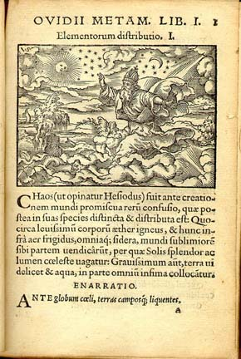
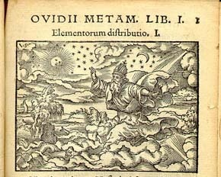
Distribution of the Elements
Salomon-Solis Illustration Cycles 1557-1591

Slide 6
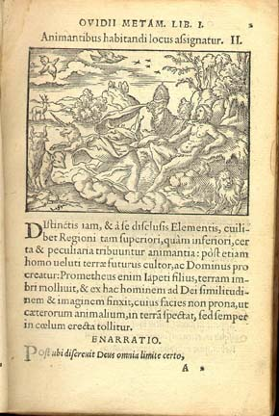
Living Creatures
Salomon-Solis Illustration Cycles 1557-1591

Slide 7
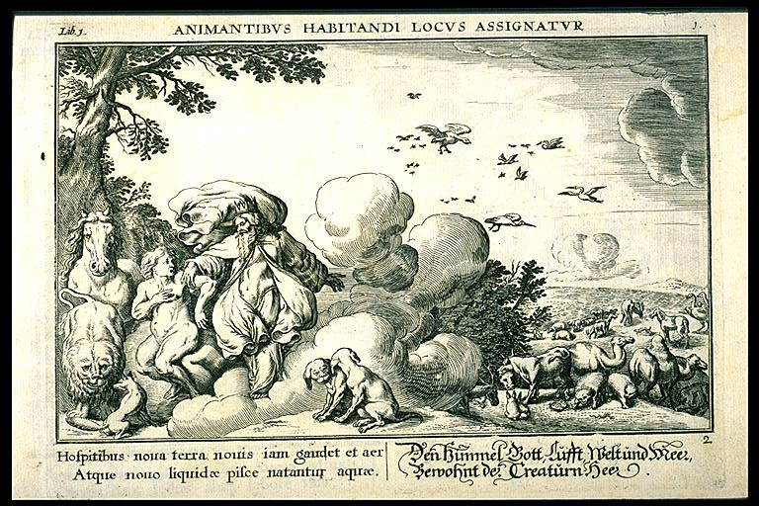
Creation of Man
Baur, 1703, the 1703 edition of Ovid's Metamorphosis with English translation by John Dryden, Alexander Pope and others

Slide 8
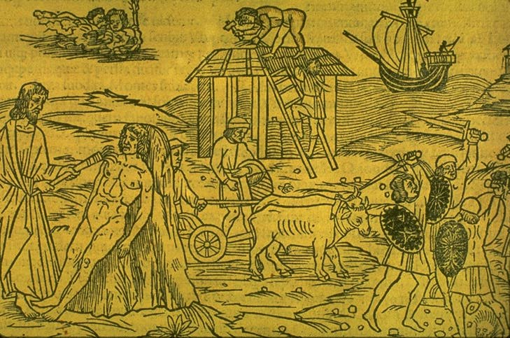
Four Ages of Man
Anonymous: Raphael Regius (died 1520), Venice ca. 1513
In University of Vermont Library

Slide 9
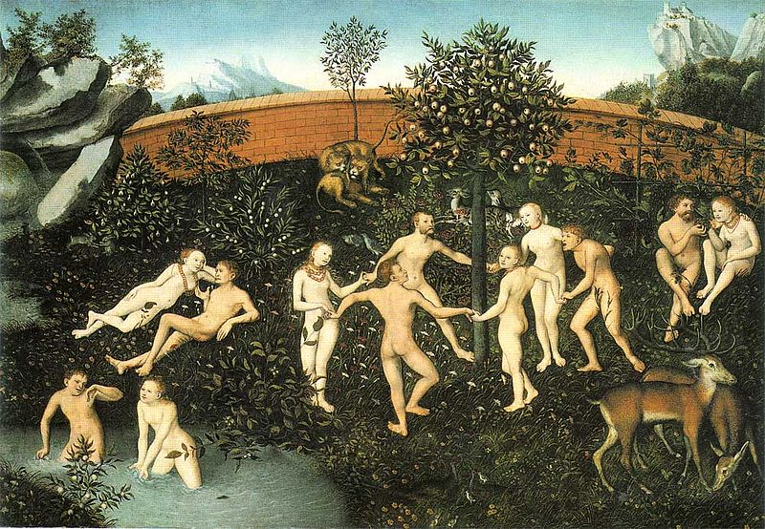
Golden Age
Lucas Cranach the Elder, The Golden Age (1530)
München Bayrische Staatsgemäldesammlung

Slide 10
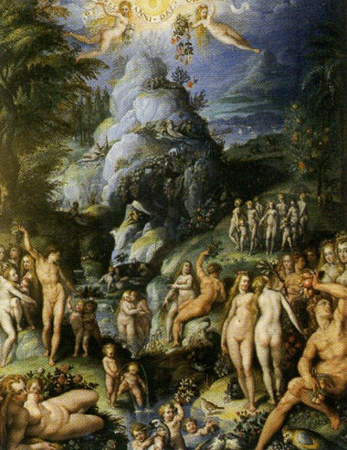
Golden Age
Jacopo Zucchi (c. 1541- c. 1590, Florence)
Uffizi Gallery, Florence

Slide 11
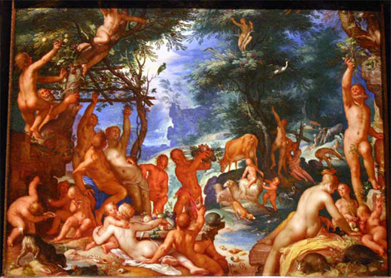
Golden Age
The Golden Age (1605) by Joachim Wtewael ((Dutch, Utrecht 1566–1638 )
Metropolitan Museum of Art, New York
http://www.metmuseum.org/works_of_art/collection_database/european_paintings/the_golden_age_joachim_wtewael/objectview.aspx?collID=11&OID=110002408

Slide 12
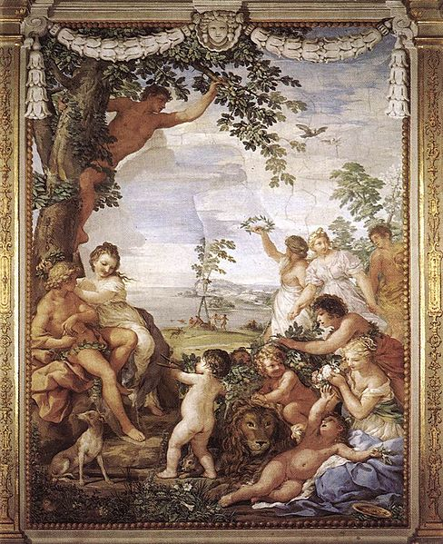
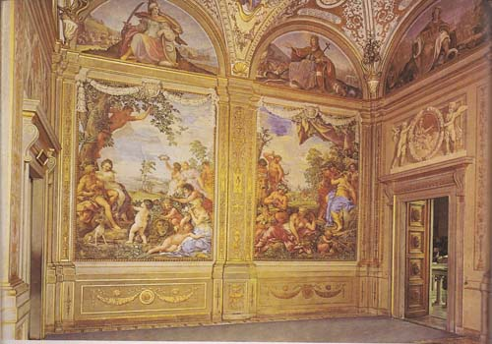
Golden Age
Pietro Berrettini da Cortona,^{[1]} (1 November 1596 – 16 May 1669)
Pitti Palace, Florence

Slide 13
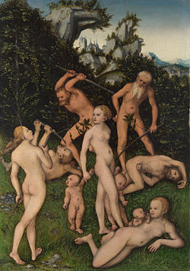
Silver Age
Lucas Cranach the Elder, The Silver Age (1530)
München Bayrische Staatsgemäldesammlung

Slide 14
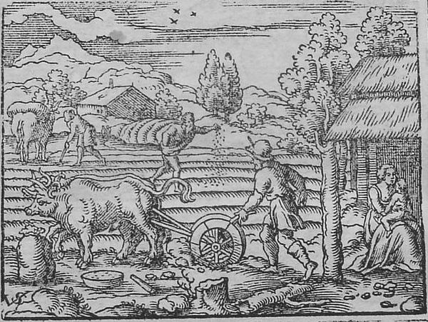
Silver Age
Vergilius Solis (1514-1562): Johann Postius von Gemersheim, Frankfurt, 1563

Slide 15
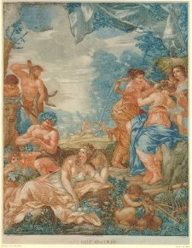
Silver Age
Pietro Berrettini da Cortona,^{[1]} (1 November 1596 – 16 May 1669)
Pitti Palace, Florence

Slide 16
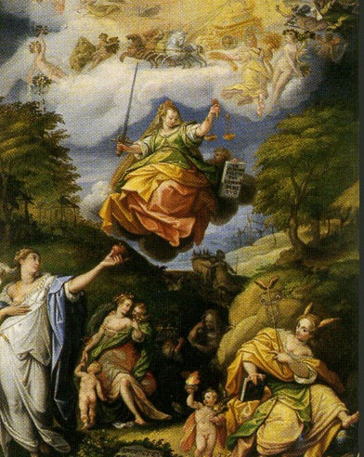
Silver Age
Jacopo Zucchi (c. 1541- c. 1590, Florence)
Uffizi Gallery, Florence

Slide 17
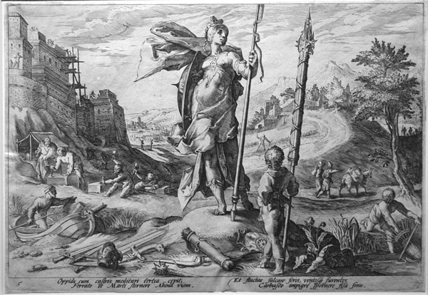
Bronze Age
The Age of Bronze by Hendrik Goltzius

Slide 18
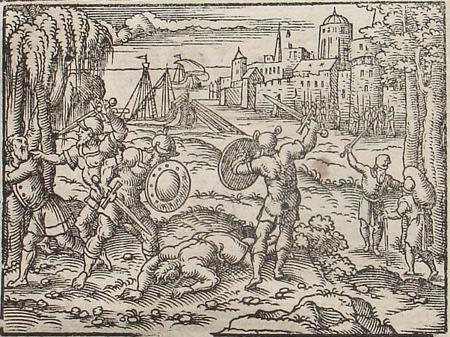
Iron Age
Vergilius Solis (1514-1562): Johann Postius von Gemersheim, Frankfurt, 1563

Slide 19
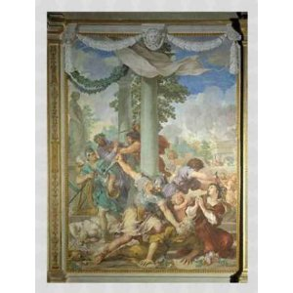
Iron Age
Pietro Berrettini da Cortona,^{[1]} (1 November 1596 – 16 May 1669)
Pitti Palace, Florence

Slide 20
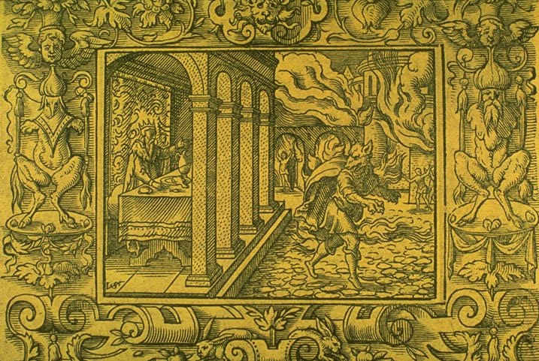
Lycaon
Vergilius Solis (1514-1562): Johann Postius von Gemersheim, Frankfurt, 1563
In University of Vermont Library

Slide 21
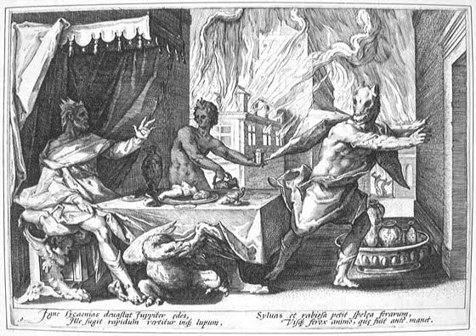
Lycaon
Lycaon. Engraving by Hendrik Goltzius (1558-1617) for Ovid's Metamorphoses Book I, 209 ff.

Slide 22
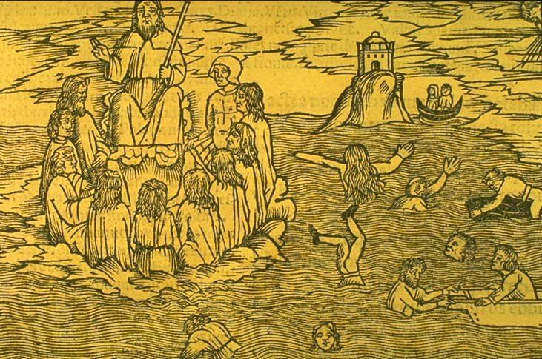
Flood
Anonymous: Raphael Regius (died 1520), Venice ca. 1513
In University of Vermont Library

Slide 23
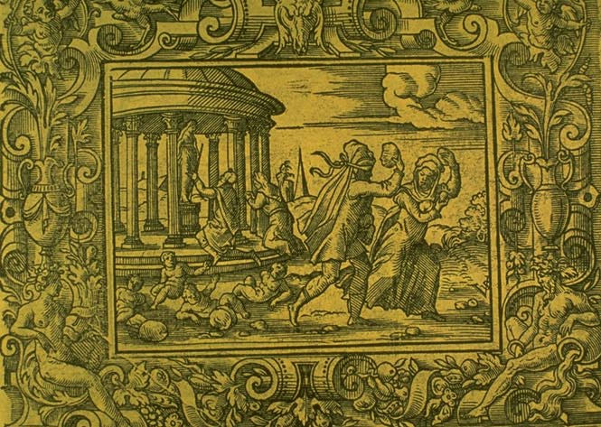
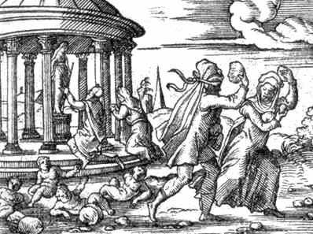
Deucalion and Pyrrha
Vergilius Solis (1514-1562): Johann Postius von Gemersheim, Frankfurt, 1563
In University of Vermont Library

Slide 24
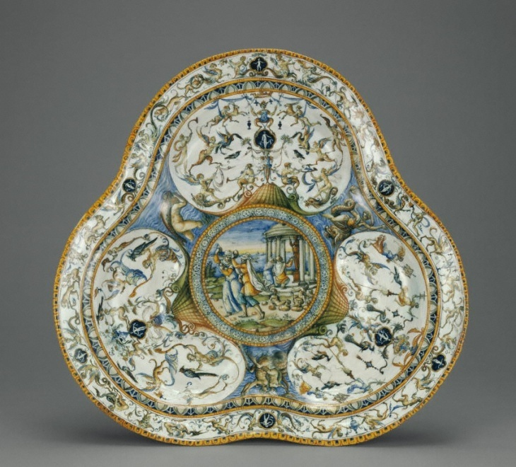
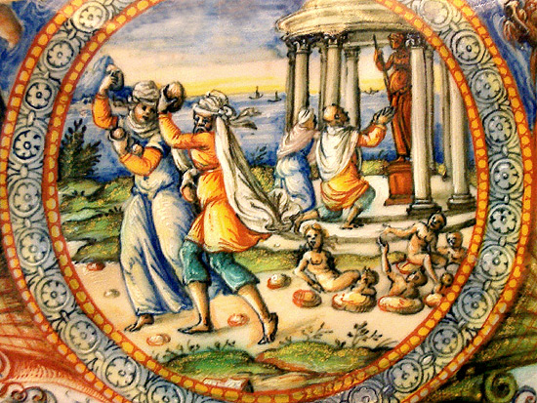
Deucalion and Pyrrha
Ceramic Basin. Fontana Workshop
possibly Orazio Fontana [Italian, 1510 - 1571] or possibly Flaminio Fontana [Italian, active 1571 - 1591] Urbino, Italy
Now in Getty Museum, Malibu, California

Slide 25
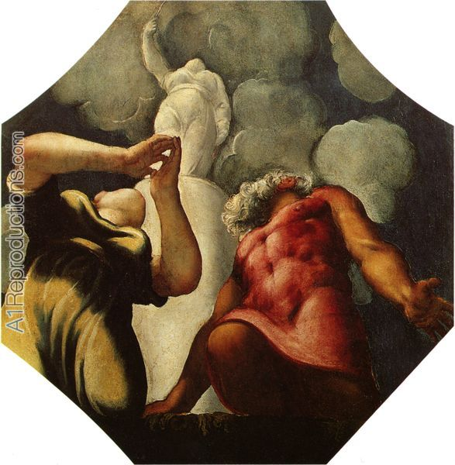
Deucalion and Pyrrha
Author :TINTORETTO Date :c. 1542 Technique :Oil on panel, 127 x 124 cm Form :painting Location :Galleria Estense, Modena

Slide 26
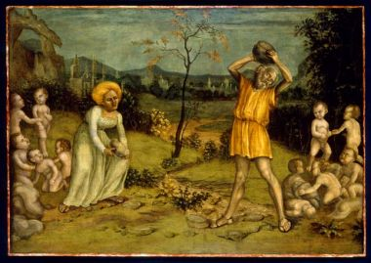
Nicola Giolfino (Italian, 1476–1555) The Myth of Deucalion and Pyrrha, ca. 1550
Tempera on panel 40 ½ x 57 ¾ in. (102.9 x 146.7 cm); frame: 50 ½ x 67 ¼ in. (128.3 x 170.8 cm) Samuel H. Kress Study Collection, 62.159, Indiana University Art Museum

Slide 27
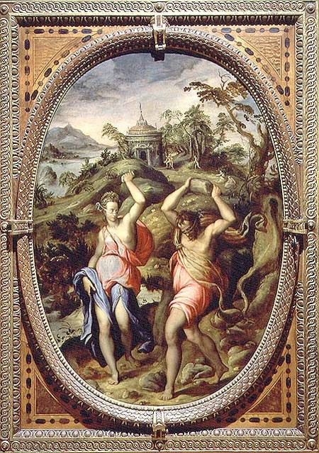
Deucalion and Pyrrha
Deucalion and Pyrrha (1572)
Andrea di Mariotto del Minga (1540 - 96)
Oil on slate
Palazzo Vecchio (Palazzo della Signoria) Florence

Slide 28
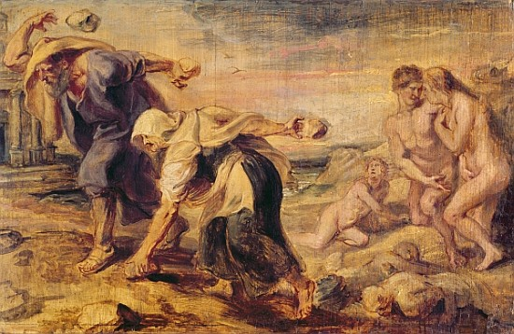
Rubens,Peter Paul (1577-1640), Antwerp
Deucalion and Pyrrha, creators of humanity after the first flood.(Ovid,metamorphoses) Wood,26 x 42 cm Inv.2041Museo del Prado, Madrid, Spain

