Slide 1
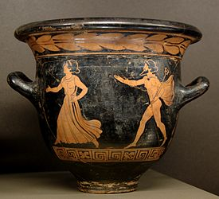
Herse
Hermes pursuing a woman, probably Herse,Lucanian red-figure bell-krater, ca. 390–380 BC,Louvre (G 494).

Slide 2
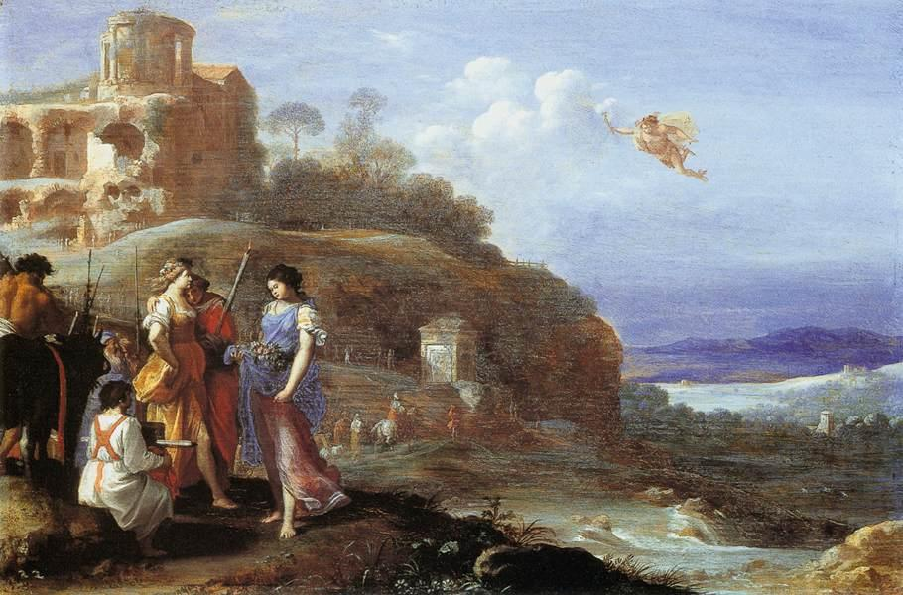
Poelenburgh, Cornelis van (1594-1667)
Mercury and Herse c 1620
Baroque
Mauritshuis, The Hague, Netherlands

Slide 3
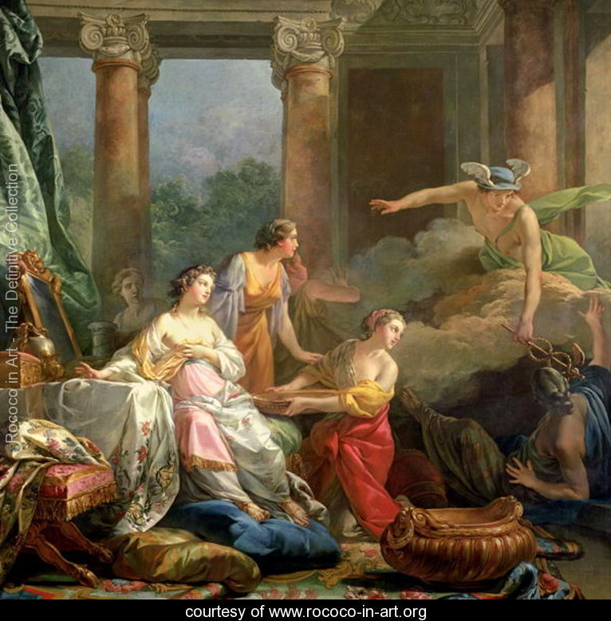
Mercury, Herse and Aglauros, 1763
Jean-Baptiste-Marie Pierre
Musée Du Louvre, Paris, France
1763

Slide 4
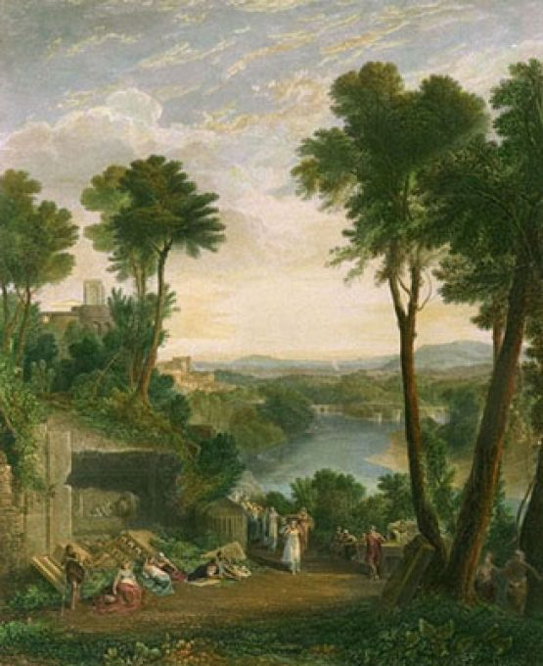
Joseph Mallord William Turner's 1811 painting, Mercury and Herse
Private collection
http://www.invaluable.com/auction-lot/joseph-mallord-william-turner-r.a.-1775-1851-mer-1-c-7u7r6aoldu

Slide 5
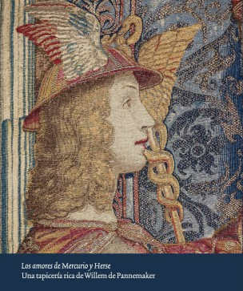
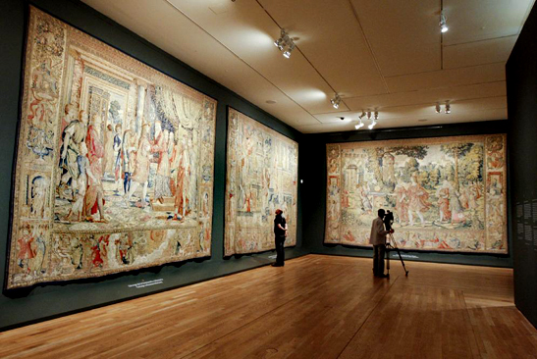
Museo del Prado. The Loves of Mercury and Herse. A Tapestry Series by Willem de Pannemaker
http://www.museodelprado.es/en/exhibitions/exhibitions/at-the-museum/willem-pannemaker-la-serie-de-mercurio/the-exhibition/the-catalogue/

Slide 6
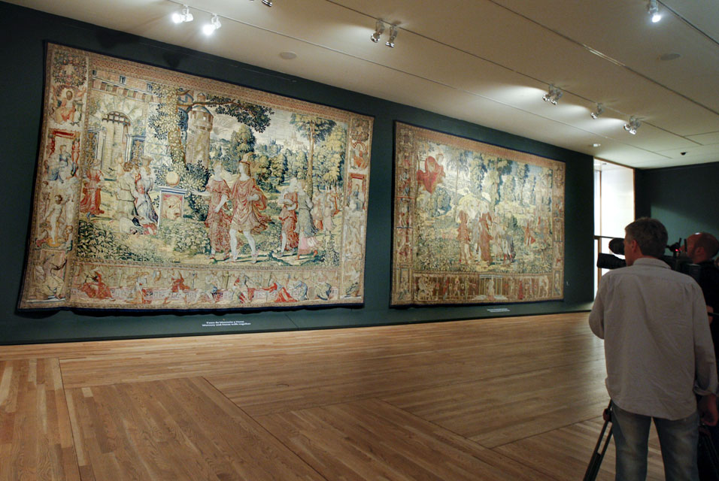

Slide 7
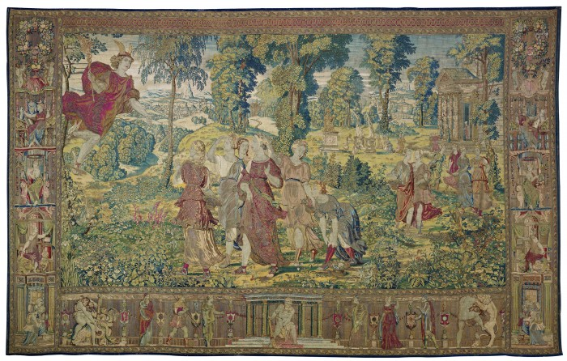
Willem de Pannemaker (active 1535-1581), Mercury enamoured of Herse, 1570 Colección Casa Ducal de Alba Seville

Slide 8
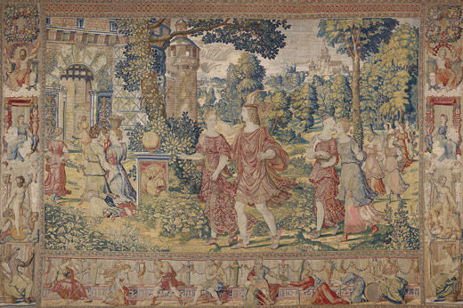
Mercury and Herse together, Manufactured by Willem de Pannemaker. Gold, silver, silk and wool thread, 443 x 672 cm. Brussels, ca.1570. Madrid, Museo Nacional del Prado

Slide 9
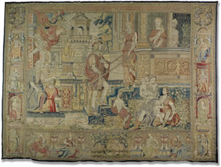
Aglauros detains Mercury
Manufactured by Willem de Pannemaker
Gold, silver, silk and wool thread, 437 x 603 cm
Brussels, ca.1570
Colección Duque de Lerma, depositado en la Casa Ducal de Medinaceli

Slide 10
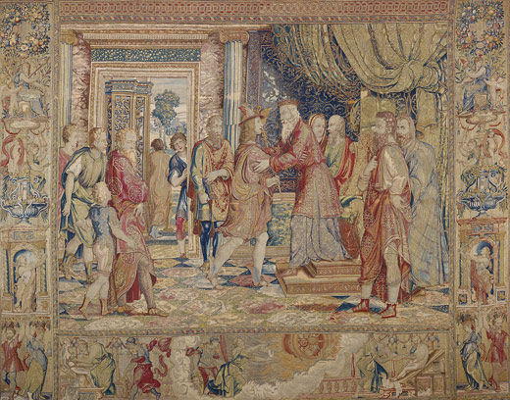
Cecrops welcomes Mercury, Manufactured by Willem de Pannemaker. Gold, silver, silk and wool thread, 435 x 551 cm. Brussels, ca.1570. Madrid, Museo Nacional del Prado.

Slide 11
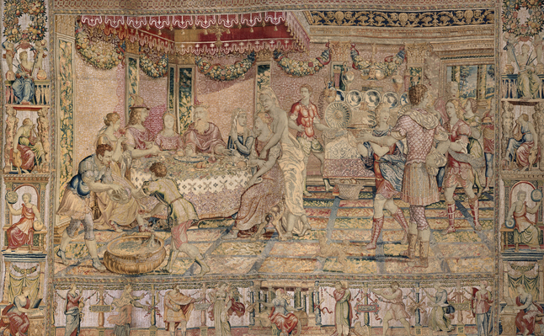
Aglauros corrupted by Envy
Manufactured by Willem de Pannemaker
Gold, silver, silk and wool thread, 440 x 650 cm
Brussels, ca.1570
Colección Duques de Cardona

Slide 12
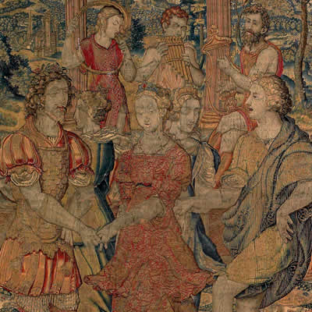
6. The Dance in Cecrops’ Palace
Manufactured by Willem de Pannemaker
Gold, silver, silk and wool thread, 436 x 607 cm
Brussels, ca.1570
Colección Fundación Casa Ducal de Medinaceli

Slide 13
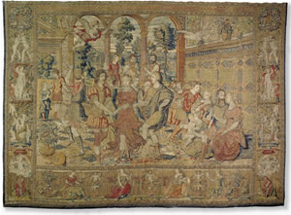
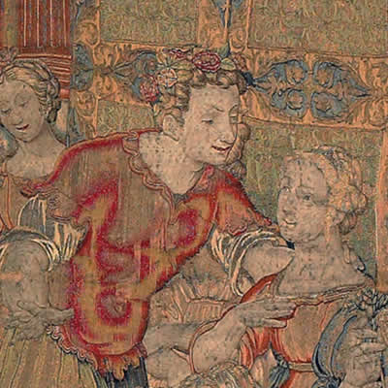
6. The Dance in Cecrops’ Palace
Manufactured by Willem de Pannemaker
Gold, silver, silk and wool thread, 436 x 607 cm
Brussels, ca.1570
Colección Fundación Casa Ducal de Medinaceli

Slide 14
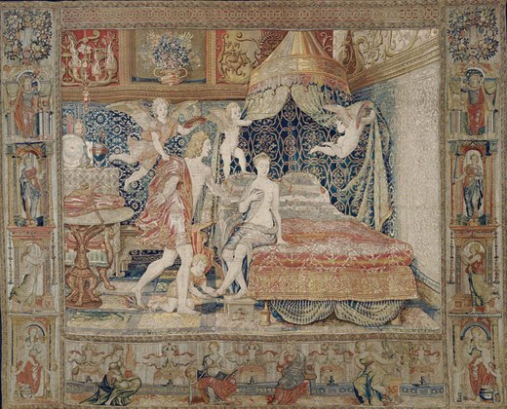
7. Herse’s nuptial Chamber, Manufactured by Willem de Pannemaker. Gold, silver, silk and wool thread, 437 x 541 cm. Brussels, ca.1570. New York, Metropolitan Museum of Art
https://sites.google.com/site/livingmadridinenglish/archive-news/museodelpradothelovesofmercuryandherseatapestryseriesbywillemdepannemaker

Slide 15
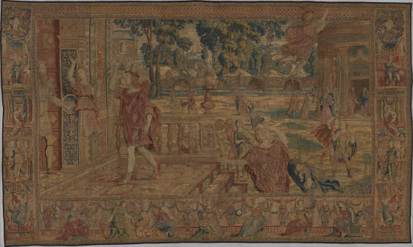
8. The Metamorphosis of Aglauros and Mercury’s Departure
Manufactured by Willem de Pannemaker
Gold, silver, silk and wool thread, 450 x 716 cm
Brussels, ca.1570
Metropolitan Museum of Art

