Slide 1
King Midas
Howell, Frahm, Villarreal

Slide 2
The Midas Touch
Midas was a fair and kind king
While roaming his garden he found a satyr asleep in his flowers
Midas took pity on the old satyr and let him go without punishment
Dionysus granted Midas a wish because of his kindness
Midas wished that everything he touched would turn to gold
Midas soon figured out he could no longer eat or drink because his food and water would turn to gold
Before long, Midas had turned his daughter and his whole castle to gold
Midas begged Dionysus to have mercy on him and return him to normal
Dionysus told him to go to the river by Sardis and plunge his head and body into the foaming fountain and at the same time it would wash away his sin
Midas did as he was told and his gift was taken away and everything he had turned to gold was returned to its original form

Slide 3
Kristen Stein, “The story of king Midas” (2009), Philadelphia

Slide 4
Giovanni Caselli “from The Age of Fable” (1855)

Slide 5
Barthelemy Eyck, “Uomini Famosi”, The Metropolitan Museum of Art, New York,

Slide 6
Nicolas Poussin, “Midas at the source of the river” (1626), Pactole. Ca.

Slide 7
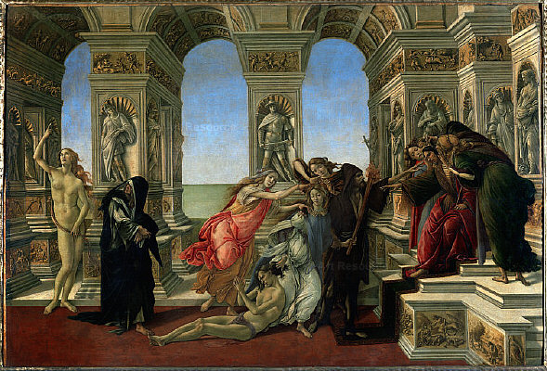
Sandro Botticelli, “The Calumny of Apelles (1495)”, Florence Italy

Slide 8
Acheloos Painter, “King Midas lying in wait for Silenos” (6th B.C.) The Metropolitan Museum of Art, New York

Slide 9
Walter Crane, “Midas' Daughter Turned to Gold” (1892), British Library, London

