Slide 1
Death OF Achilles
Presented by: Emmery Schutyema, Brett Sutter, and Andrew Shiakallis

Slide 2
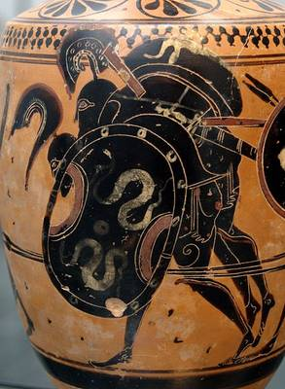
Ajax carrying the body of Achilles.
Attic black-figure lekythos
ca. 510 B.C.
From Sicily.
At the Staatliche Antikensammlungen, Munich, Germany.

Slide 3
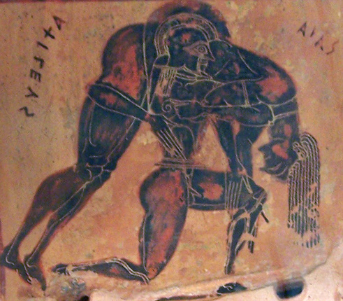
On the handles of the Francois Vase
about 470 BC
Kleitias painted this scene
Ajax carrying the body of Achilles from the battlefield at Troy.
On the left is painted, from right to left, Achilles' name, "AKhILEUS," and on the right, from left to right, Ajax's name, "AIAS."
Here Kleitias closes the story he began on that vase with the wedding of Achilles' mother, the sea nymph Thetis, with his father Peleus, and continued with a scene of Achilles chasing the young Trojan prince Troilus to capture or kill him. Here he ends it with the death of Achilles on the battlefield.

Slide 4
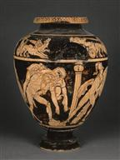
Anonymous
Red Figure Stamnos
Achilles and Troilus in the presence of Athena; Ajax carrying the body of Achilles
Etruscan, from Vulci, 4th BCE.
Louvre, Paris, France

Slide 5
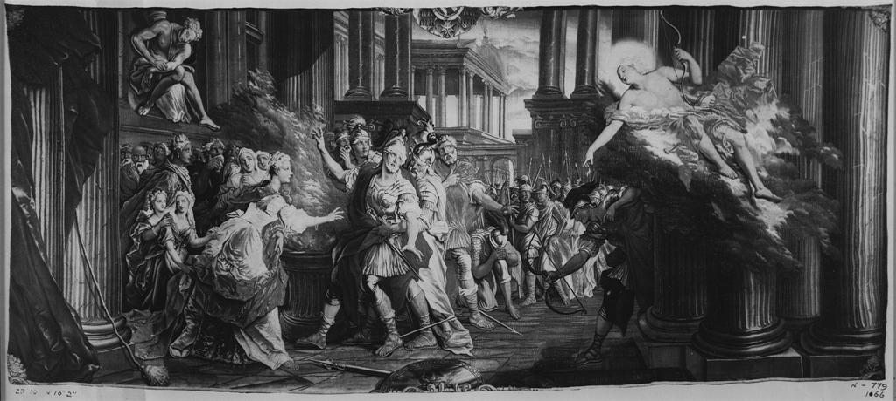
Coypel, Antoine (1661-1722) Coypel, Charles-Antoine (1694-1752) Houasse, René-Antoine (1645-1710)
Death of Achilles
Textiles - Tapestries
c. 1730-1740
Paris, France
Material unknown

Slide 6
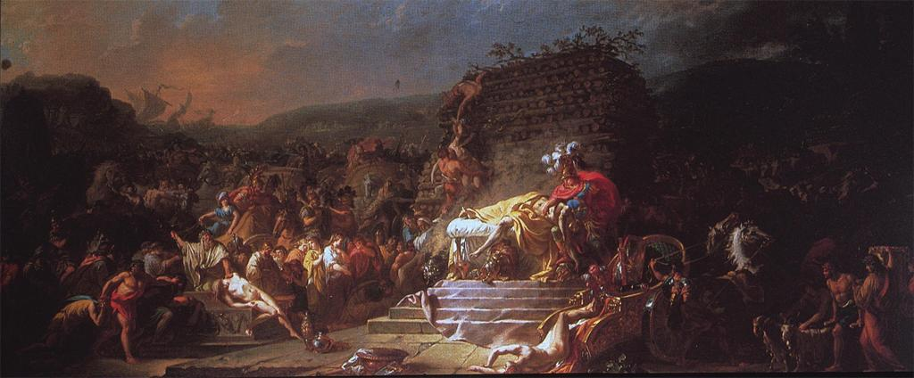
David, Jacques-Louis, 1748-1825
Funeral of Patroclus
1779
oil on canvas
94 X 218 cm.
National Gallery of Ireland

Slide 7
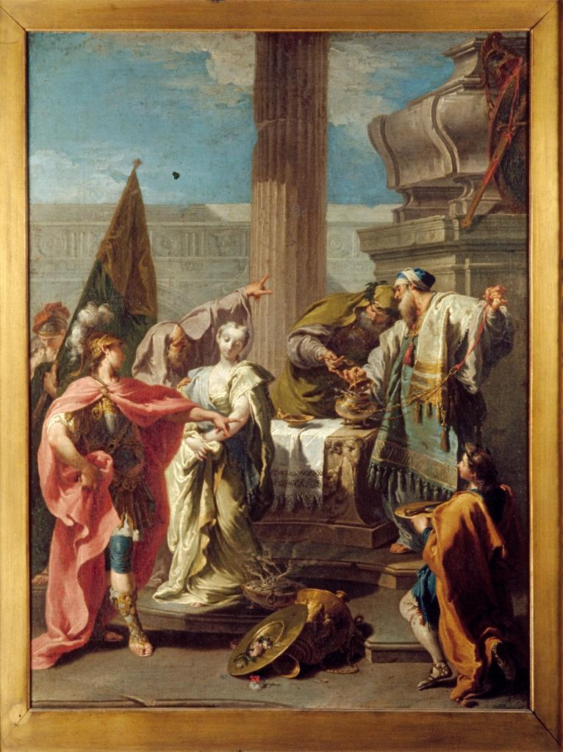
Giovanni Battista Pittoni, the younger, Italian, 1687-1767
The Sacrifice of Polyxena at the Tomb of Achilles
painting
Baroque
ca. 1735
Venice, Italy
oil on canvas

Slide 8
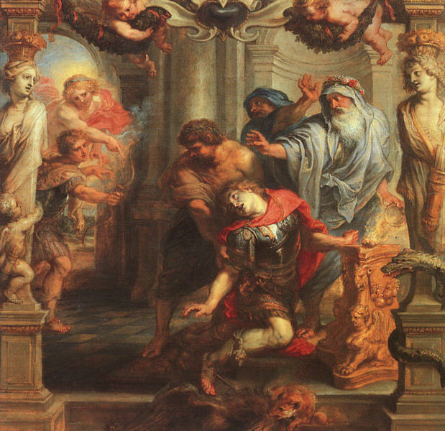
Peter Paul Rubens (1577-1640)
Death of Achilles (1630-32)
Oil painting
Located in Rotterdam, Netherlands in Museum Boijmans Van Beuningen???

Slide 9
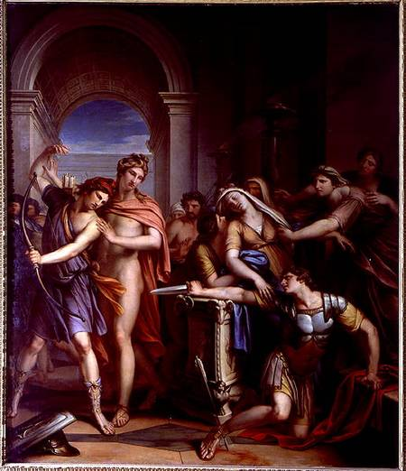
Gavin Hamilton (1723-1798)
“The Death of Achilles” (1782-1784)
Oil painting
Located in Rome, Museo Nazionale Romono (National Museum of Rome)

Slide 10
Troy: The Death of Achilles
http://youtu.be/ak9juZMO0A4

