Slide 1
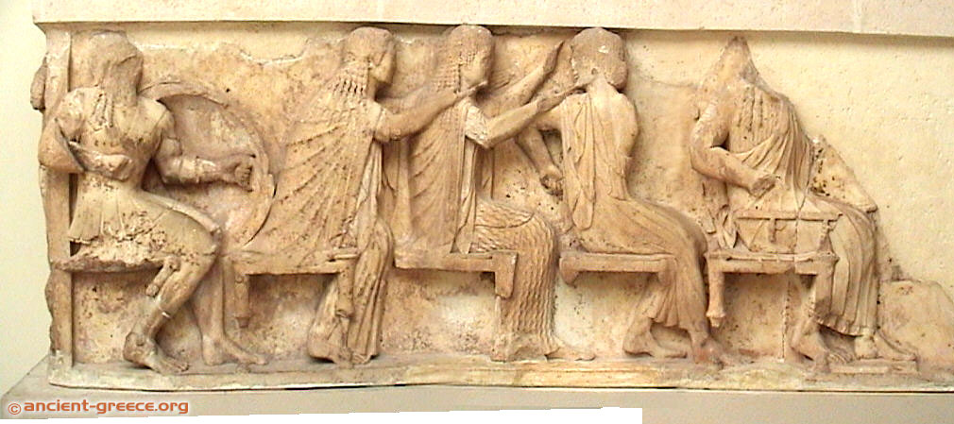
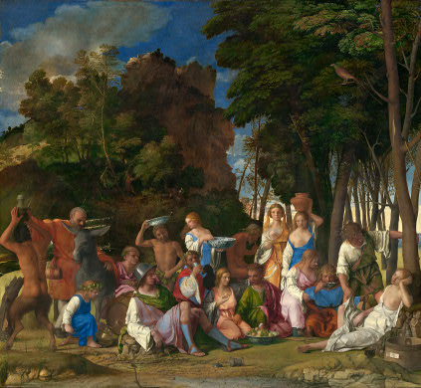
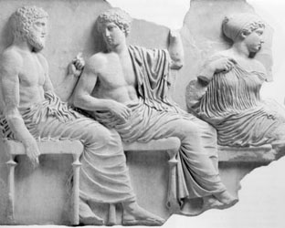
The Greek Gods in Art

Slide 2
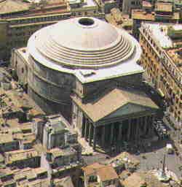
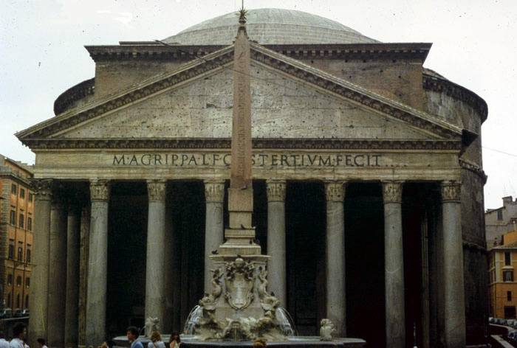
Pantheon

Slide 3
Important Terms
Pantheon
Assembly of the Gods
Polytheism
Monotheism
Theriomorphism
Anthropomorphism

Slide 4
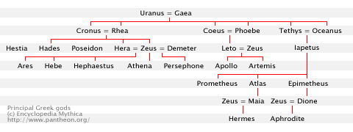
The Greek Pantheon
For information on the Greco-Roman deities, see http://department.monm.edu/classics/Courses/CLAS230/MythDocuments/Pantheon/Pantheon.htm

Slide 5
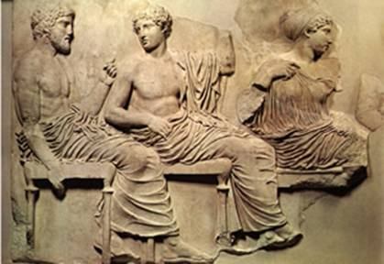
More on the Greek Gods
Genealogical Tables
Apollodorus 1.1.1-1.4.1 (the gods)
The Major Gods
The Pantheon
12 Olympian Gods

