Slide 1
Metamorphoses of a Myth
Actaeon in Antiquity

Slide 2
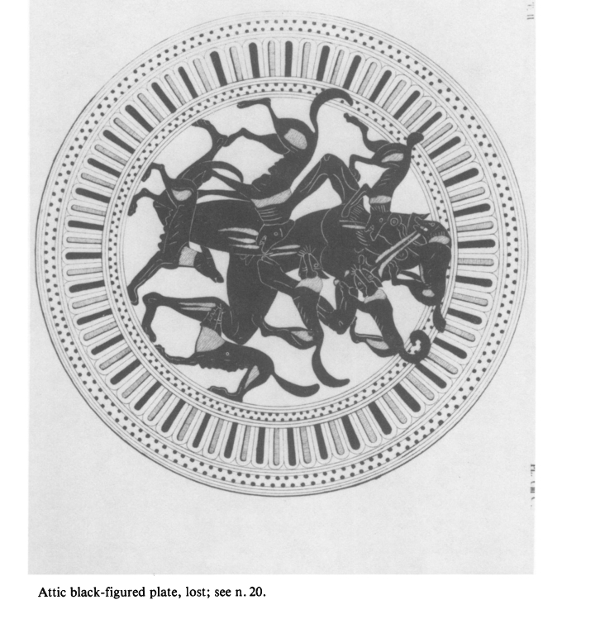

Slide 3
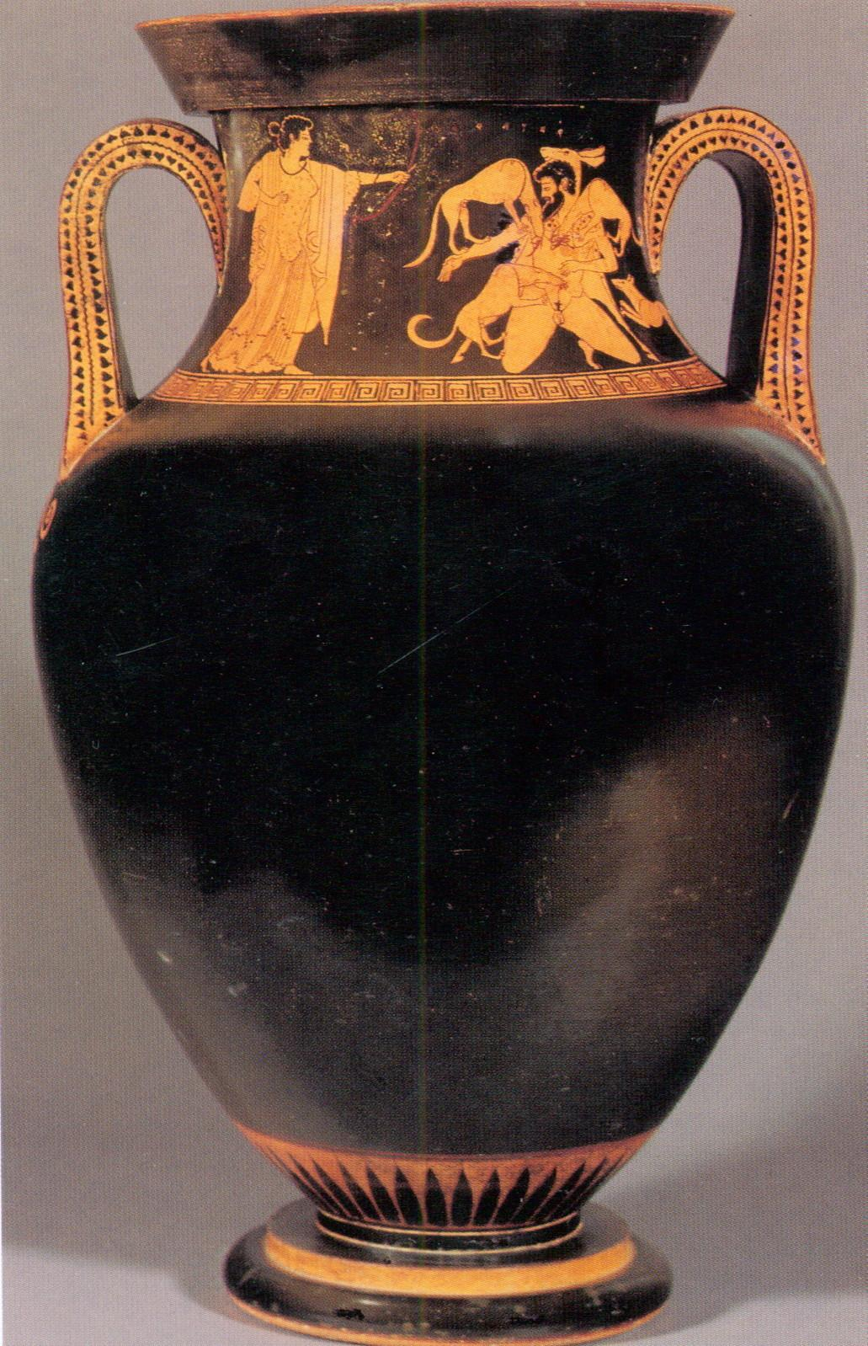
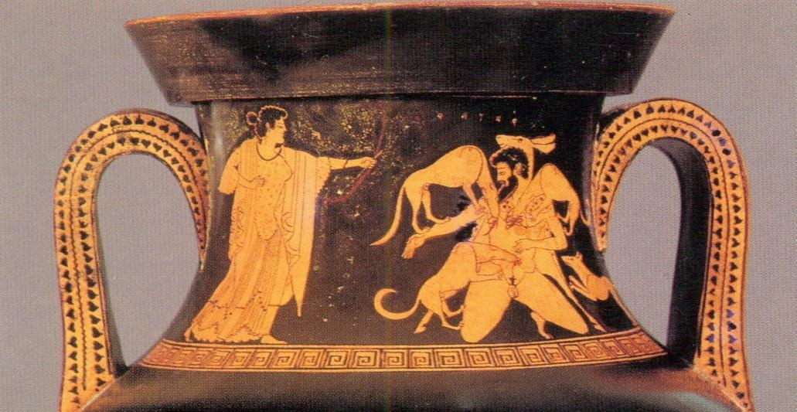
Amphora with Artemis and Aktaeon
The Eucharides Painter
C.500-480
Attic clay,
Hamburg Museum fue Kunst und Gewerbe
Note that Actaeon is wearing a deerskin.

Slide 4
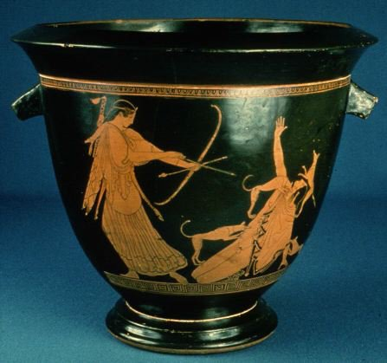
Pan Painter. Artemis Slaying Actaeon. Red figure decoration on bell crater. 37 cm. c. 470 BC. Museum of Fine Arts in Boston, Massachusetts

Slide 5
Melian relief; Paris, Louvre, Nr. 4447
480-430 B.C.
20 cm x 20 cm

Slide 6
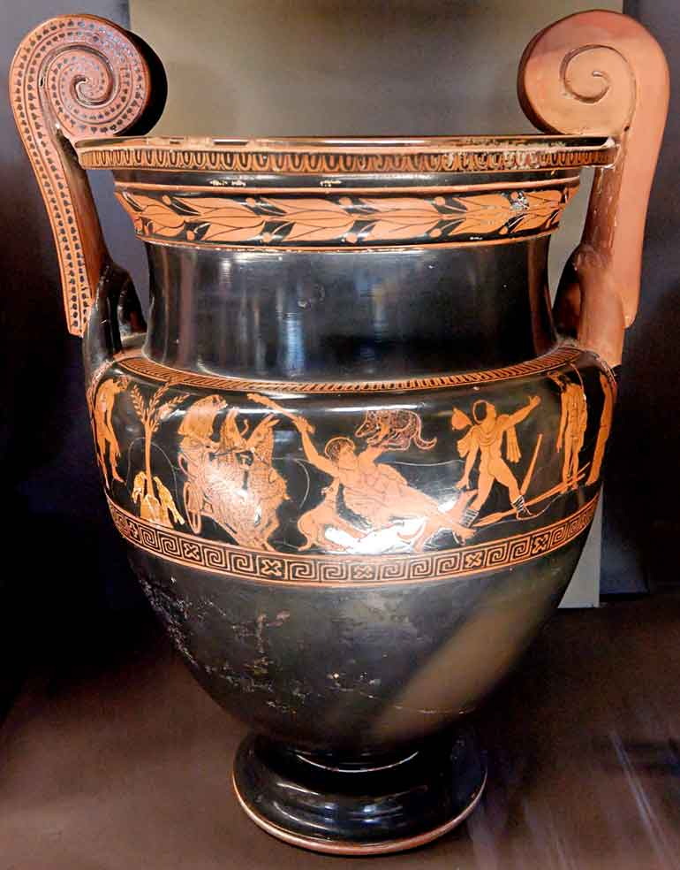
Painter of the Woolly Satyrs Actaeon's death
The scene is probably based on Aeschylus' lost play The Toxitides, which dealt with the story of Actaeon.
Side A from an Attic red-figure volute crater, ca. 450–440 BC. Dimensions H. 51 cm (20 in.), Diam. 33.1 cm (13 in.) Musée du Louvre, Paris, France
http://www.mlahanas.de/Greeks/Mythology/ActaeonLouvreCA3482.html

Slide 7
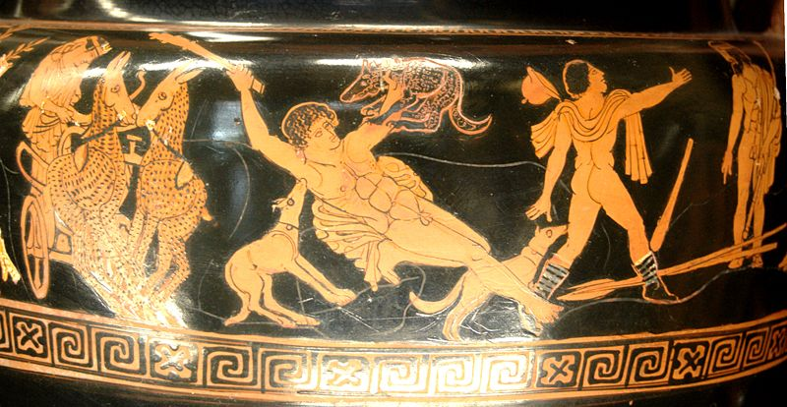
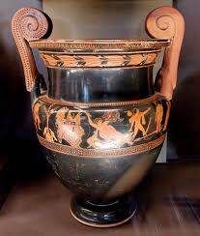
Painter of the Woolly Satyrs Actaeon's death
Artemis drives a chariot drawn by a team of deer.
Side A from an Attic red-figure volute crater, ca. 450–440 BC. Dimensions H. 51 cm (20 in.), Diam. 33.1 cm (13 in.) Musée du Louvre, Paris, France
http://www.mlahanas.de/Greeks/Mythology/ActaeonLouvreCA3482.html

Slide 8
Painter of the Woolly Satyrs Actaeon's death
At left Apollo looks calmly over the scene (Delphi) Artemis drives a chariot drawn by a team of deer (Mt. Cithaeron)
Side A from an Attic red-figure volute crater, ca. 450–440 BC. Dimensions H. 51 cm (20 in.), Diam. 33.1 cm (13 in.) Musée du Louvre, Paris, France
http://www.mlahanas.de/Greeks/Mythology/ActaeonLouvreCA3482.html

Slide 9
Painter of the Woolly Satyrs Actaeon's death
To Aactaeon’s right a man reports Actaeon's death to his parents Aristaeus and Autonoe (Thebes)
Side A from an Attic red-figure volute crater, ca. 450–440 BC. Dimensions H. 51 cm (20 in.), Diam. 33.1 cm (13 in.) Musée du Louvre, Paris, France
http://www.mlahanas.de/Greeks/Mythology/ActaeonLouvreCA3482.html

Slide 10
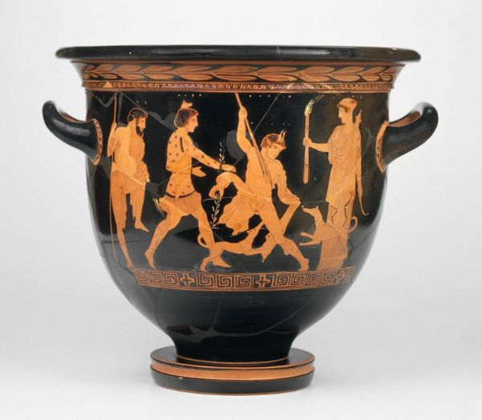
Actaeon (Aktaion) is transformed into a stag (for the first time indicated by the pair of horns) by Artemis, and torn apart by his dogs. Artemis is depicted with flaming torch and quiver. She is attended by Lyssa (personification of raving madness) who drives the dogs to fury. Lyssa is depicted as a Thracian huntress (similar to Bendis) with a fox-head cap. Zeus passively observes the scene.
c 440 BC, Attributed to the Lykaon Painter

Slide 11
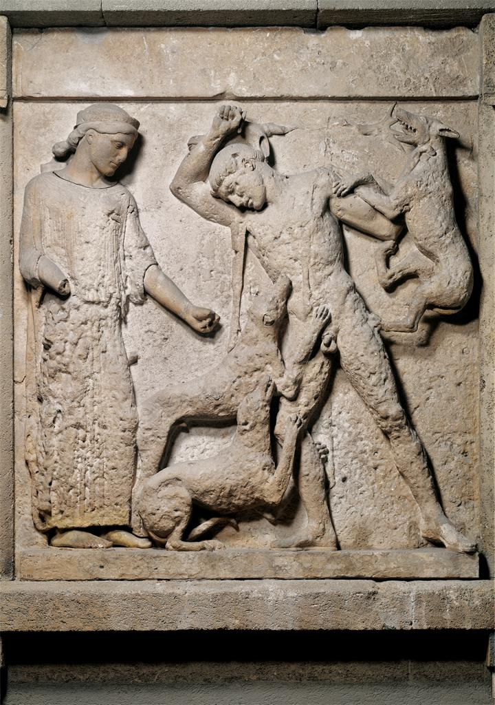
Magna Graecia
Artemis and Actaeon, Metope from the Temple of Hera, Temple E, in Selinus sculpture
c. 470-450 BC
Material limestone and marble
Measurements height: 162 cm
Museo archeologico "A. Salinas" (Palermo, Italy)
This standing Actaeon type becomes the norm in later art in Italy.

Slide 12
Dolon Painter Actaeon attacked by his hounds. Detail from a red-figure Lucanian nestoris, ca 390-380 BC. From the Basilicata. British Museum GR 1865.1-13.17 (Cat. Vases F 176)

Slide 13
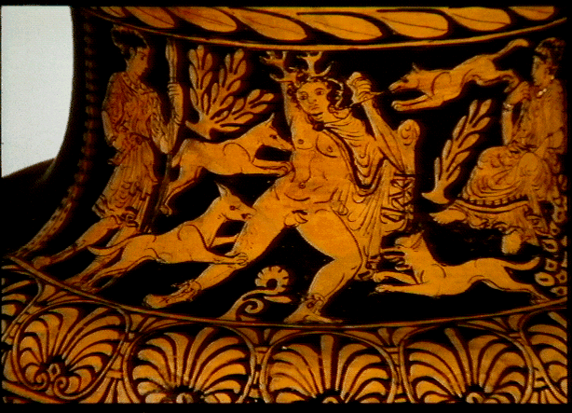
Choephoroi Painter. Death of Actaeon (c. 350-340 B.C.)

Slide 14
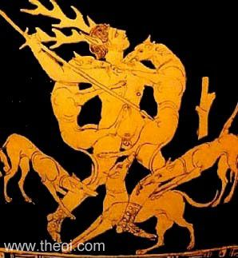
THE DEATH OF AKTAION
Badisches Landensmuseum,
Karlsruhe, Germany
Apulian Red-figure
Skyphos
Date: ca 400 - 350 BC
Period: Late Classical

Slide 15
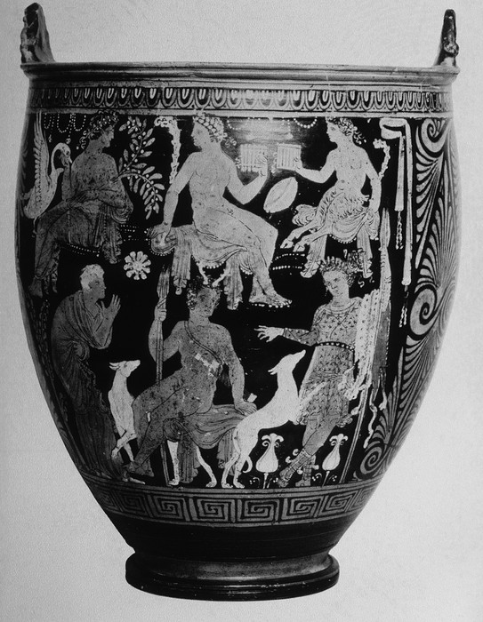
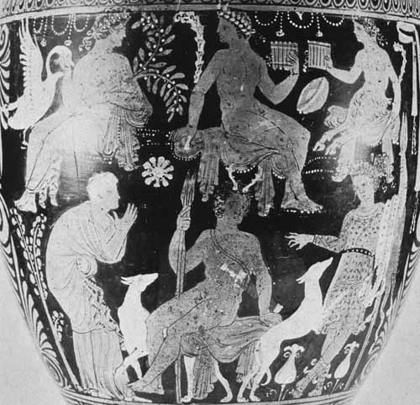
Apulian red-figure situla near Hippolyte Painter showing (below) Actaeon sprouting stag's horns, which attracts his dog's curiosity, while his mother Autonoe gestures anxiously from left and Artemis stands on right with second dog; and (above) Apollo (father of Aristaeus and grandfather of Actaeon), satyr or Actaeon's father Aristaeus, and Pan; Kilinski cat. #29.

Slide 16
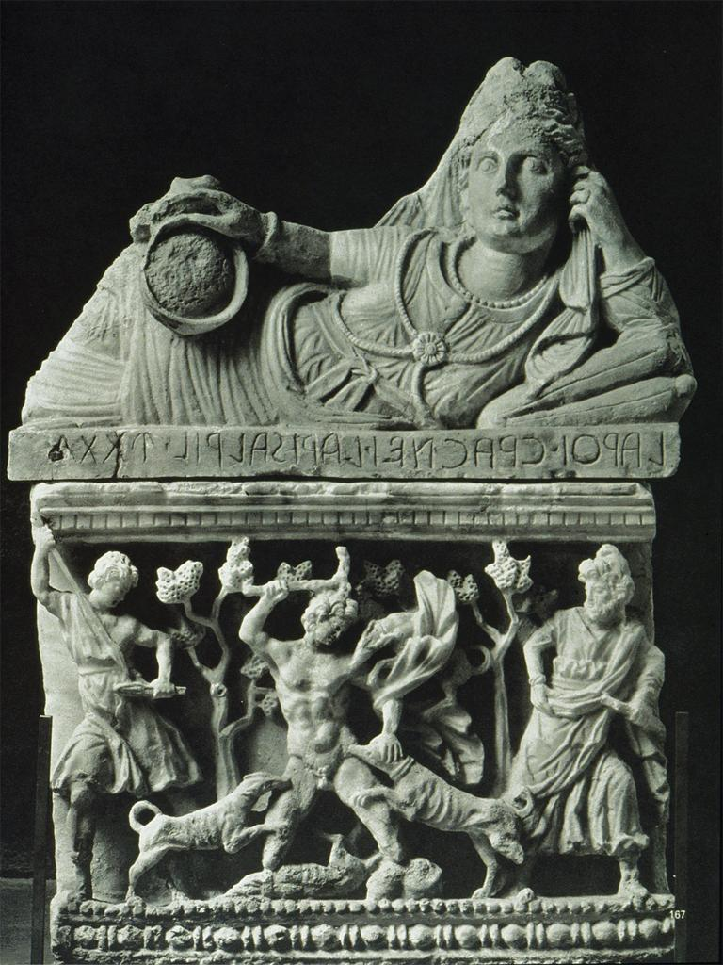
Cinerary Urn: Front Actaeon
Date 2nd C. B.C
Material alabaster
Sculpture--Etrusco/Italic (Etruria)--199-100 BC
Volterra

Slide 17
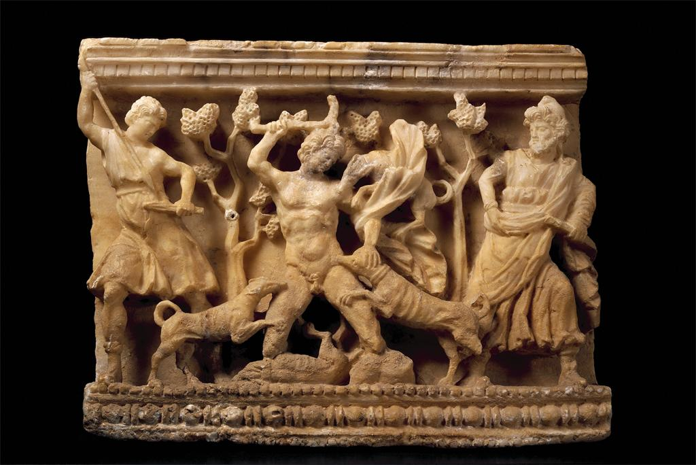
Etruscan Urn with Actaeon attacked by dogs (Death of Actaeon)
Alabaster sculpture, 2nd century BC , Measurements 51 x 39 x 23 cm
Repository Museo Etrusco Guarnacci, Volterra 356

Slide 18
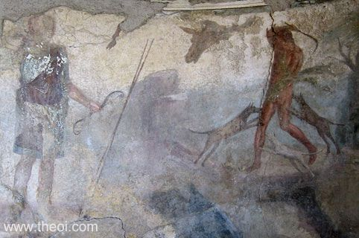
ARTEMIS & AKTAION
Museum Collection: Museo Archeologico Nazionale di Napoli, Naples, Italy Type: Fresco, Roman, Pompeii Imperial Roman
SUMMARY
Artemis stands holding a bow, watching as Aktaion is torn apart by his hounds. The stag-head above the boy's head represents his metamorphosis.

Slide 19
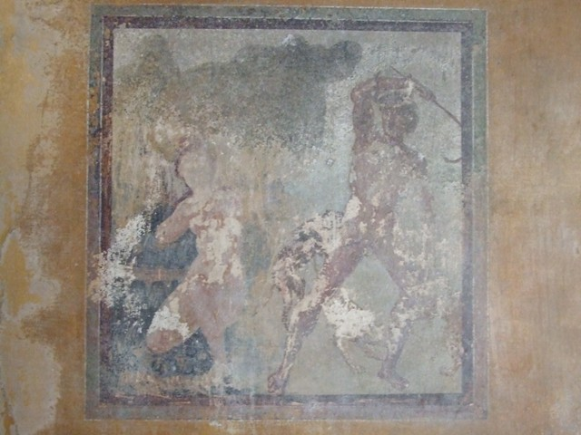
Pompeii. Casa della Venere in Bikini or House of Venus in the Bikini
or Domus of Maximus
Room 7, east wall of triclinium.
Wall painting of Acteon and Artemis, or Diana.

Slide 20
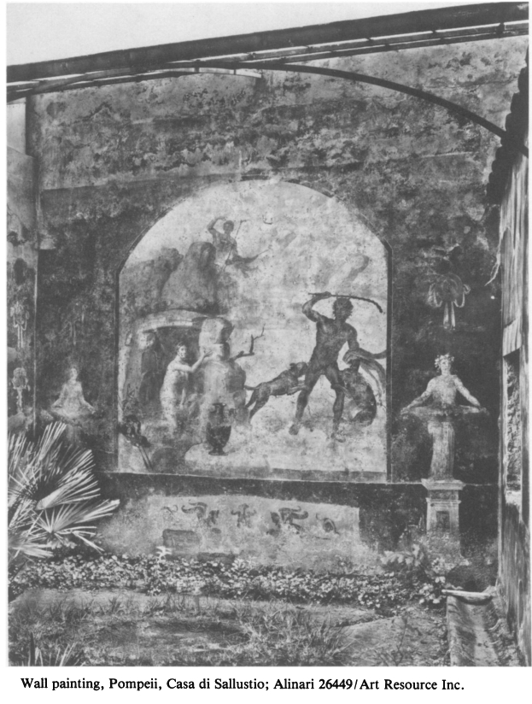
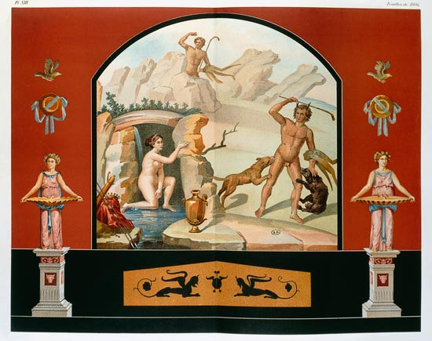

Slide 21
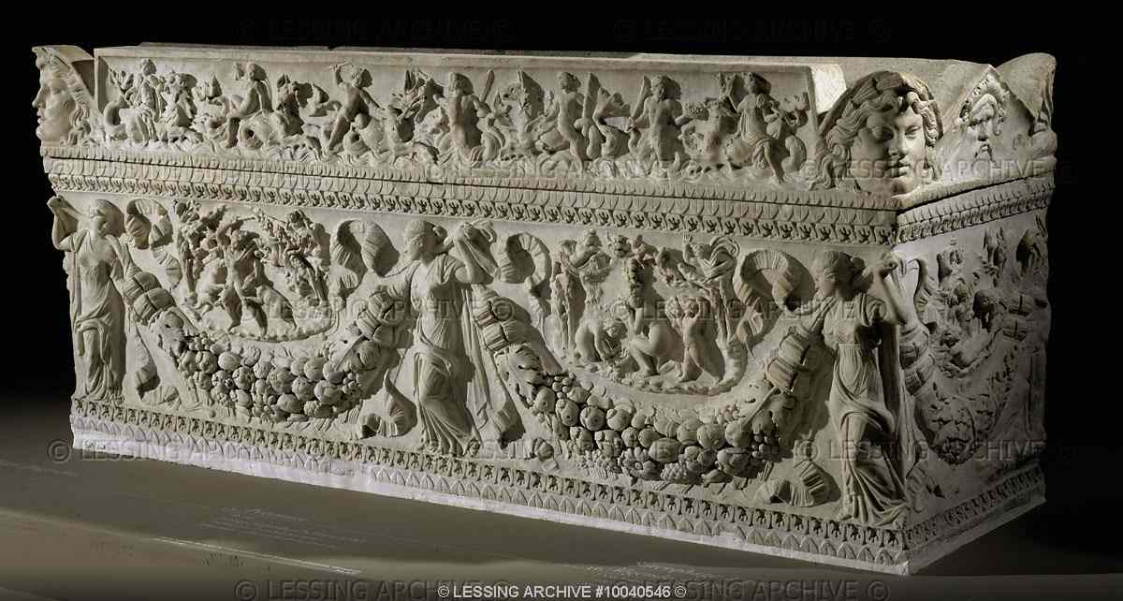
ROMAN SARCOPHAGUS 2ND CE
Sarcophagus with garlands and scenes from the legend of Actaion.Left oval:Actaion,who has surprised the goddess Artemis in her bath,is attacked by his own pack of hounds.Right:putti pour water for Artemis. Marble,99 x 236 cm.Borghese Collection. Ma 459Louvre, Departement des Antiquites Grecques/Romaines, Paris, France

Slide 22
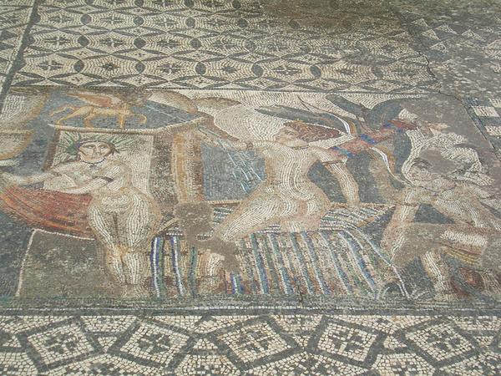
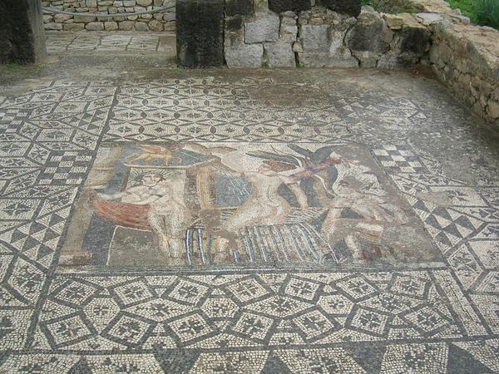
Diana & maids bathing mosaic
Volubilis, Morocco

Slide 23
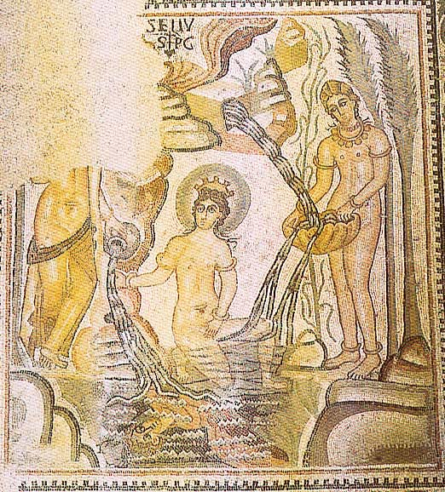
A mosaic in the Villa of Trajan at Timgad (late fourth- or early fifth-century) shows Actaeon both on top of the cave and reflected in the water

Slide 24
http://www.online-literature.com/forums/showthread.php?p=1062652

