Slide 1
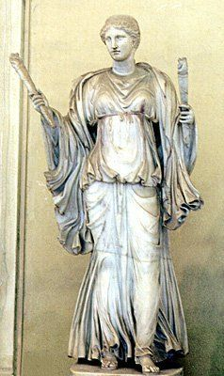
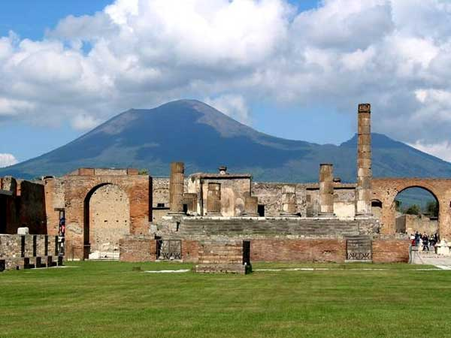
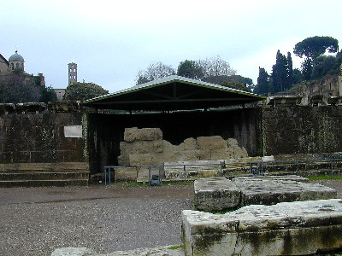
Roman Gods and Temples

Slide 2
Temple of Jupiter (Capitolium) Pompeii

Slide 3
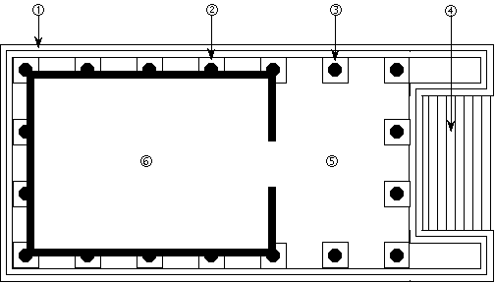
1. Podium (or base).
2. Engaged column.
3. Freestanding column. Virtual Roman Temple
4. Entrance steps.
5. Porch.
6. Cella.

Slide 4
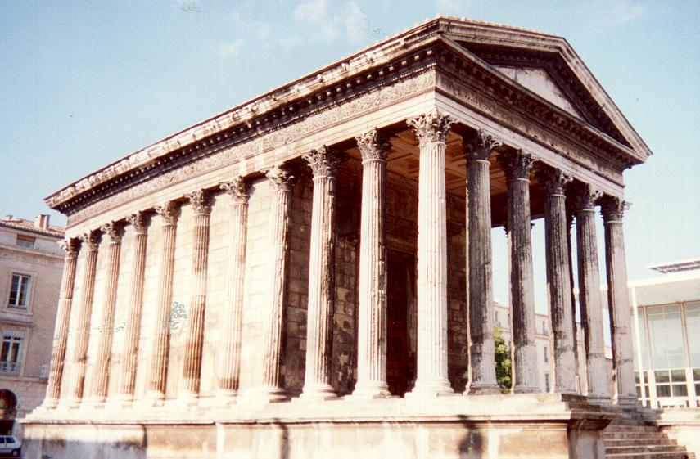
Maison Carree
Freestanding column Porch
Engaged column
Cella Podium (or base) Entrance steps

Slide 5
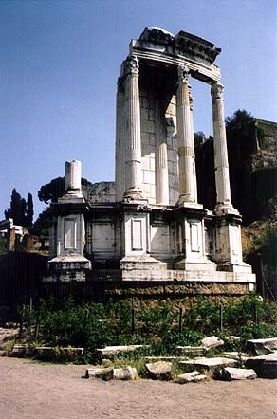
Vesta
Statue of goddess with torches, probably Vesta (VRoma: Vatican Museums, Rome: Lisanne Marshall)
Vestalalia
June 7 – June 15
Read Ovid’s Fasti

Slide 6
Vestal Virgins
6 priestesses
chosen by pontifex maximus at 6-10
patrician
served for 30 years
learned for 10
performed for 10
Taught for 10
special privileges and duties

Slide 8
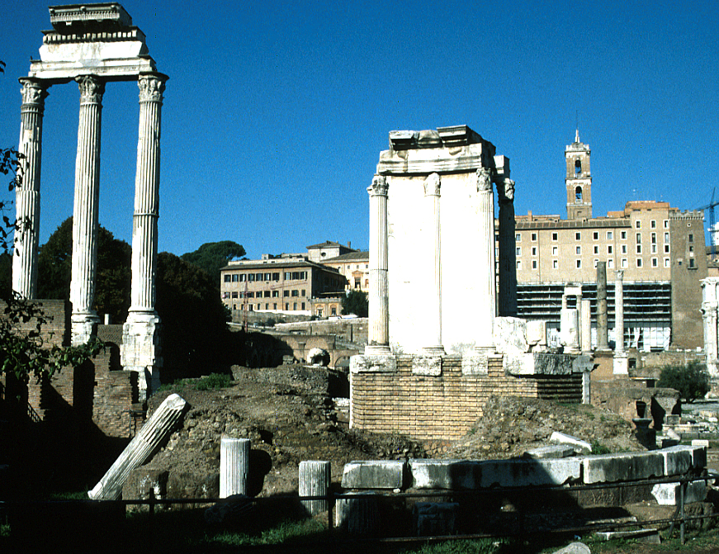
Contained sacred fire (relit every March 1st)
the Palladium (a statue of Athena rescued from Troy by Aeneas, who assured the ongoing safety of Rome), and two statues of the Penates of the Roman people

Slide 9
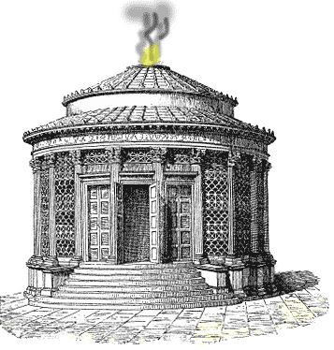
Contained sacred fire (relit every March 1st)
the Palladium (a statue of Athena rescued from Troy by Aeneas
two statues of the Penates of the Roman people

Slide 10
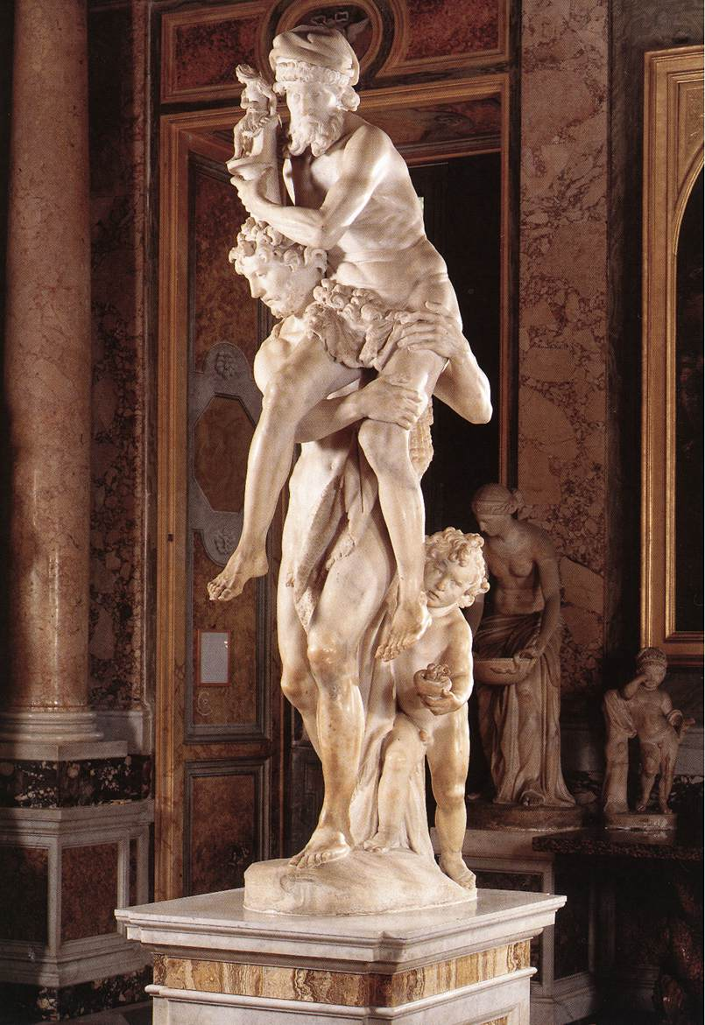
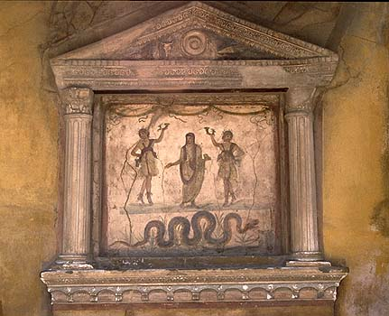
Lares and Penates
Lararium in Pompeii
Bernini, Aeneas, Anchises and Ascanius
1618-1619

Slide 11
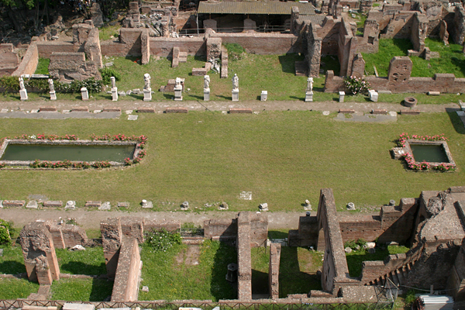
House of the Vestals

Slide 12
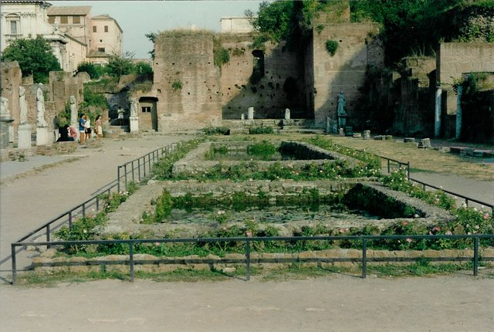
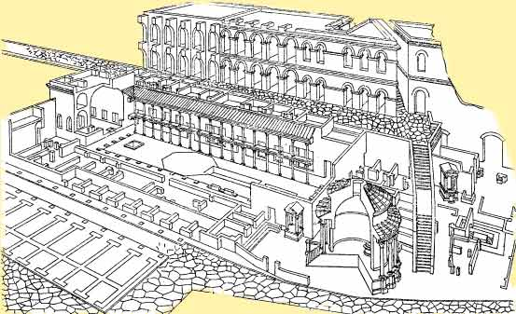

Slide 13
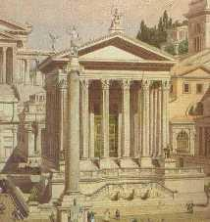
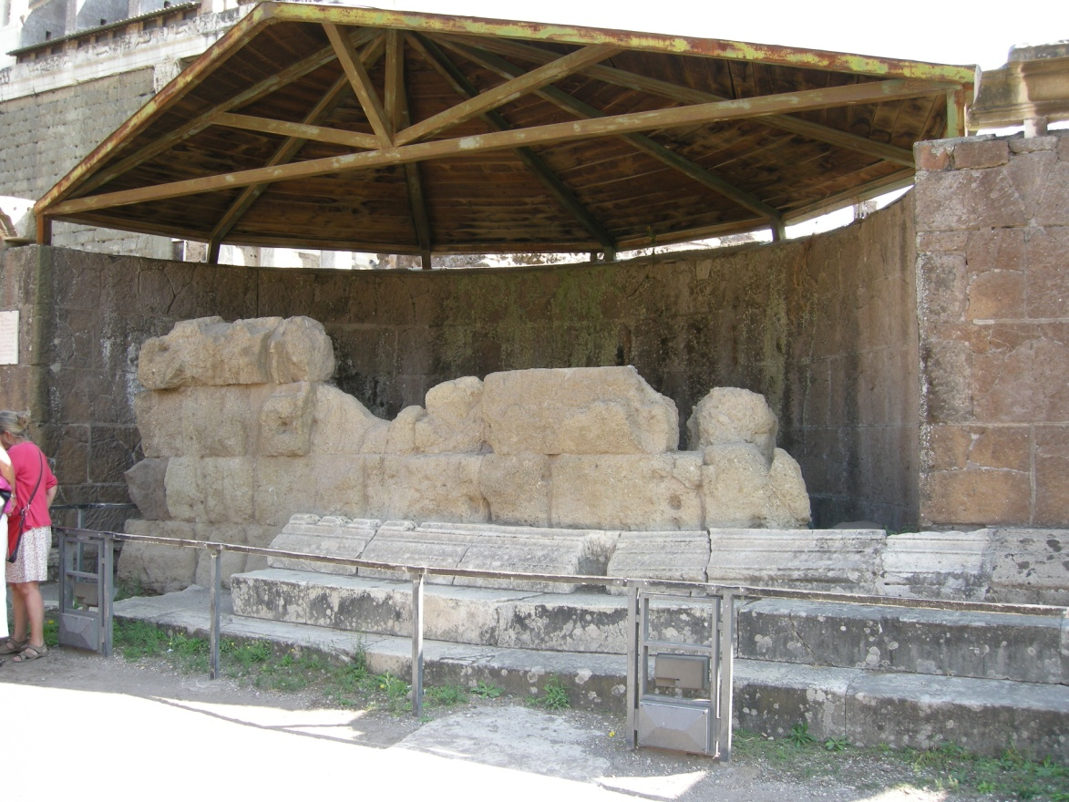
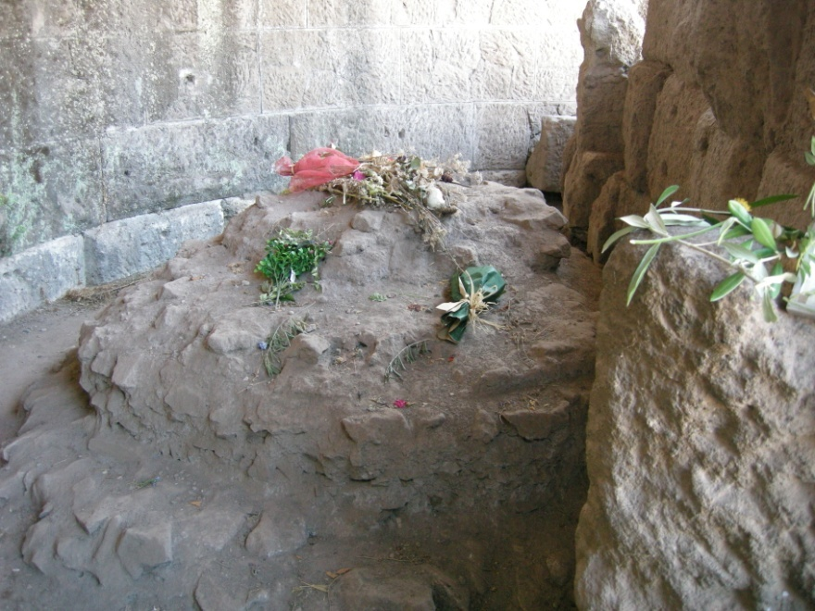
Temple of Divine Julius

Slide 14
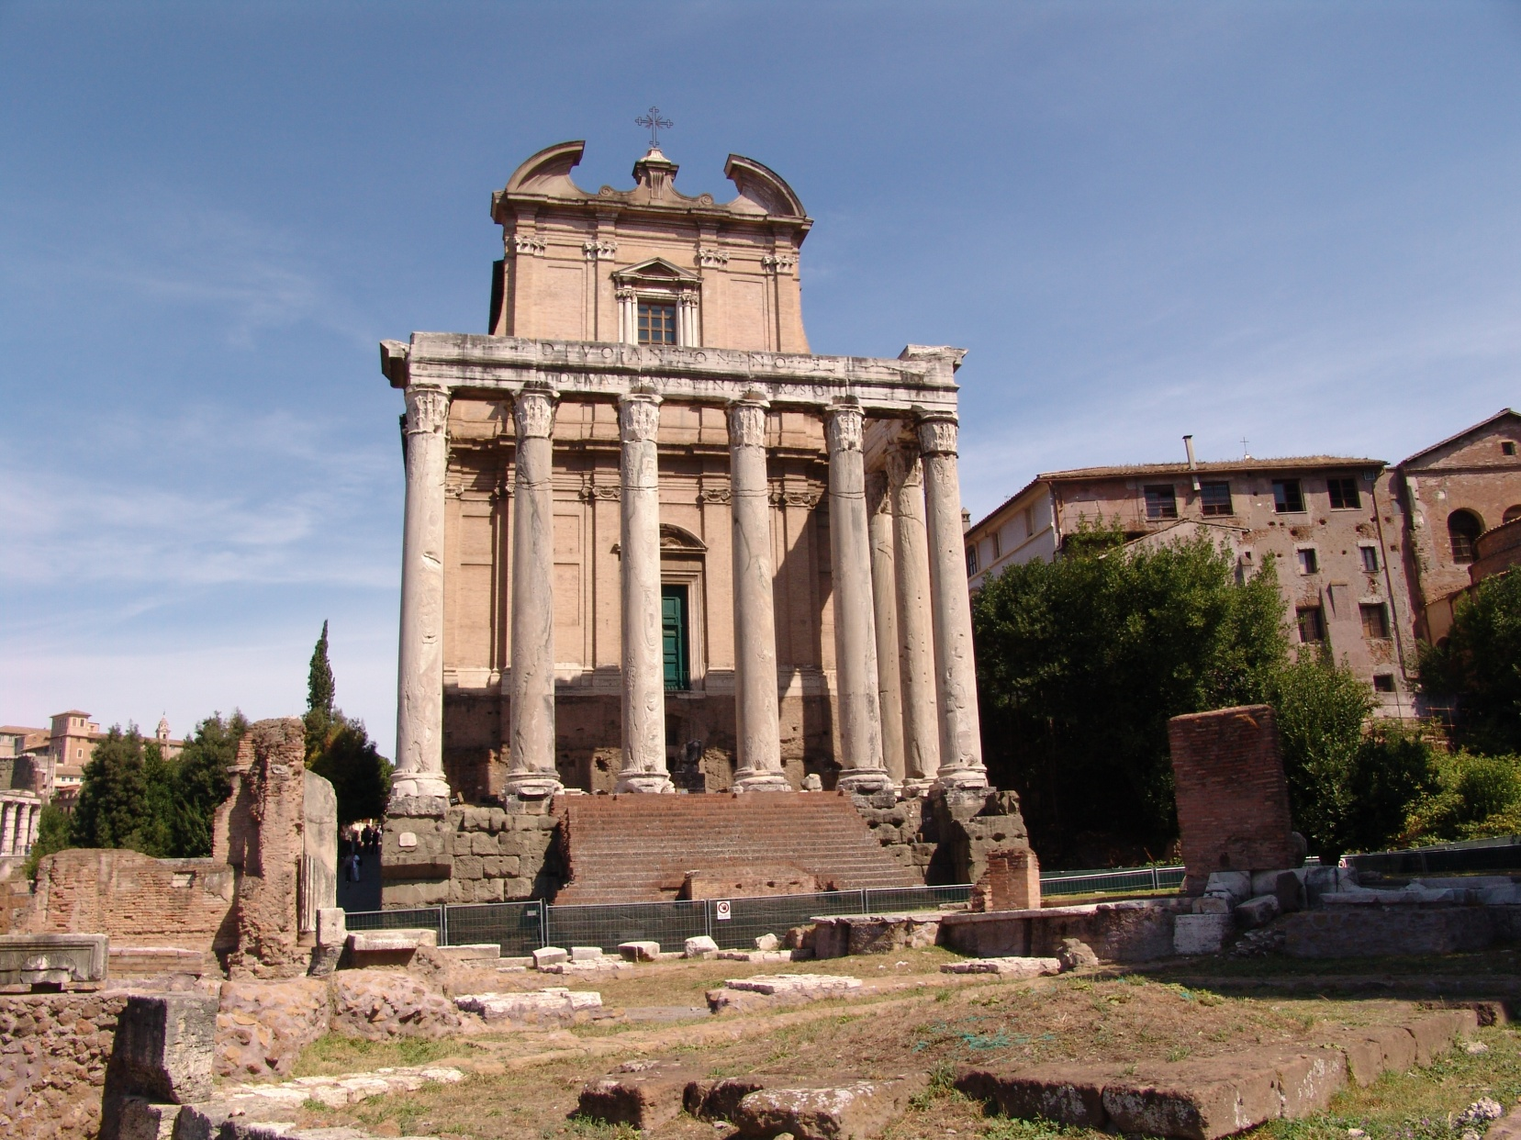
Imperial Cult
Temple of Antonins Pius
and Faustina
c. 141 A.D.

