Slide 1
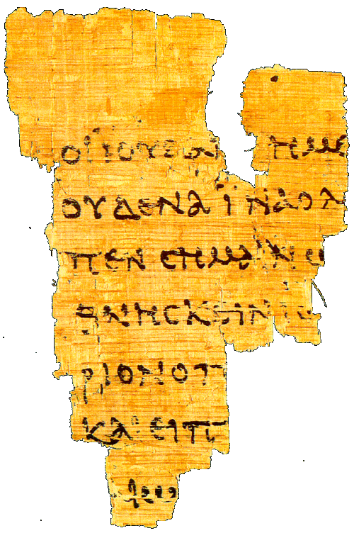
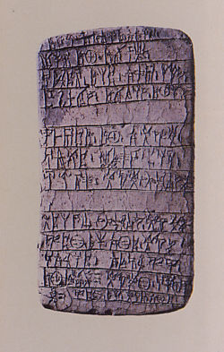
Language and Writing

Slide 2
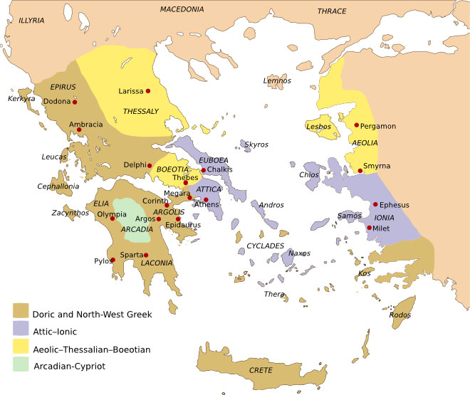
Koine

Slide 3
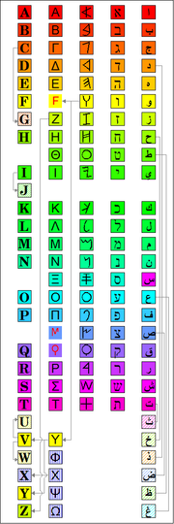
Greek Writing Systems
Cuneiform 3400 B.C.
Hieroglyphics 3000 B.C.
Linear A 2000-1200 B.C
Linear B c.1200-1000 B.C.
(Mycenaean Greek)
Phoenician c.1200 B.C.
(abjad)
Greek c.750 B.C.
Roman c.500 B.C.
Russian c.1000 A.D.

Slide 4
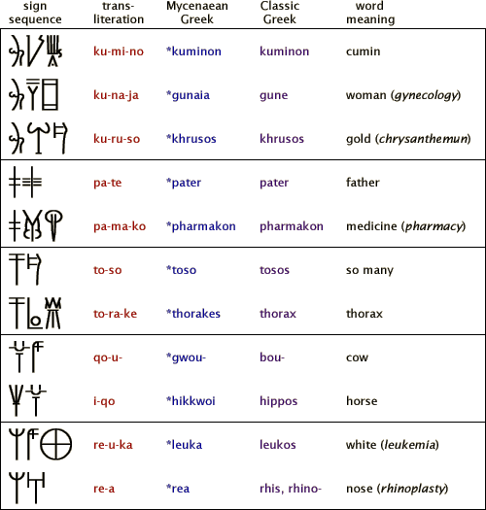
Linear B = Mycenaean Greek

Slide 5
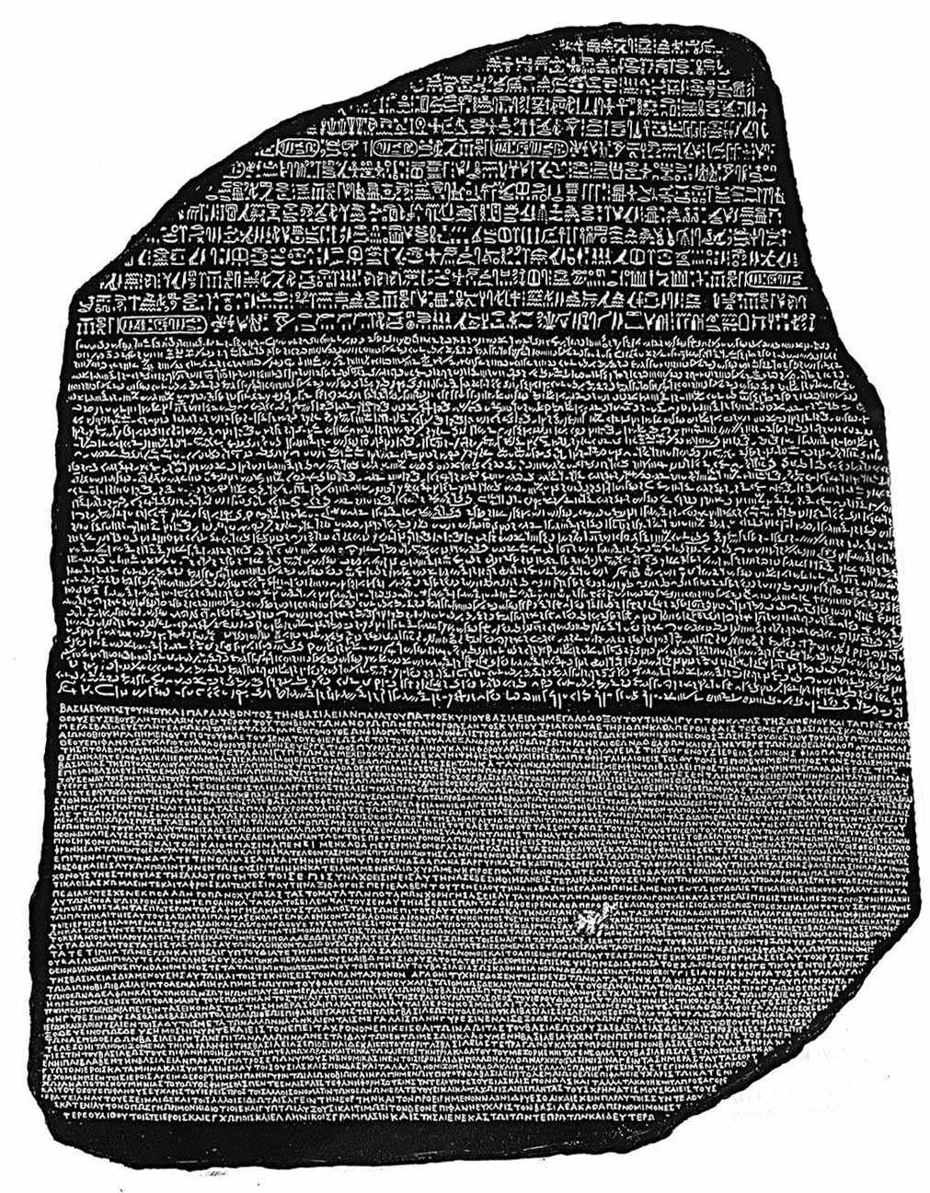
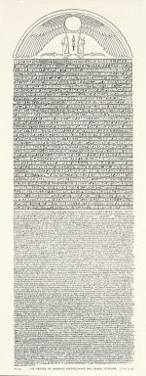
Canopus Stone
Decree of Ptolemy III
239 B.C,
Rosetta Stone
decree of Ptolemy V in 196 B.C.
discovered 1799
Deciphered by Young and Champollion 1822

Slide 6
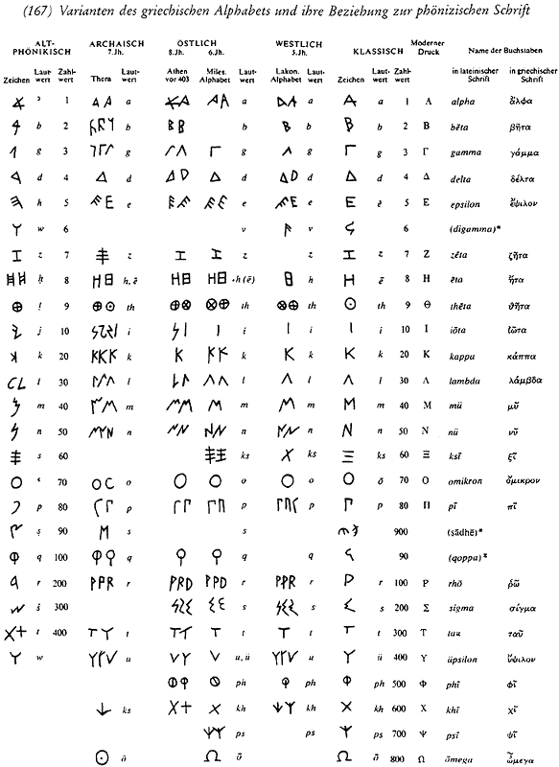
:
Left to Right: Old Phoenician,
Archaic, East Greek, West Greek,
Classical, Mdern

Slide 7
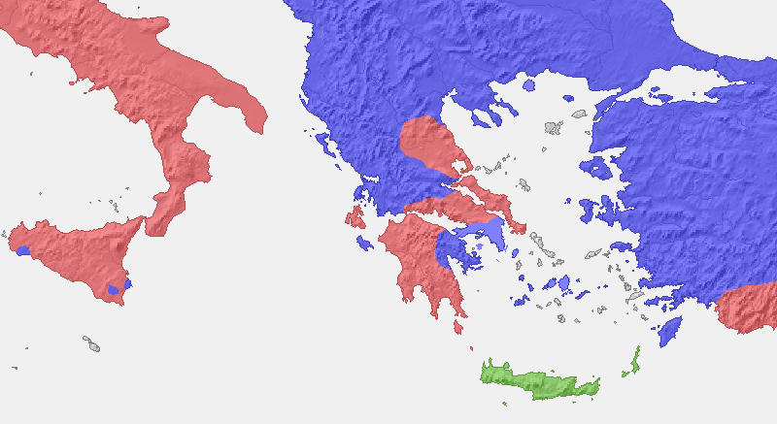
Local (epichoric) Alphabets
The red areas use Φ for [pʰ], Χ for [ks] and Ψ for [kʰ]
The blue areas have Φ for [pʰ] and Χ for [kʰ].
A dark blue subgroup (Corinth and Rhodos) also having Ψ for [ps].

Slide 8
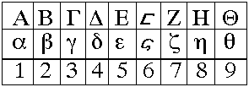
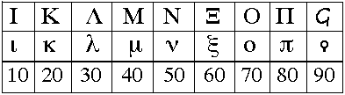

Greek Numbers
Aphabetic
Acrophonic

Slide 9
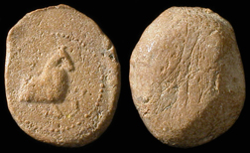
What did they write on?
Clay tablets (Linear B)
Wooden tablets
Papyrus
Parchment
Stone (inscription)
Pottery
Metal
Seals
Hellenistic Greece. 1st Century BC.
Forepart of a horse rt.

Slide 10
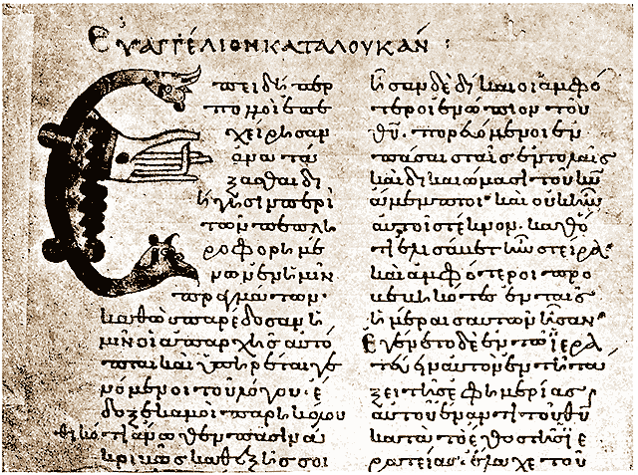
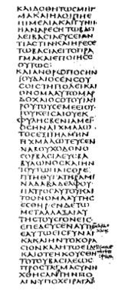
Codex Sinaiticus, written in the 4th century on parchment
Magiscule
Uncial
The manuscript here reproduced was written in the year 1022, and is now in the Ambrosian Library at Milan.
It contains the Gospels only, and its official designation in the list of New Testament MSS. is Evan.348.
Miniscule
Cursive

Slide 11
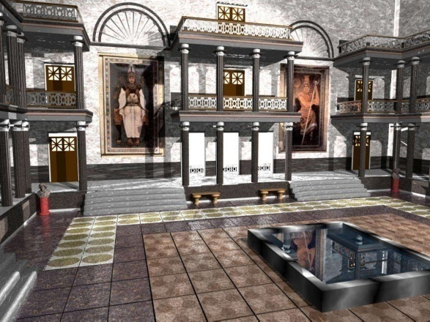
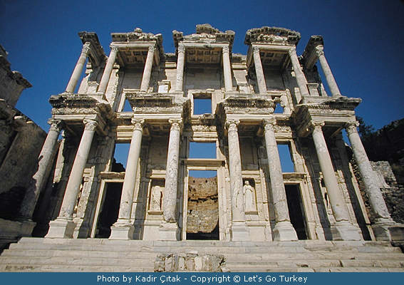
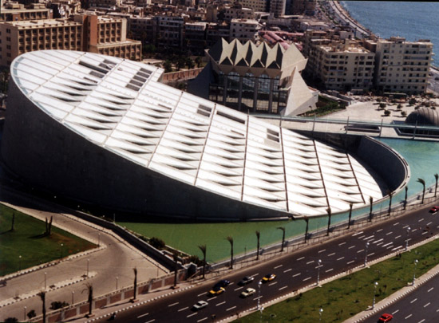
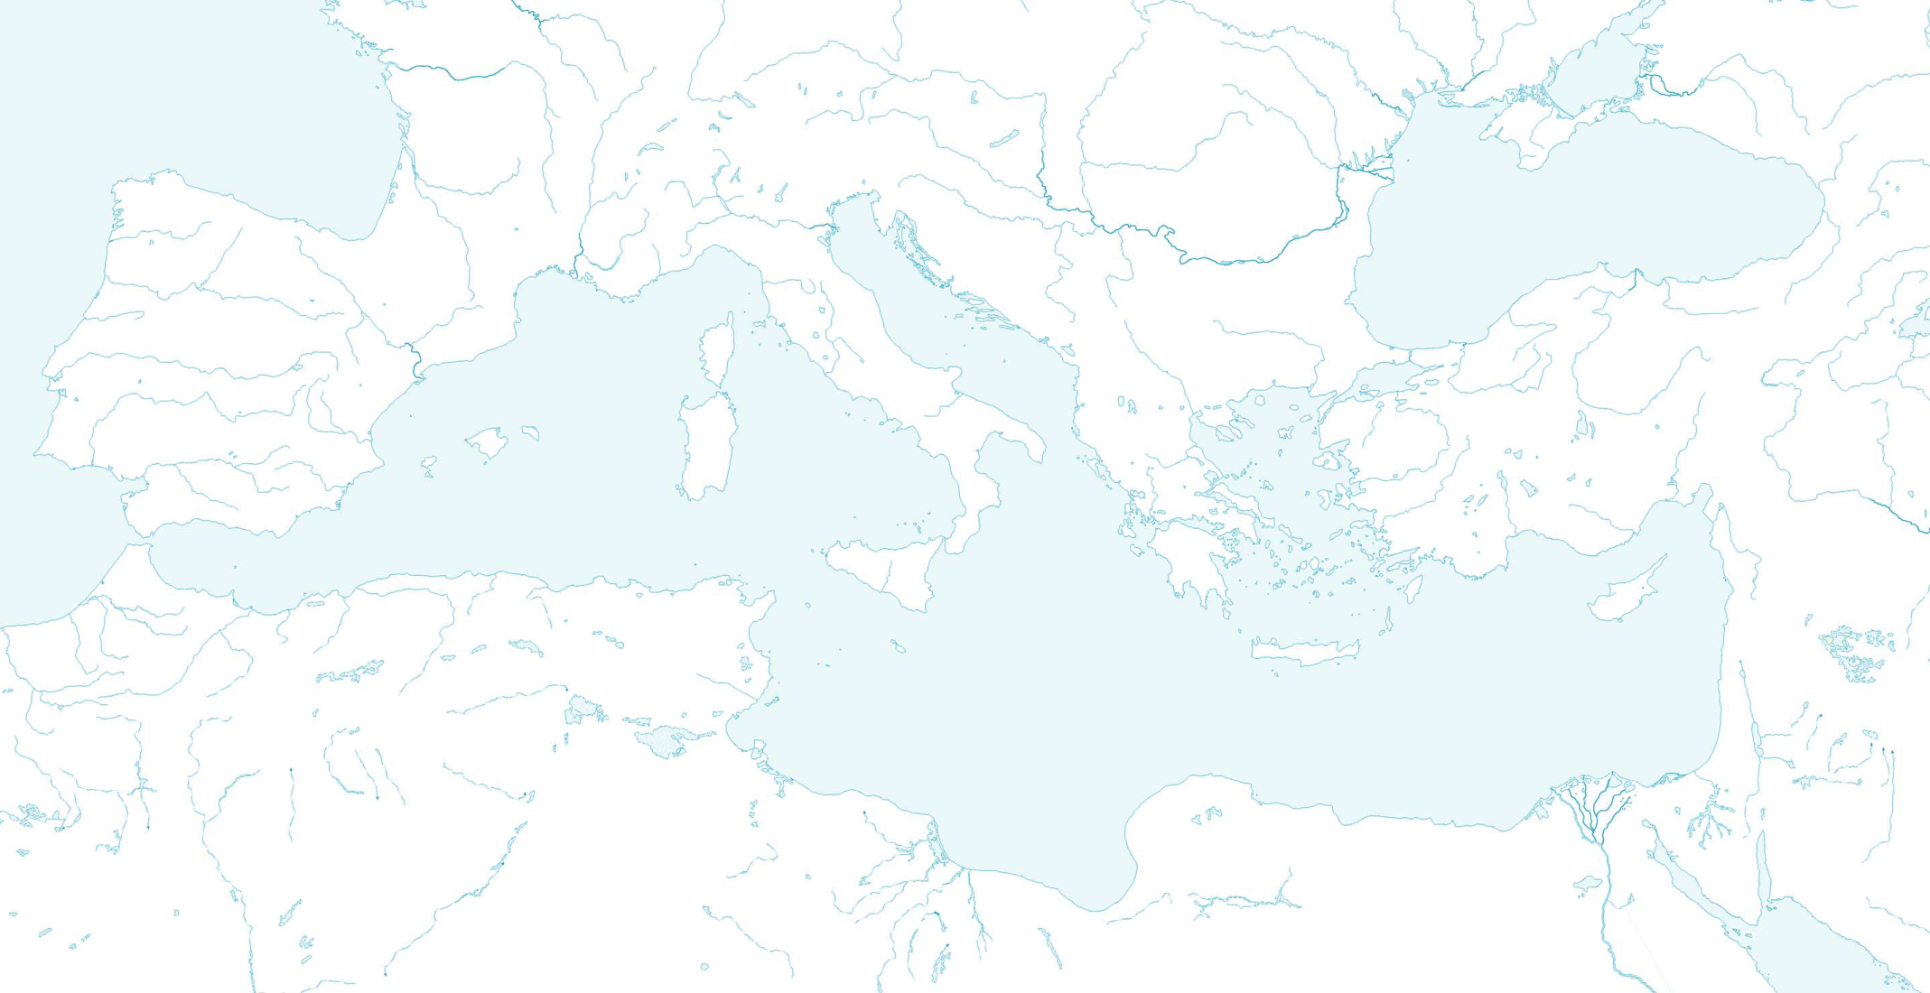
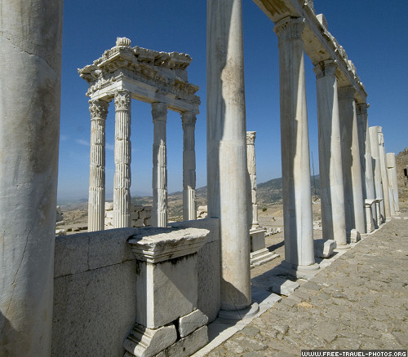
Libraries
PERGAMON
ATHENS
ALEXANDRIA
EPHESUS

Slide 12
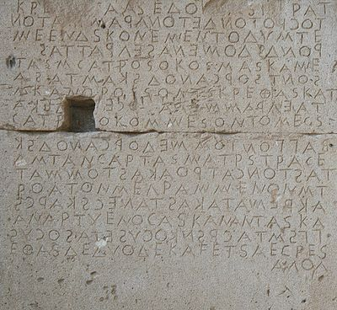
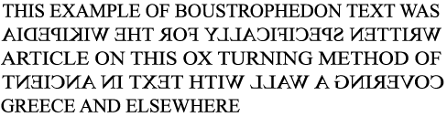
Boustrophedon
Gortyn Law code
5th cent.

Slide 13
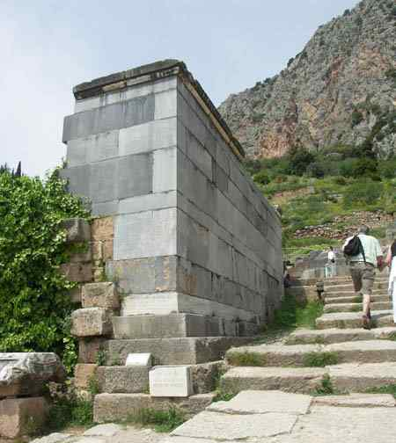
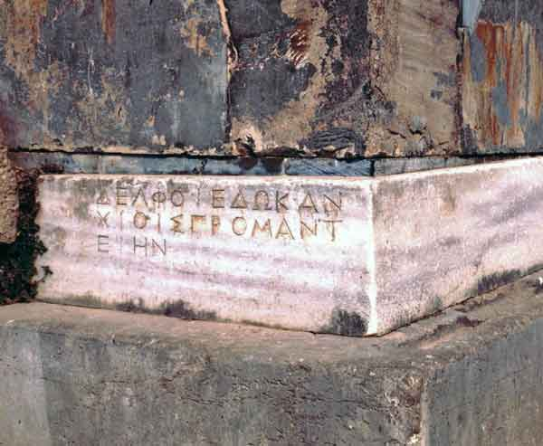
Stoikehedon
Delfoi Edokan Chiois Propmaneiin

Slide 14
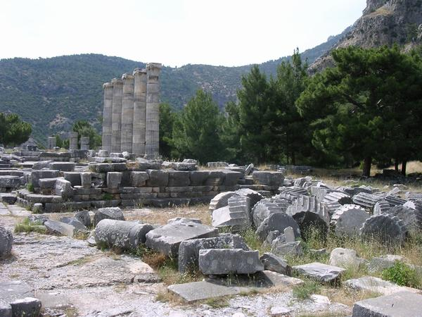
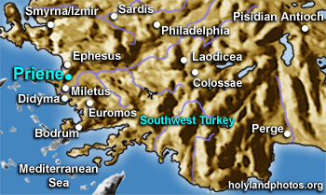
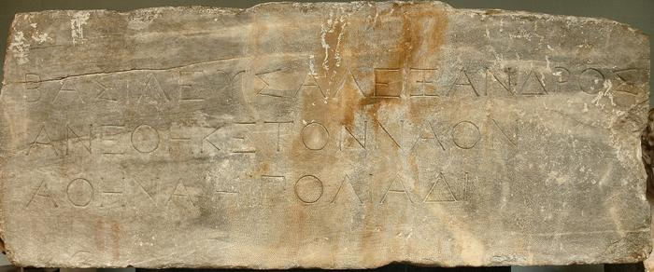
Dedicatory Inscription
Alexander to Athena 334 B.C. (Priene)

Slide 15
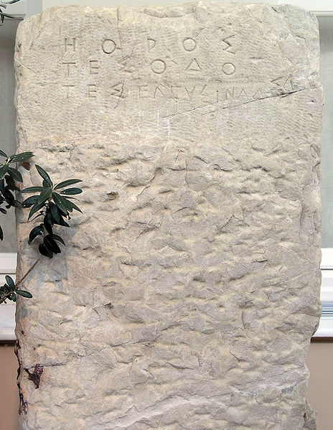
Boundary Stone
From the Sacred Way
leading from Athens to Eleusis
c.520 B.C.
“Boundary of the Road of Eleusis”

Slide 16
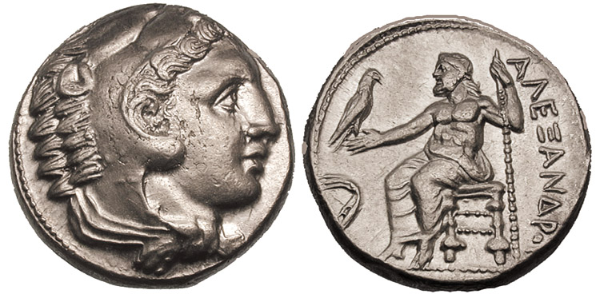
Coins

Slide 17
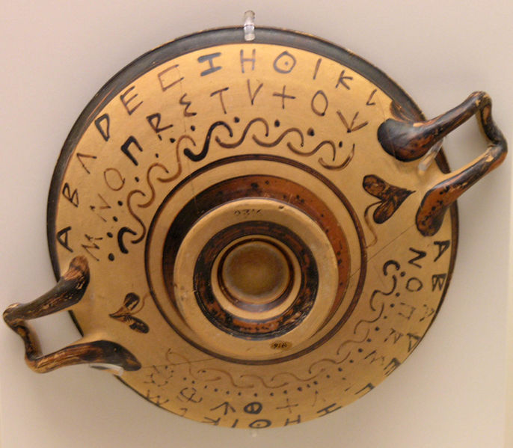
Black-figure kylix
National Archaeological Museum, Athens

Slide 18
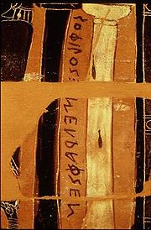
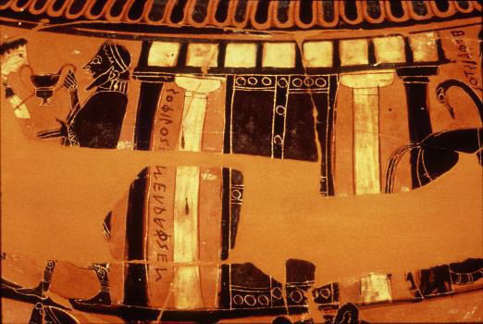
Sophilos megraphsen
590-580 B.C.

Slide 19
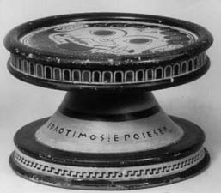
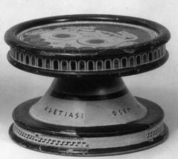
Kleitias egraphsen
Ergotimos epoiesen

Slide 20
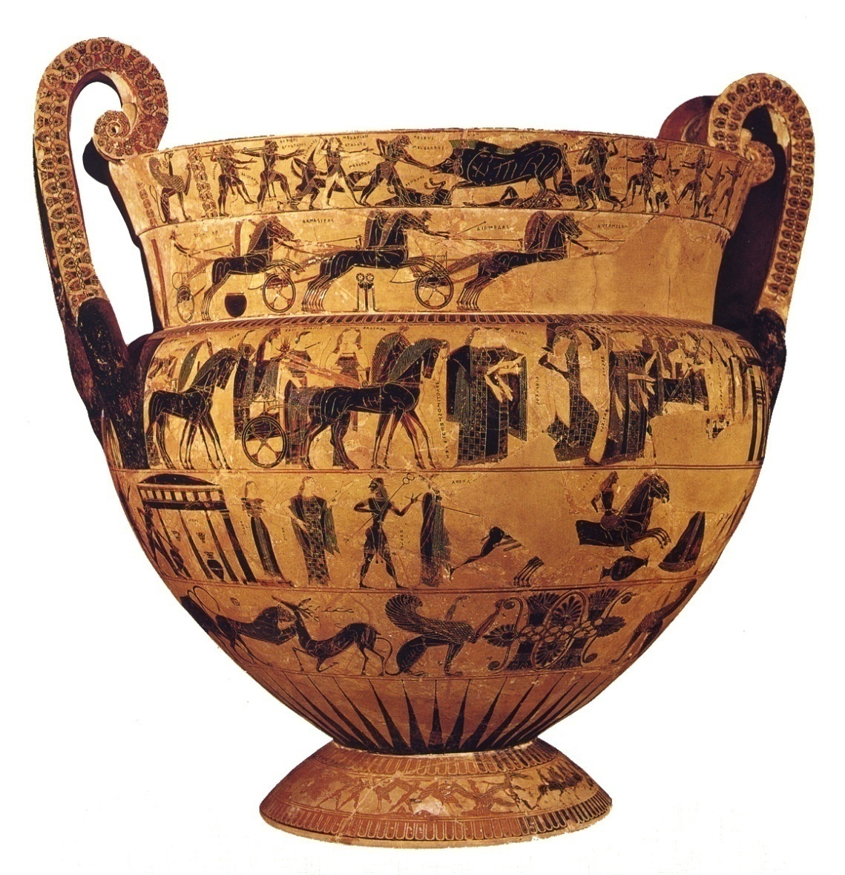
Francois Vase
volute krater
570BC.
Made by Ergotimos
Painted by Kleitias

Slide 21
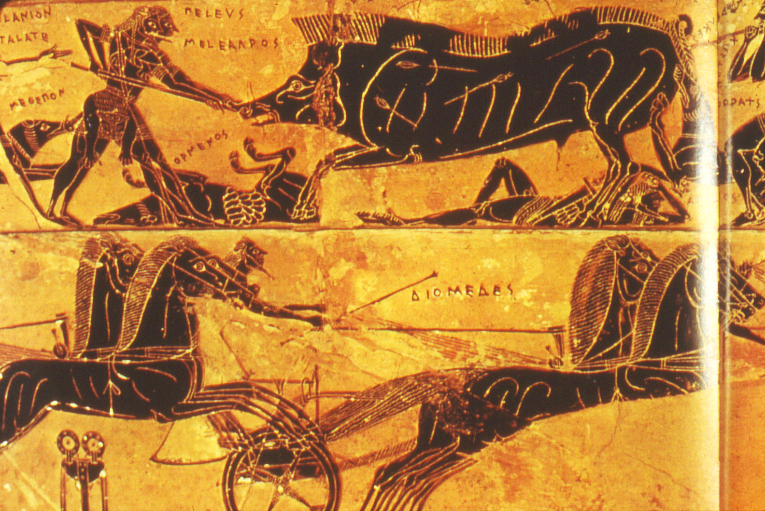

Slide 22
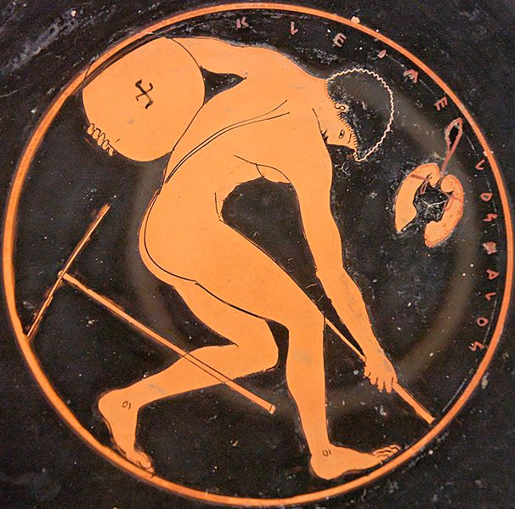
Kalos Inscriptions
KLEOMElOS KALOS

Slide 23
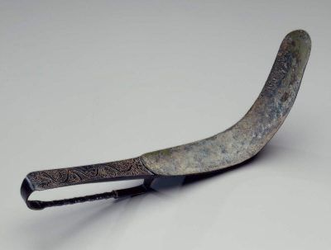
Strigil
Of (or by) Apollodorus

