Slide 1
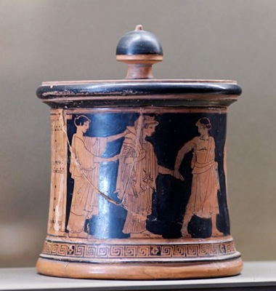
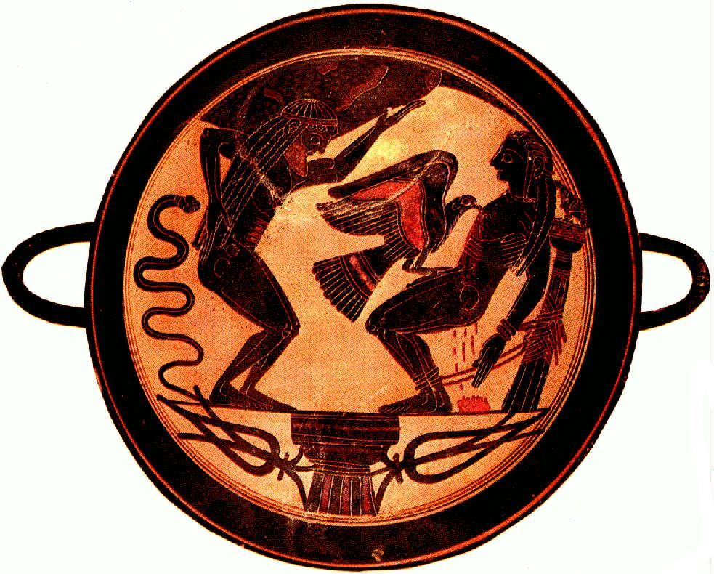
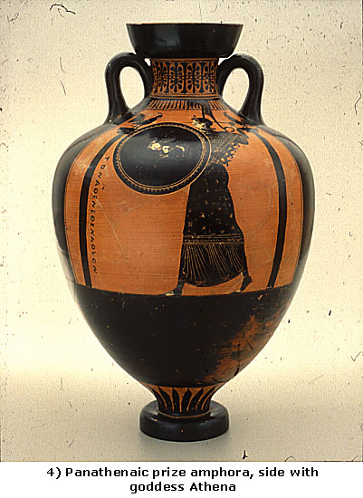
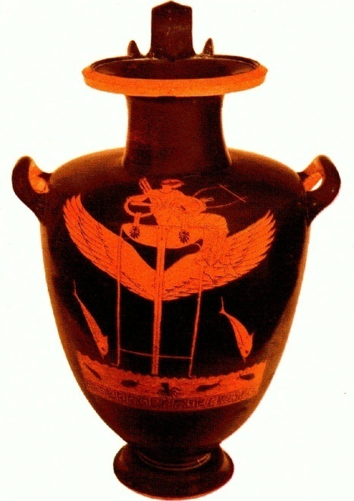
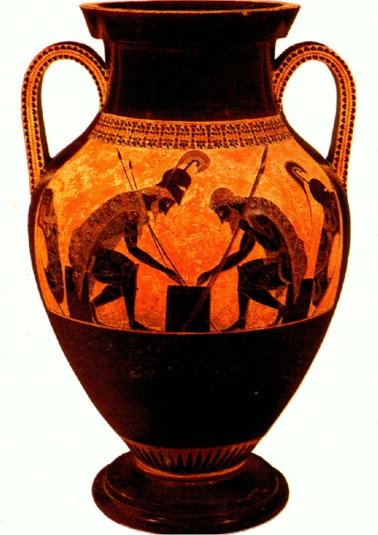
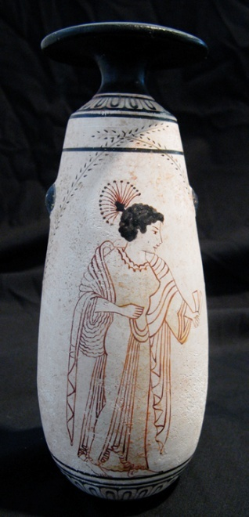
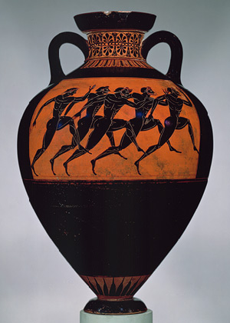
Greek Pottery
Greek Vases / Pottery Types Periods

Slide 2
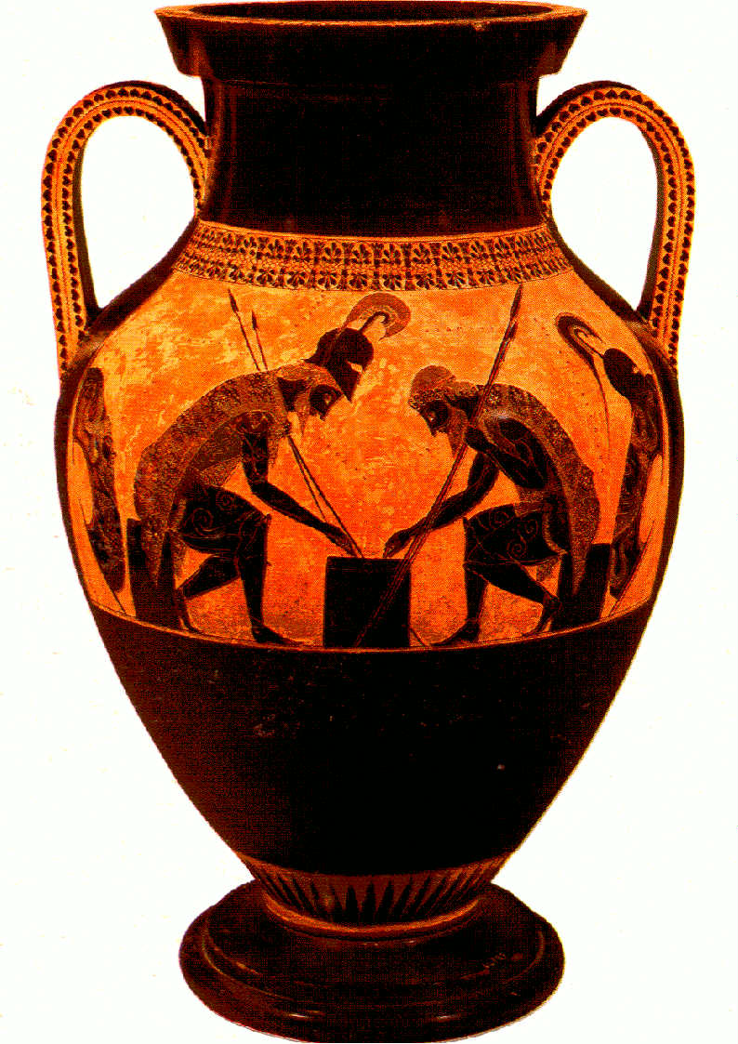
Amphora of Exekias Vatican Museum This amphora came to Etruria from the Athenian workshop of Exekias, the greatest potter working around 530 B.C. Depicted on the principal side of this amphora, are Achilles and Ajax (201K) who, having cast aside their arms, play "morra".

Slide 3
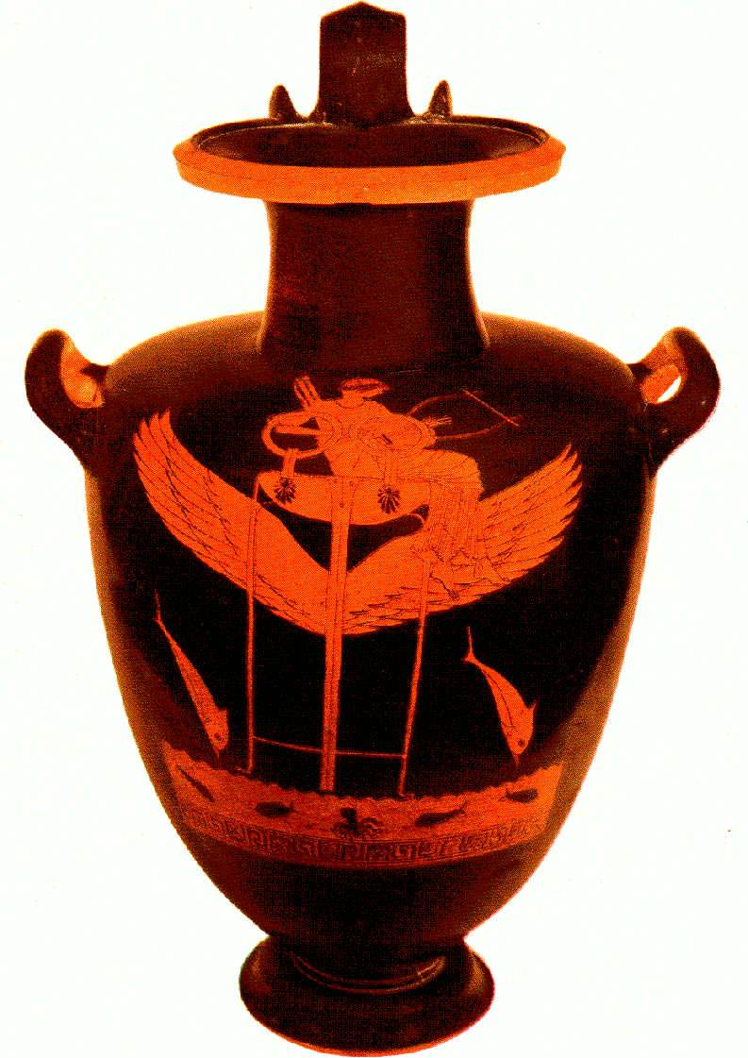
Red-figured hydria (Vatican Museum) This Attic vase was painted by the “Berlin Painter" (who got his name after an amphora in Berlin that ranks among his major works), circa 490 B.C. ; its height is 58 cm. The god Apollo is seated on a winged tripod (266K), riding over the sea (hyperpontios), which is denoted by fish and an octopus. Two dolphins (187K) leaping over the waves accompany him. Apollo plays the lyre.

Slide 4
Black-figured Laconian kylix, circa 555 B.C. is attributed to the Arkesilas Painter; its diameter is 20 cm. Vatican Museum Atlas (272K) is at the left holding up the sky, while an eagle picks at the chest of Prometheus (293K) who is tied to a column, at the right; a small bird is perched on the column. Below the main picture, there is a Doric column (324K) and two flowers. The groundline, supported by the column in the exergue, must represent the disk of the earth (in cross section).

Slide 5
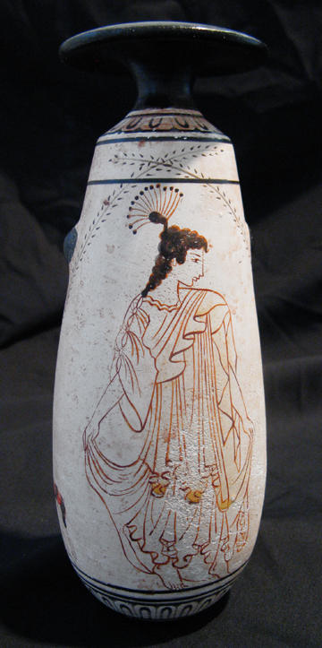
Woman/Maiden Alabastron Transitional Greek (White-Ground Pottery) date of the original: c. 480 B.C. provenance of the original: now in the National Archaeological Museum, Athens
description: White ground, black figure alabastron (perfume bottle). Short neck, flat brim, cylindrical and pear shaped. Shows two women, one standing, one seated. Black neck with narrow geometric pattern, repeated on base. Height 17.5 cm, diameter 6.5 cm.

Slide 6
Attic red-figure pyxis, c. 470-460 B.C. From Athens, at the Louvre.
Pyxis is a lidded vessel for women's cosmetics or jewelry. Wedding of Thetis and Peleus, by the Wedding Painter.

Slide 7
Greek Pottery
Greek Vases / Pottery Types / Periods

