Slide 1
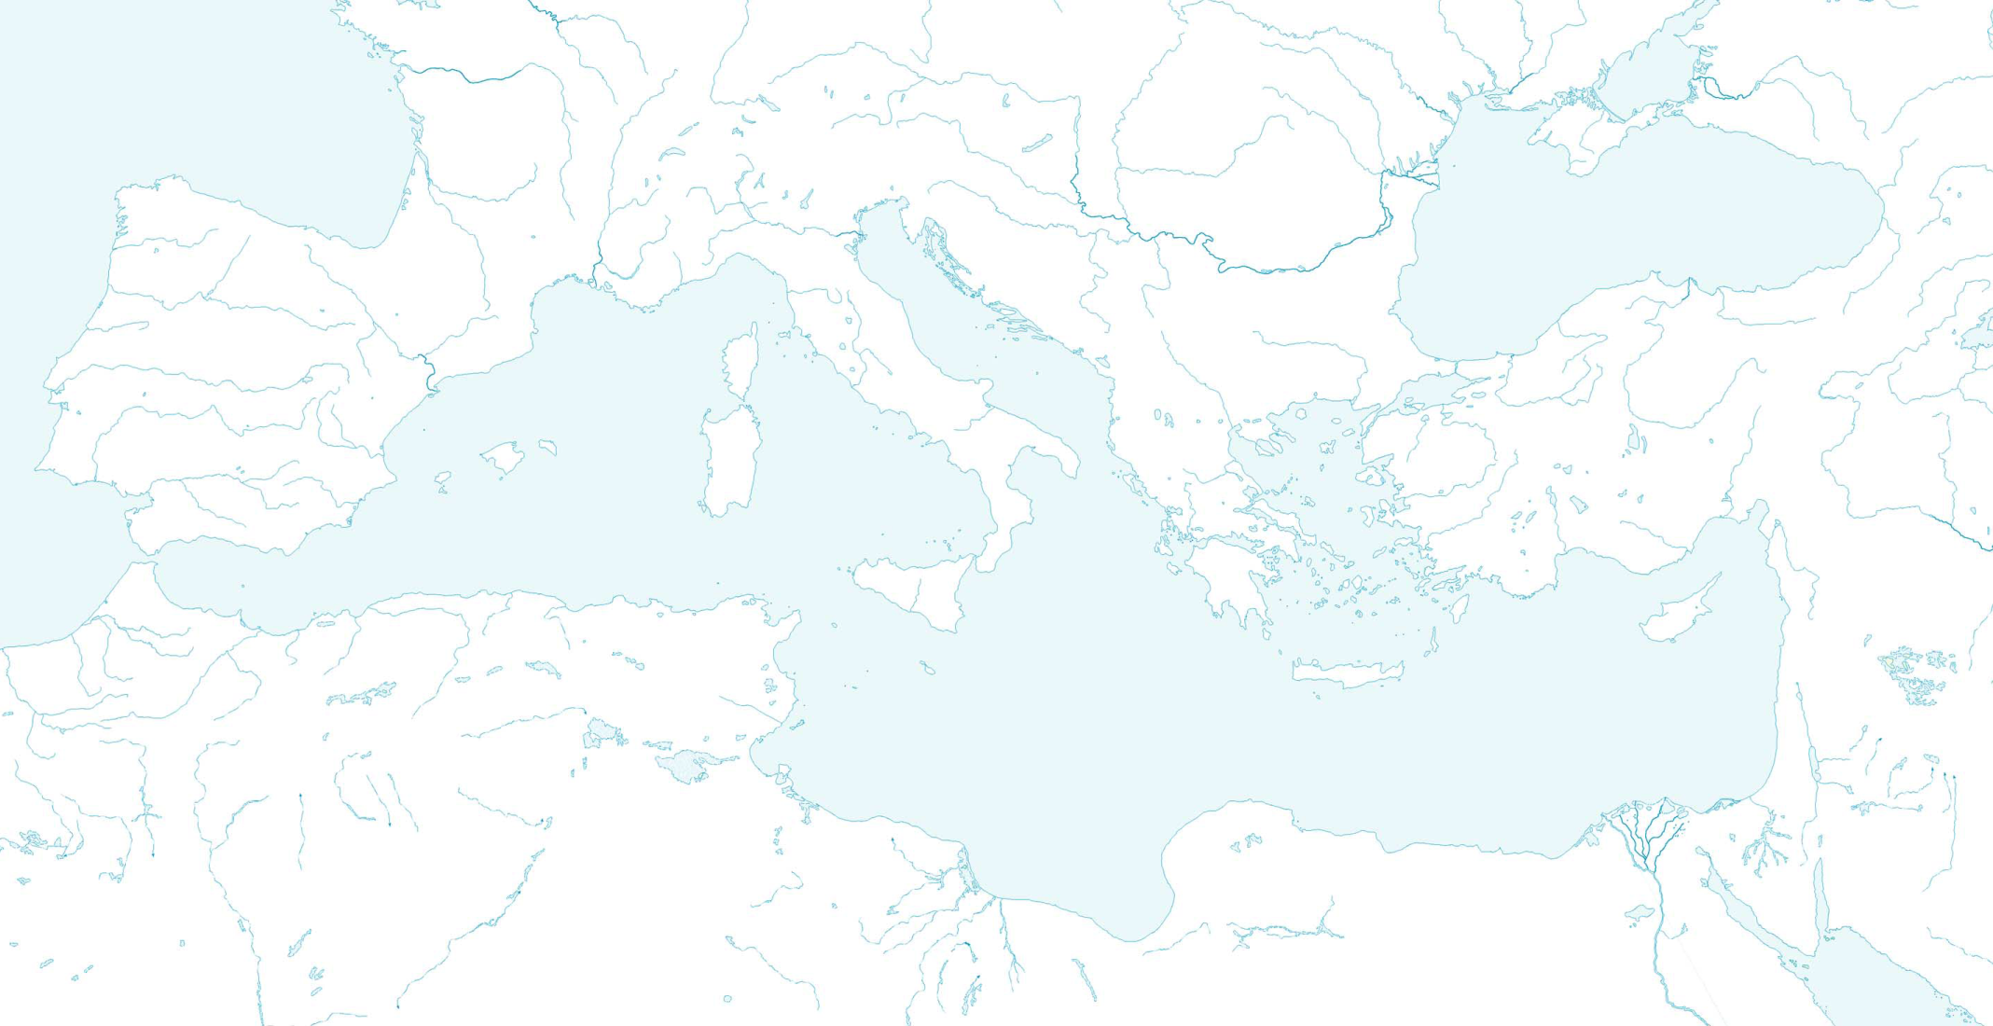
Overview of the Geography of Greece
in an historical context

Slide 2
GREEK CIVILIZATION: GENERAL CHRONOLOGY
2800-1100 B.C. THE BRONZE AGE
1100-700 B.C. THE DARK AGES
700-500 B.C. THE ARCHAIC PERIOD
500-300 B.C. THE CLASSICAL AGE
338-31 B.C. THE HELLENISTIC PERIOD
31 B.C.- A.D. 565 THE ROMAN PERIOD
565-1453 THE BYZANTINE PERIOD
1453-1829 THE TURKISH OCCUPATION
1829-present MODERN GREECE

Slide 3
Bronze Age (2800-1100 B.C.)
MYCENAE
TROY
CYCLADES
THERA
CRETE
KNOSSOS

Slide 4
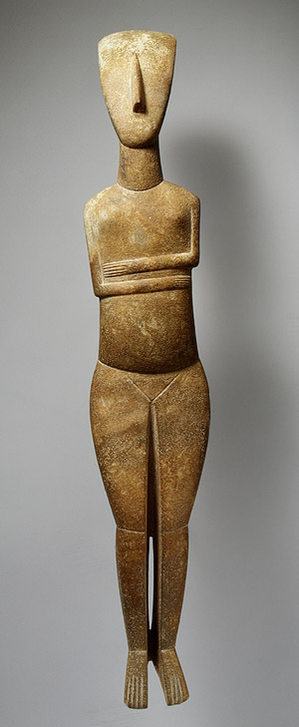
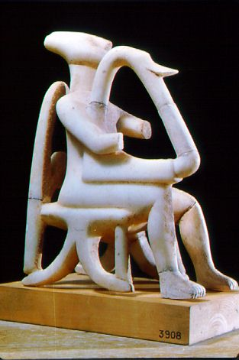
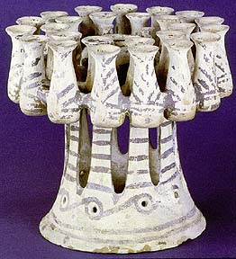
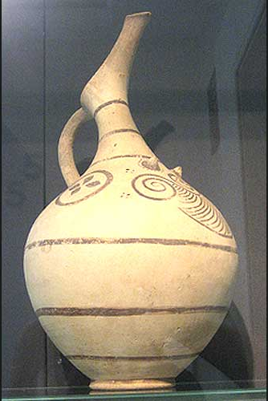
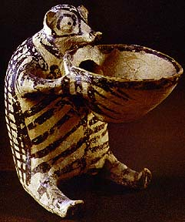
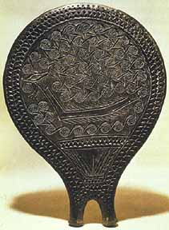
Cyclades (3000-2000 B.C.)
KERNOS
CYCLADES
AMORGOS DELOS PAROS
NAXOS THERA
“FRYING PAN”

Slide 5
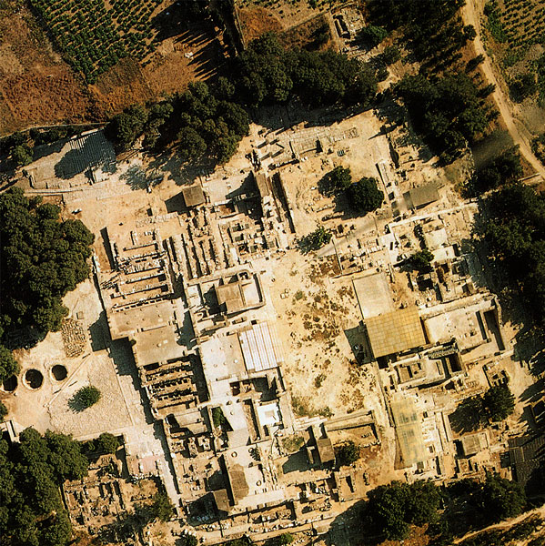
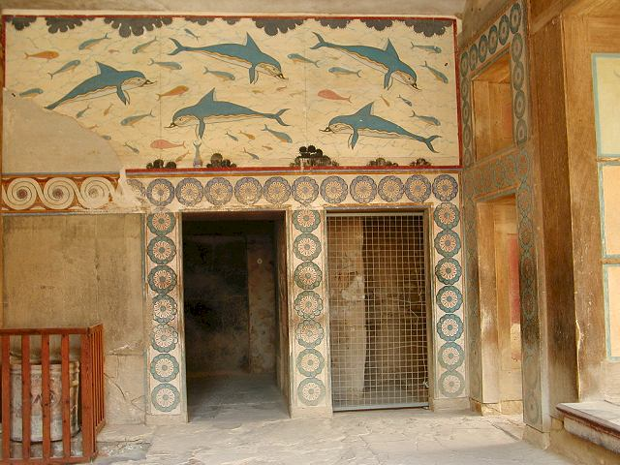
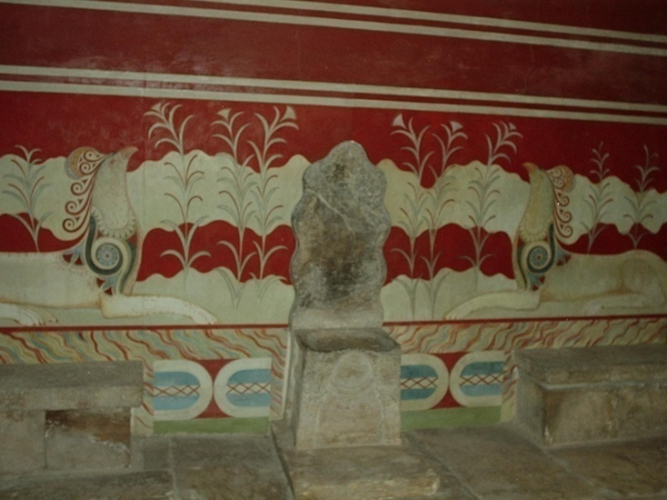
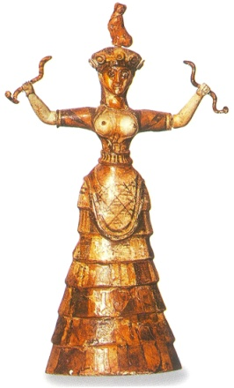
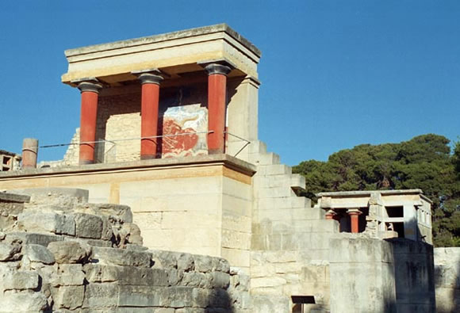
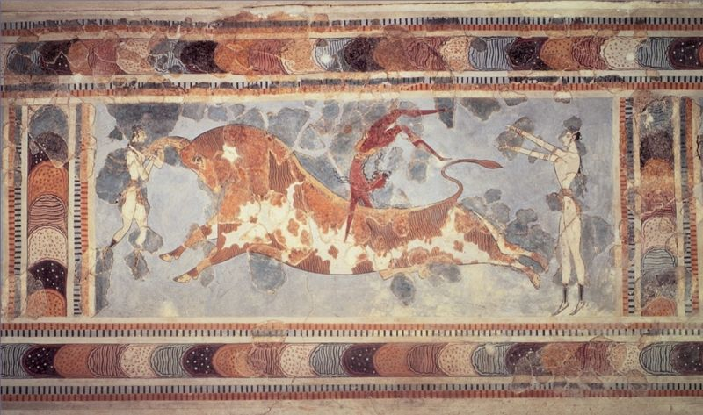
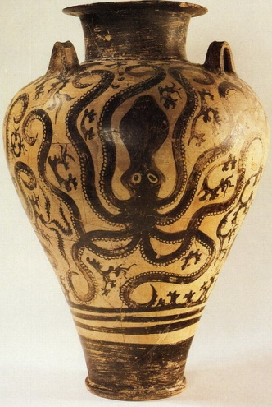
Minoan (2000-1100 B.C.)
CRETE
KNOSSOS

Slide 6
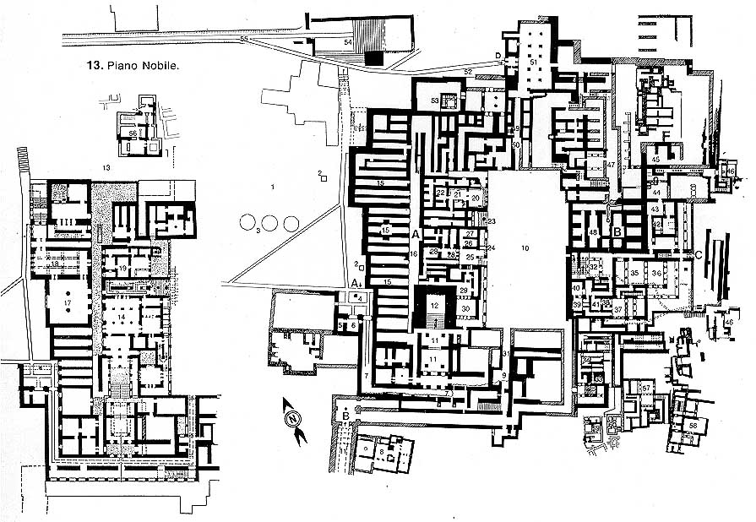
KNOSSOS

Slide 7
Minoan (2000-1100 B.C.)
CRETE
KNOSSOS

Slide 8
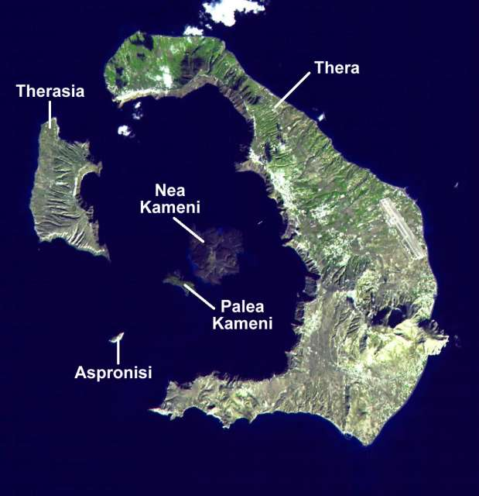
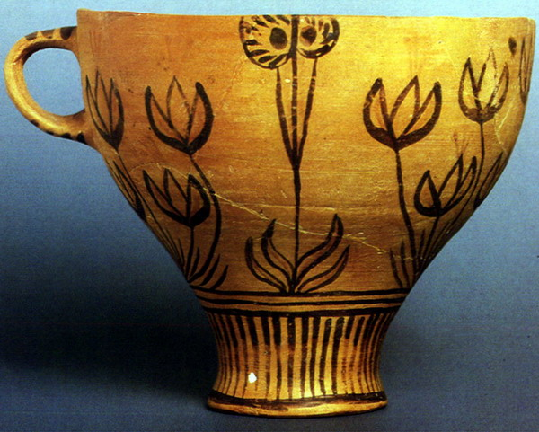
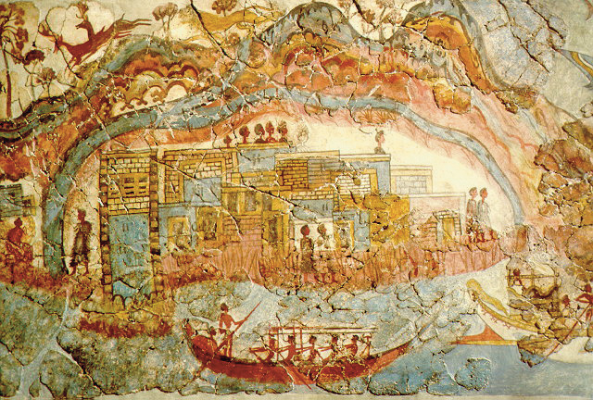
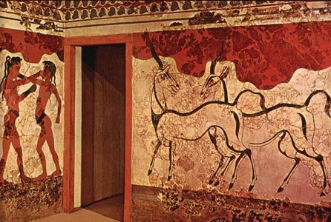
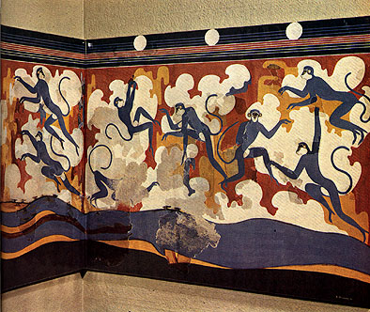
Thera (eruption: c.1500 B.C.)
MINYAN
THERA

Slide 9
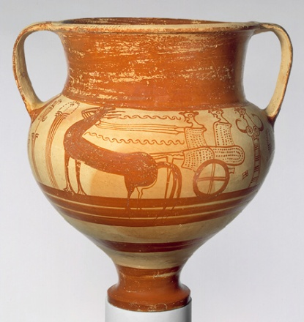
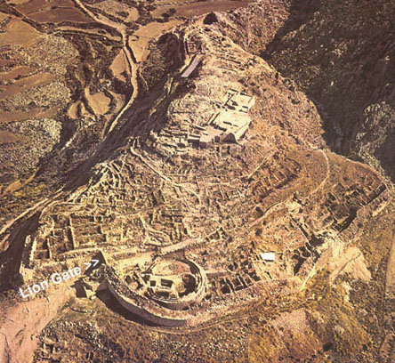
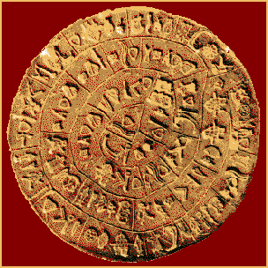
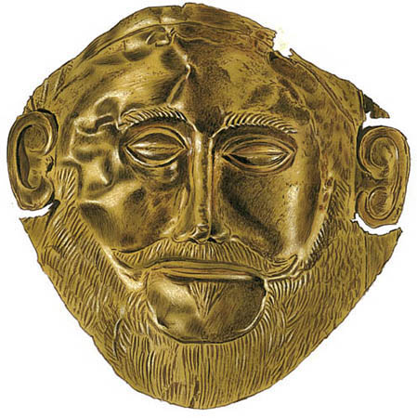
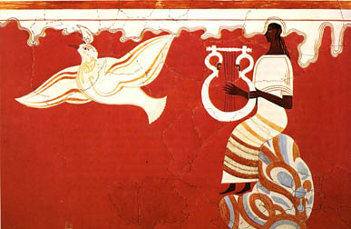
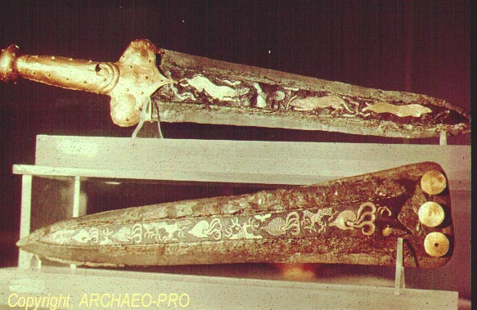
Mycenaean (1300-1100 B.C.)
MYCENAE PYLOS TIRYNS
MYCENAE

Slide 10
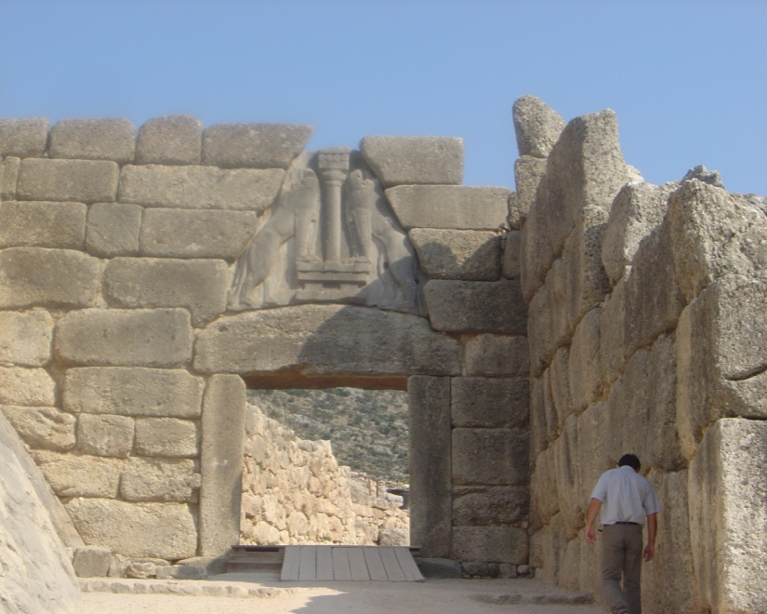
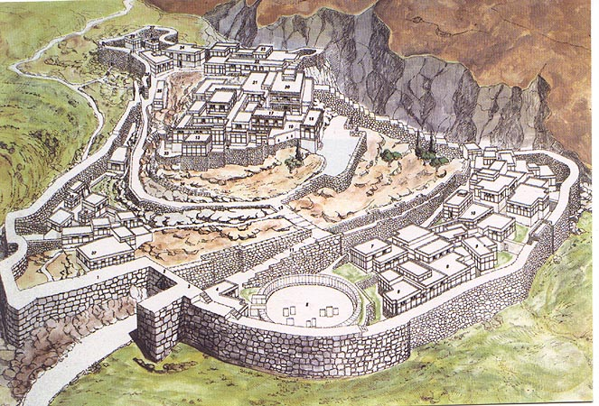
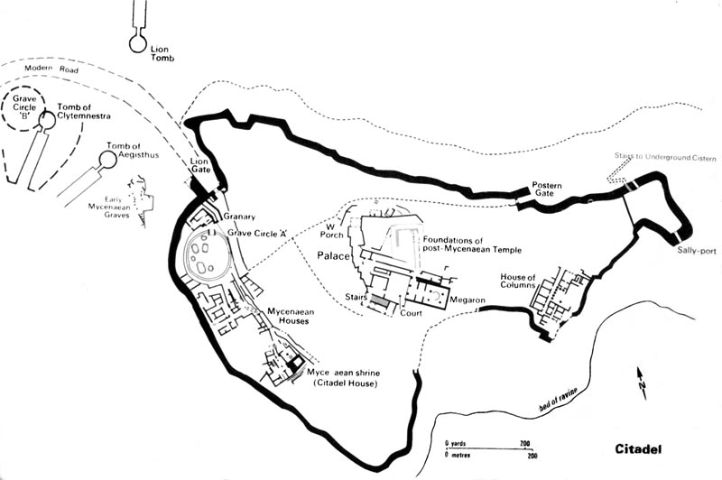
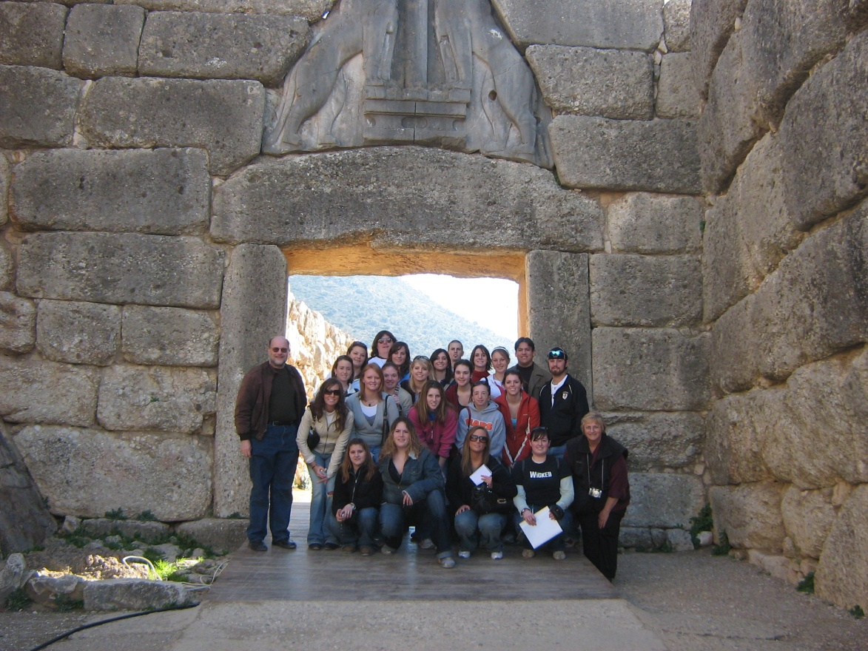
Mycenae

Slide 11
Mycenaean (1300-1100 B.C.)
MYCENAE PYLOS TIRYNS
MYCENAE

Slide 12
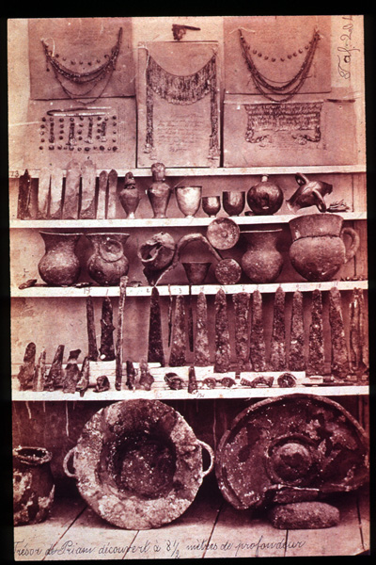
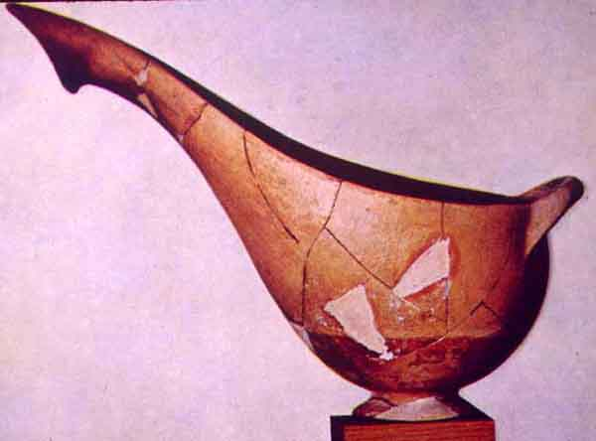
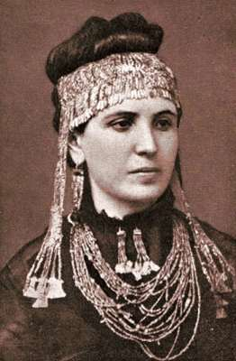
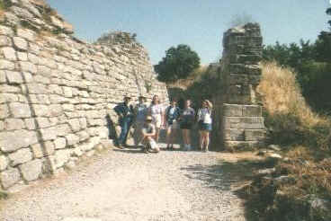
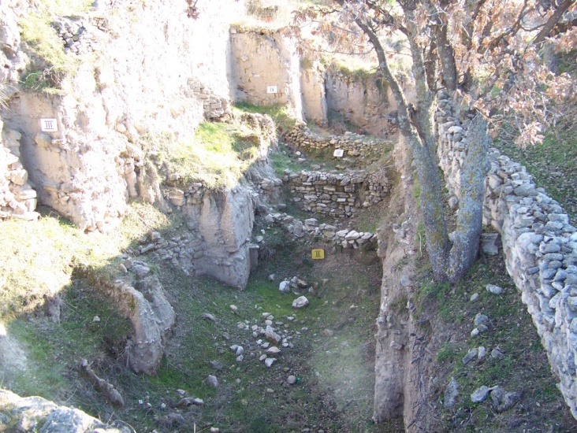
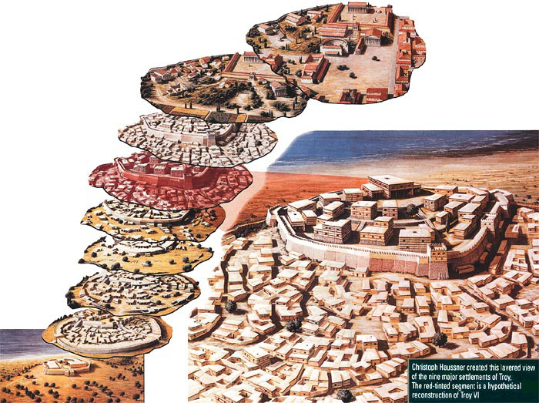
Troy (1184 B.C.)
TROY

Slide 13
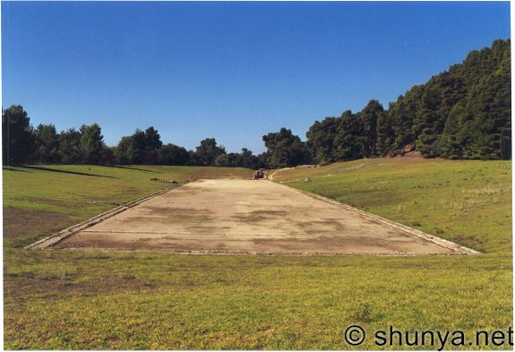
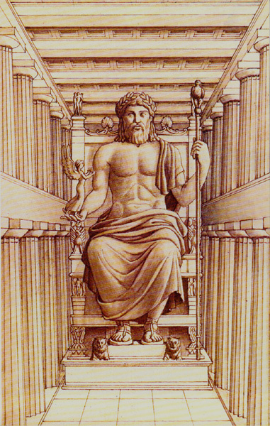
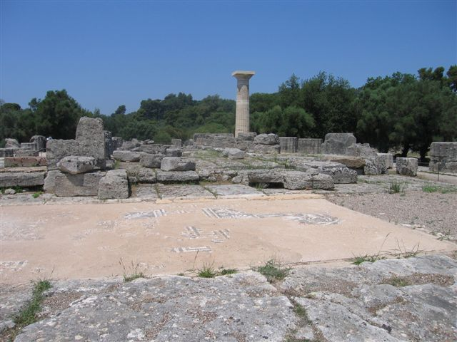
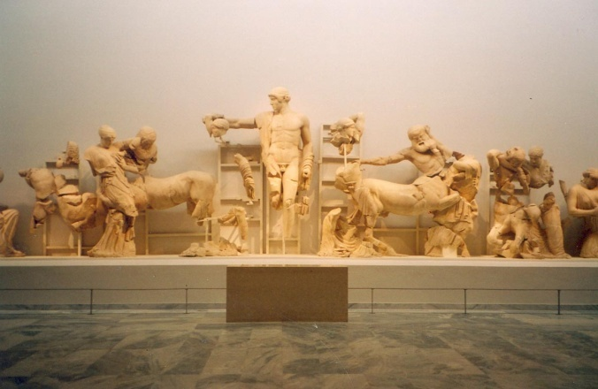
Dark Age (1100-700 B.C.)
OLYMPIA

Slide 14
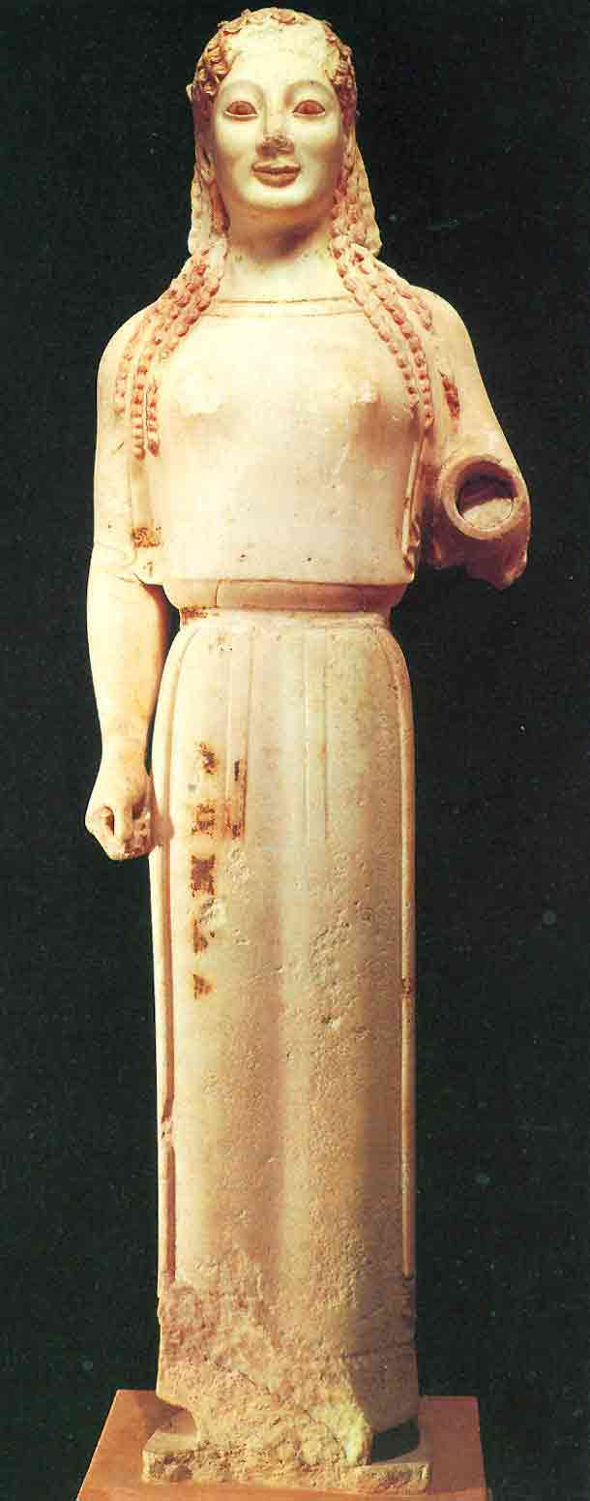
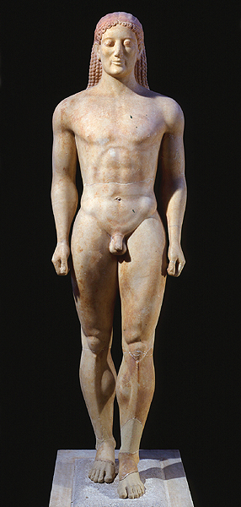
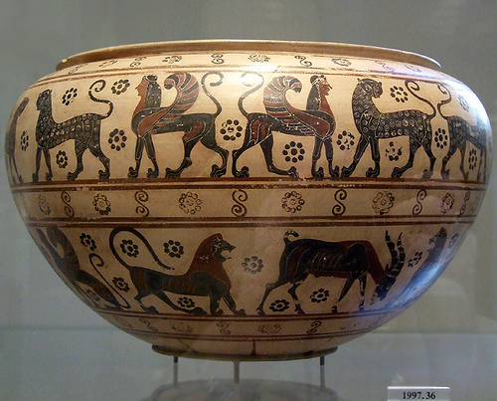
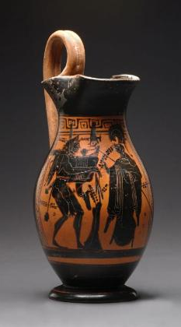
Archaic Period (700-500 B.C.) Age of Colonization
CORINTH
LESBOS
ATHENS
SPARTA
PELOPONESSUS

Slide 15
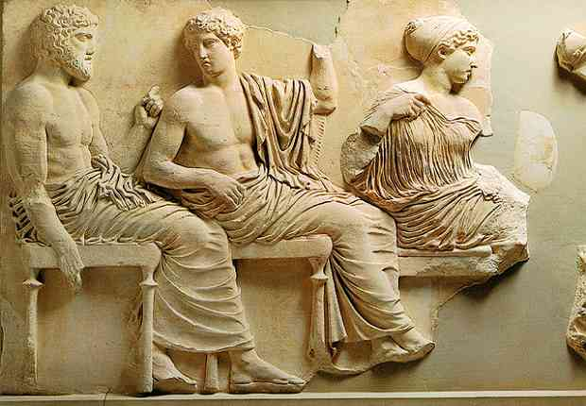
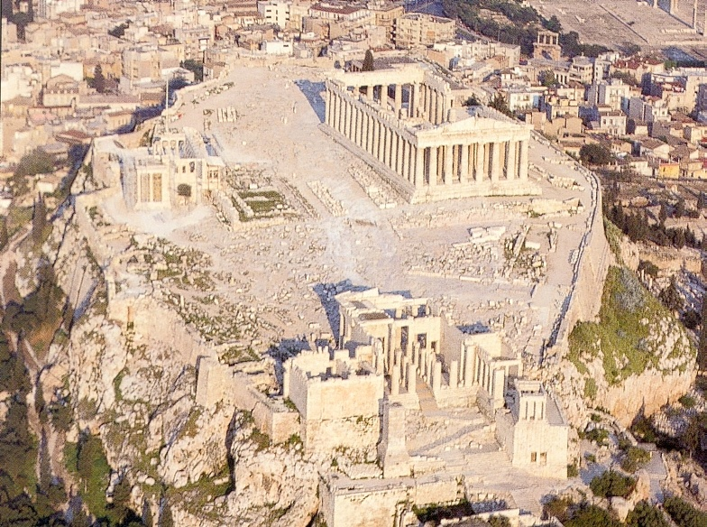
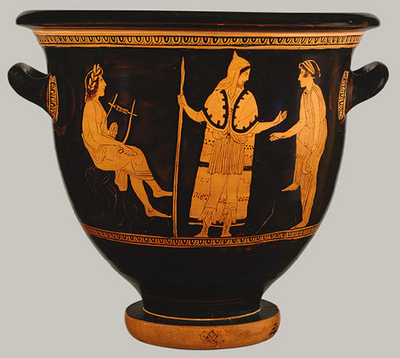
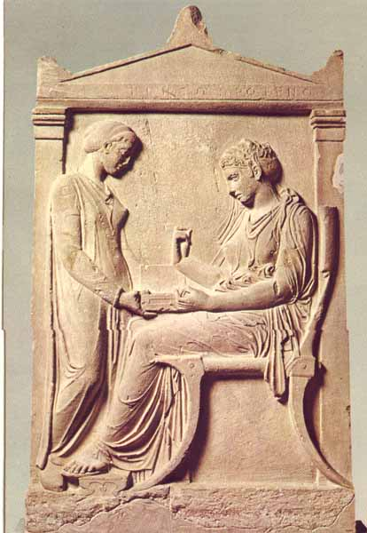
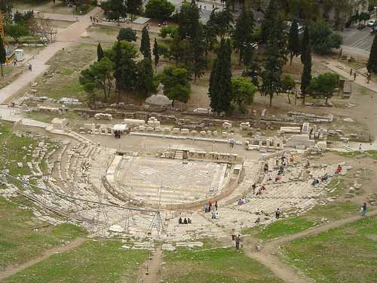
Classical Age (500-300 B.C.)
ATHENS
PERSIA

Slide 16
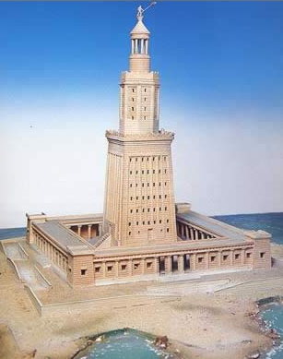
Hellenistic Age (300-31 B.C.)
PERGAMON
MACEDONIA
CYRENE
ALEXANDRIA
ANTIOCH

Slide 17
Roman Period (31 B.C.- A.D. 565)
BYZANTIUM = CONSTANTINOPLE
EPHESUS

